Slide 1
Which Is a Witch
If you go to the PBS website (Google: Secrets of the Dead Salem Witch Trials) and the interactive map will not work, installing an updated Flash Player on your computer will probably fix it. However, if you don’t want to do that, you can get most of the information in this PowerPoint. I have simply gone through the timeline and clicked on most of the names so that information would show up. Then I screen shot the images and pasted them into this PowerPoint. The interactive map is still a better option because it gives you more freedom to browse the information and to control the display of information, but this PowerPoint will at least provide the bulk of the information.

Slide 2
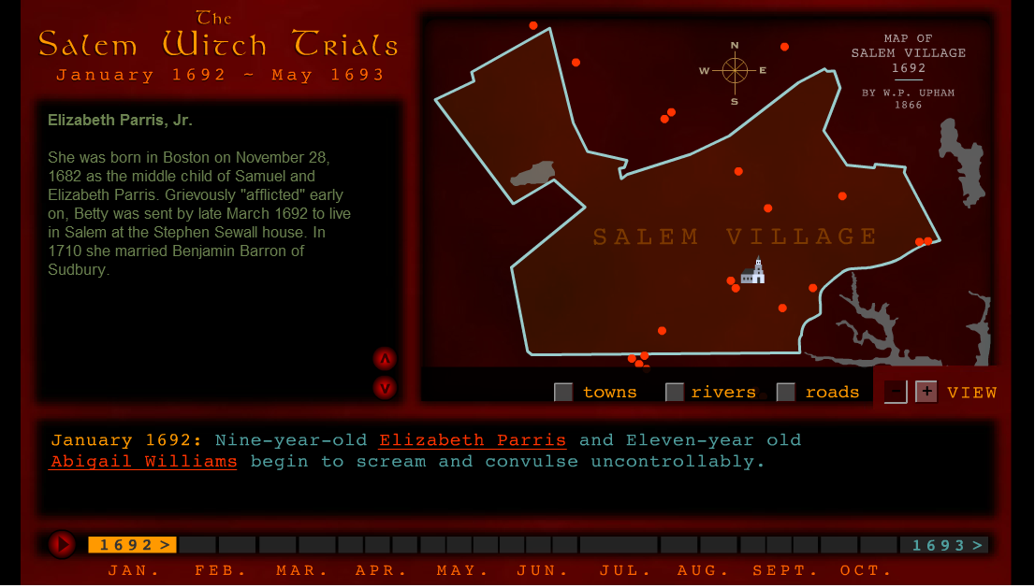
Elizabeth Parris, Jr (Betty)

Slide 3
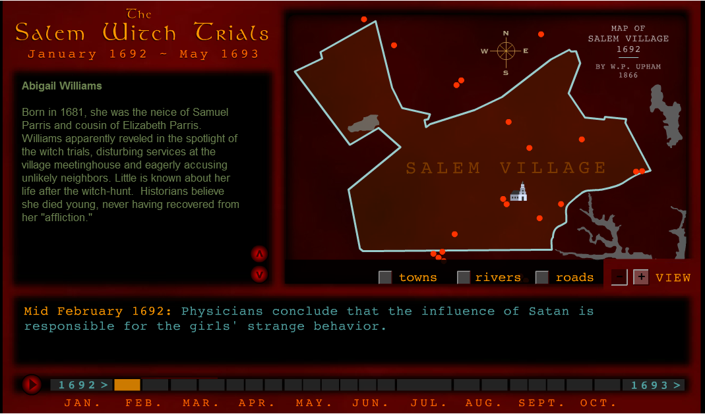
Abigail Williams

Slide 4
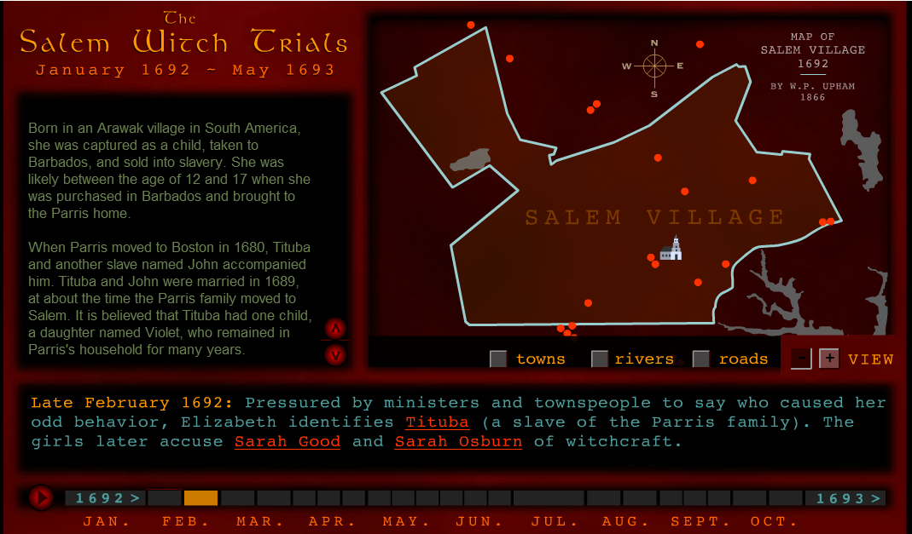
Tituba

Slide 5
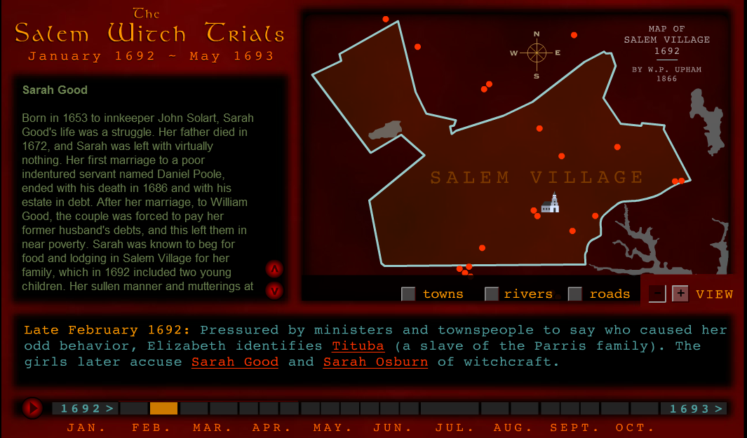
Sarah Good

Slide 6
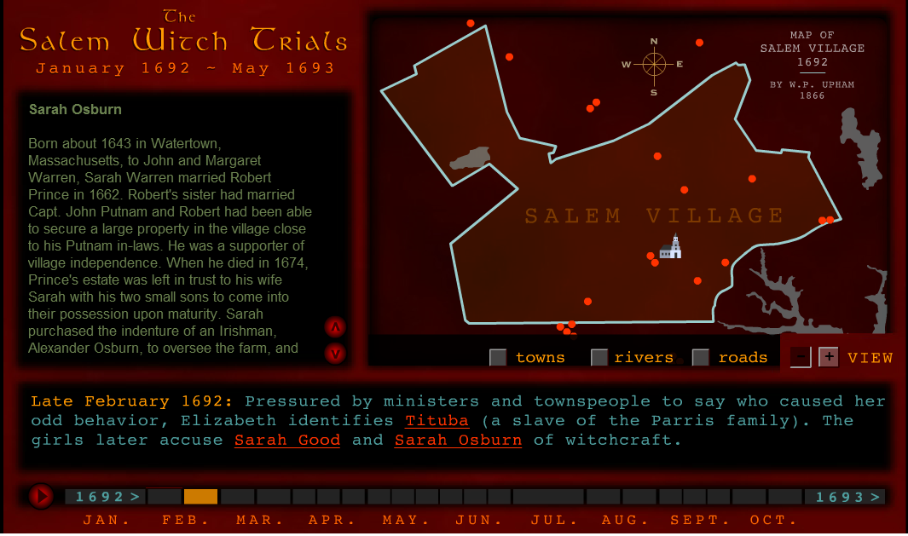
Sarah Osburn (p. 1)

Slide 7
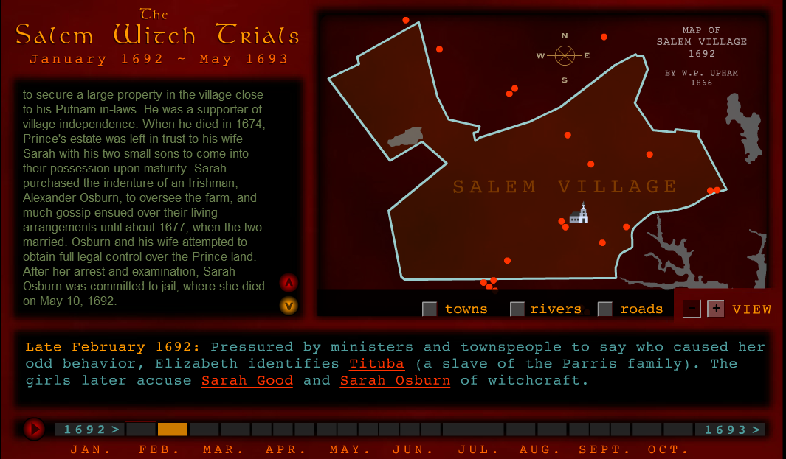
Sarah Osburn (continued)

Slide 8
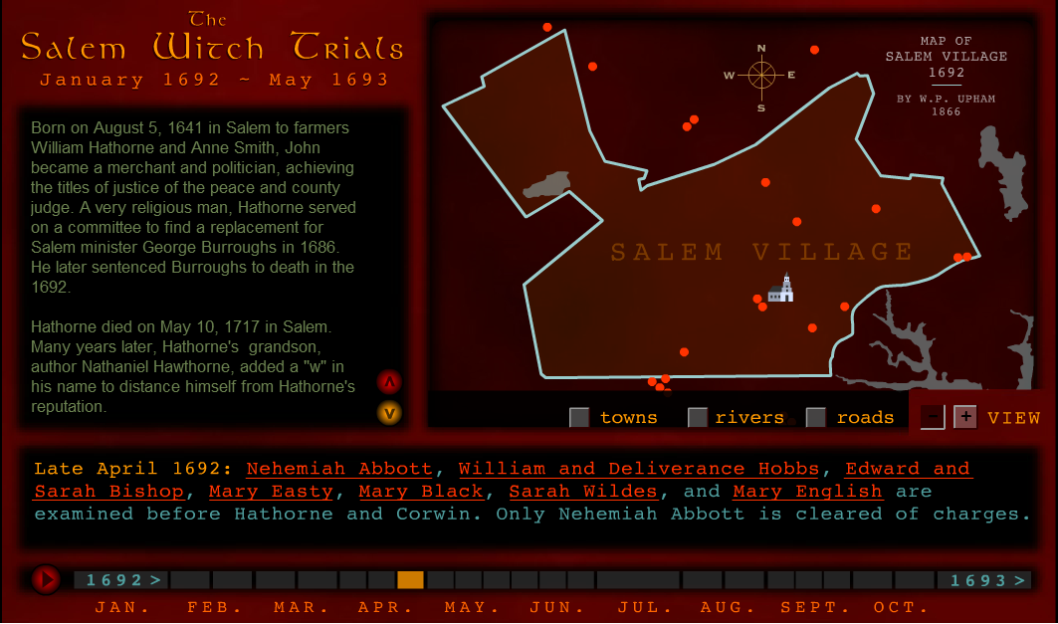
John Hathorne

Slide 9
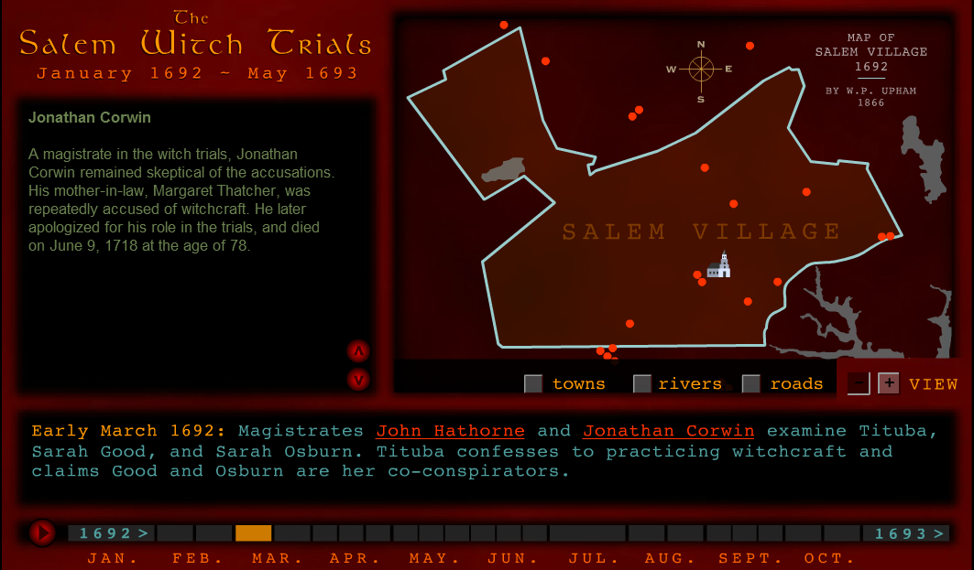
Jonathan Corwin

Slide 10
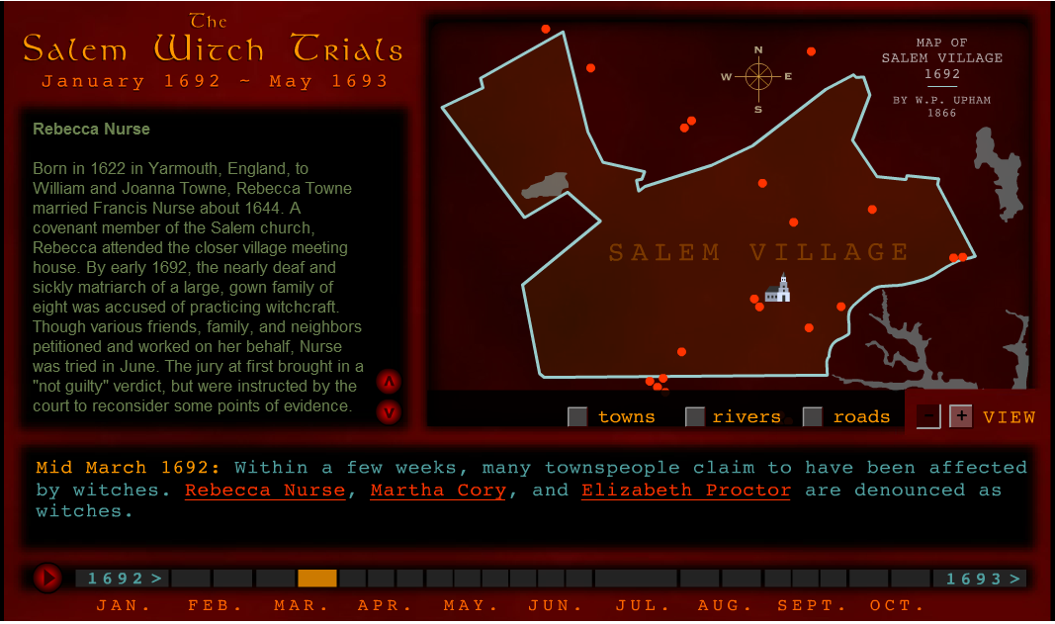
Rebecca Nurse (p. 1)

Slide 11
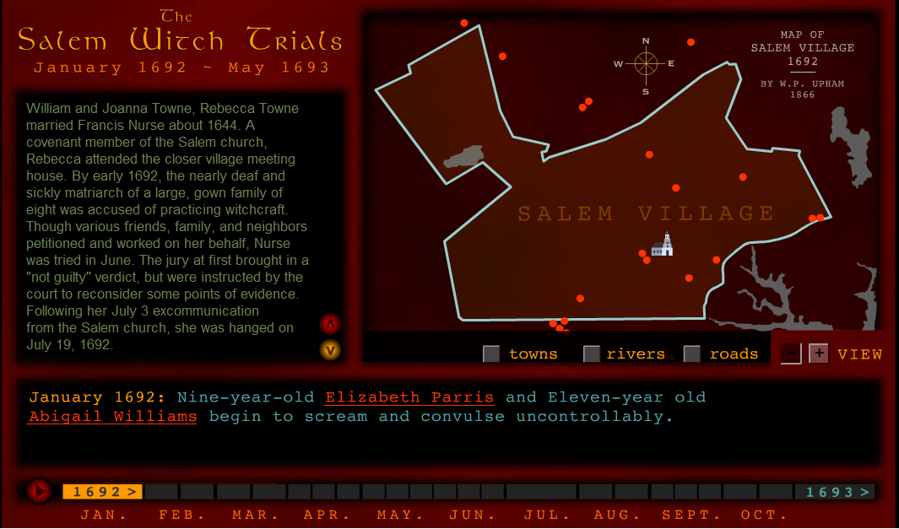
Rebecca Nurse (continued)

Slide 12
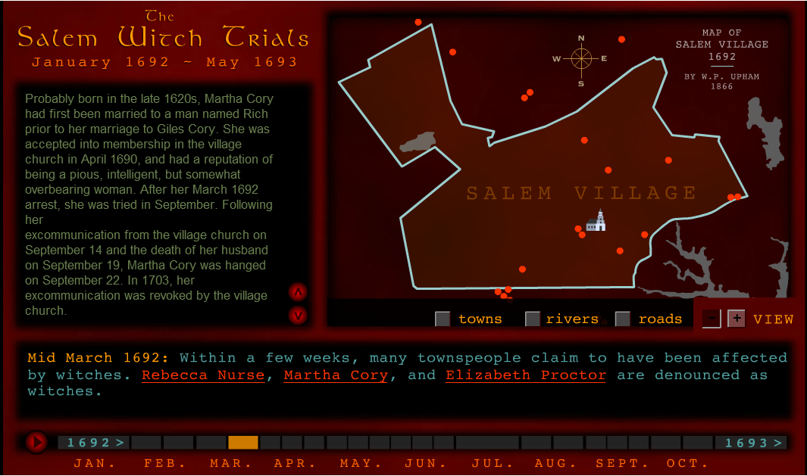
Martha Cory

Slide 13
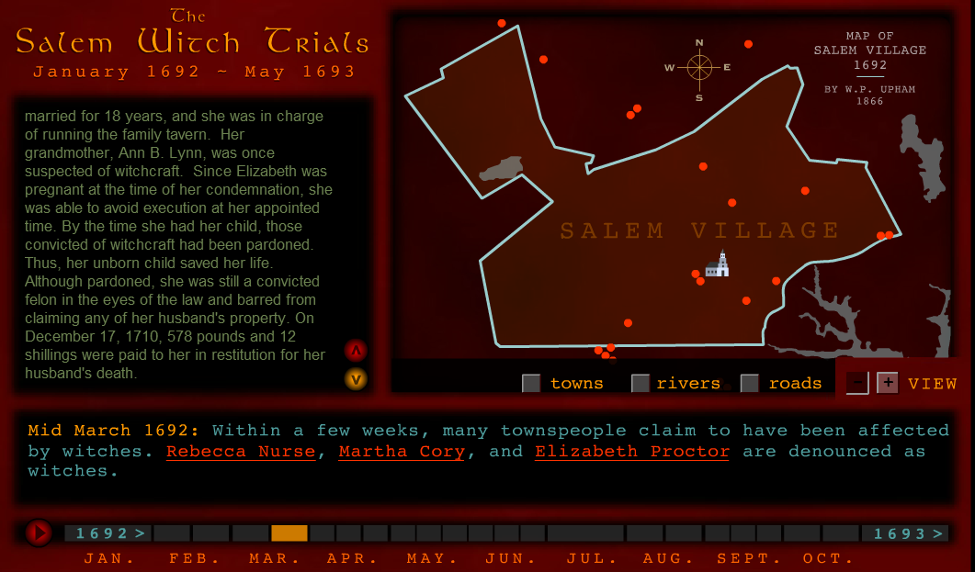
Elizabeth Proctor
The third wife of John Proctor, they were

Slide 14
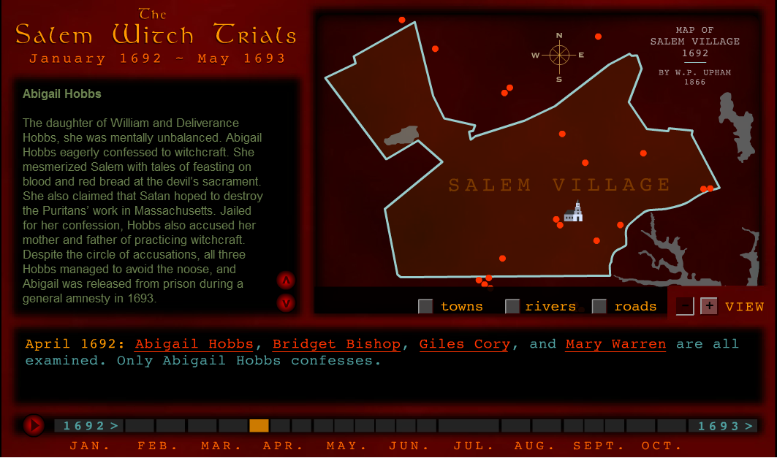
Abigail Hobbs

Slide 15
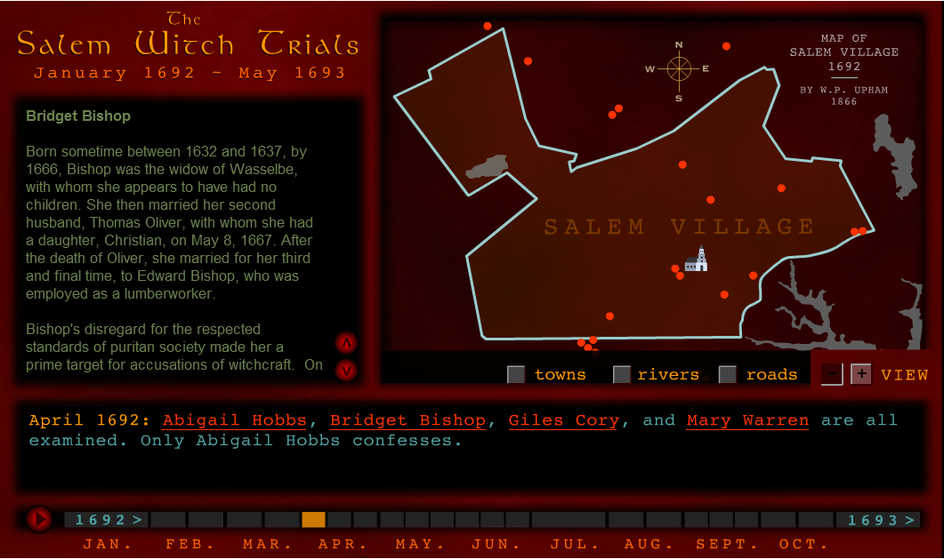
Bridget Bishop (p. 1)

Slide 16
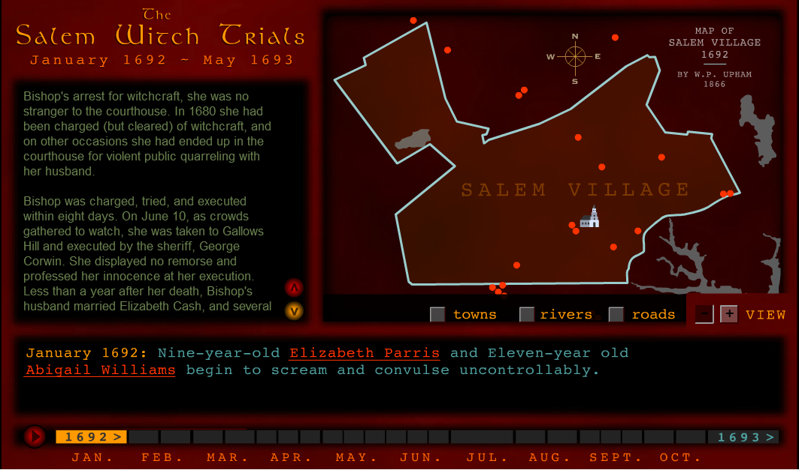
Bridget Bishop (p. 2)

Slide 17
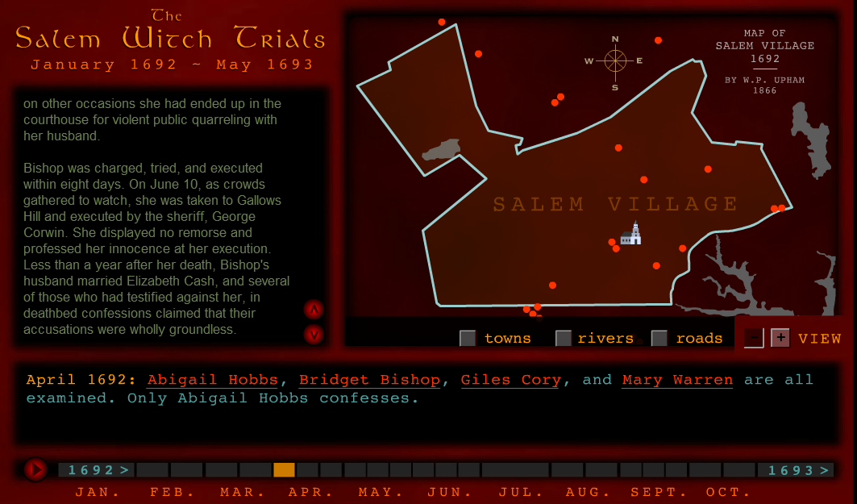
Bridget Bishop (p. 3)

Slide 18
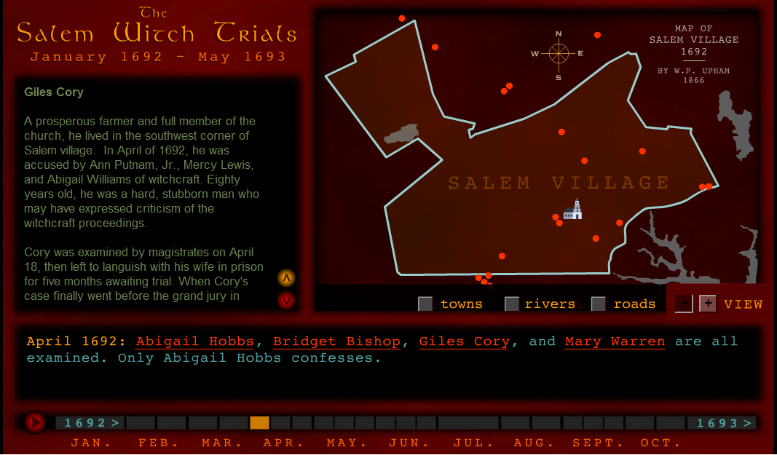
Giles Cory (p. 1)

Slide 19
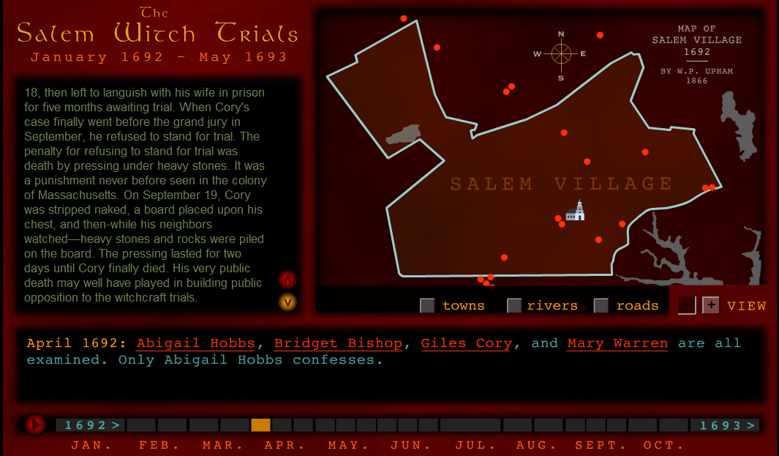
Giles Corey (p. 2)

Slide 20
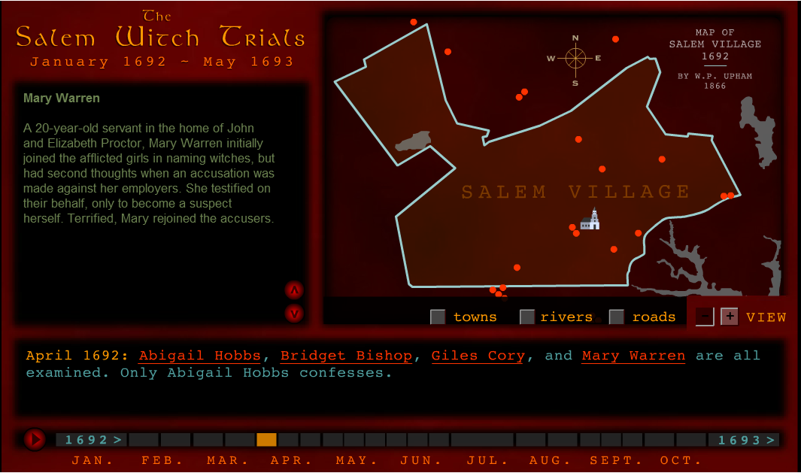
Mary Warren

Slide 21
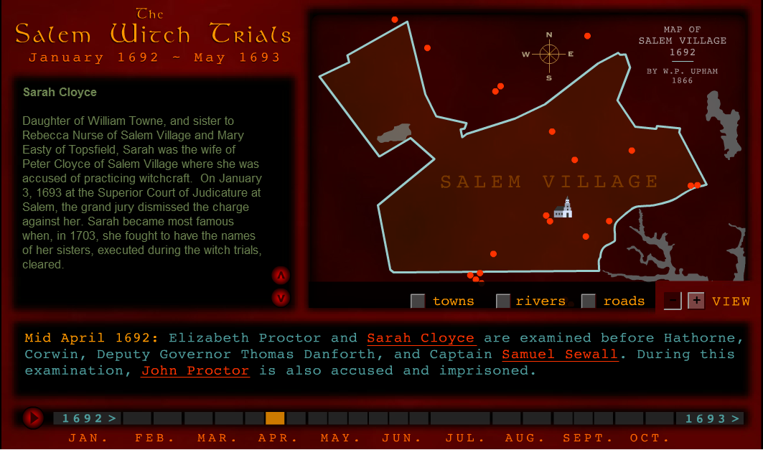
Sarah Cloyce

Slide 22
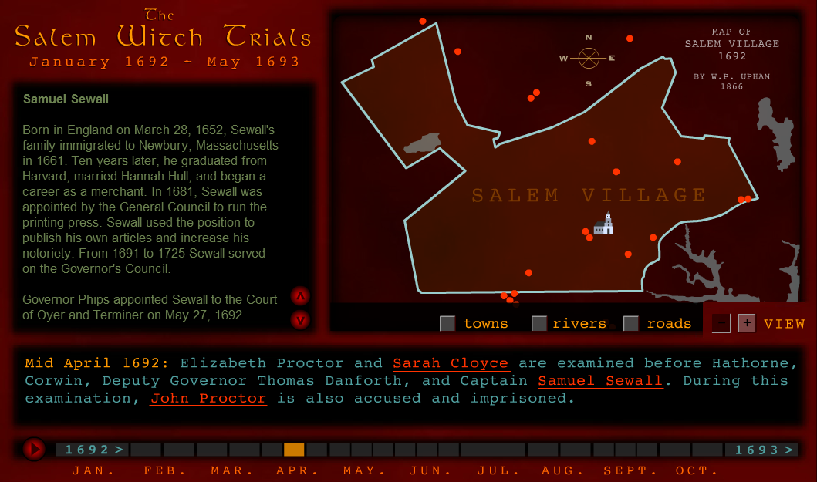
Samuel Sewall (p. 1)

Slide 23
Samuel Sewall (p. 2)

Slide 24
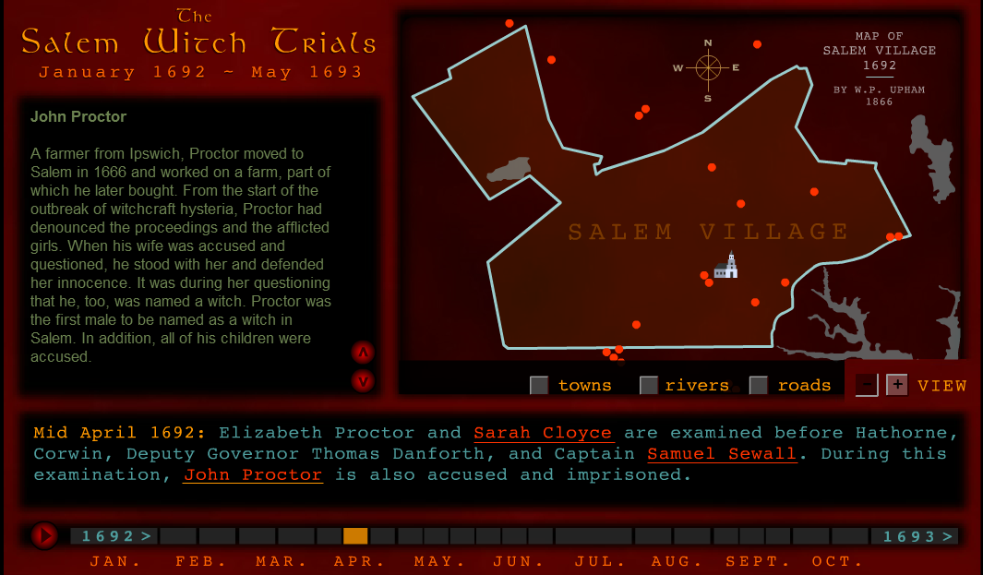
John Proctor (p. 1)

Slide 25
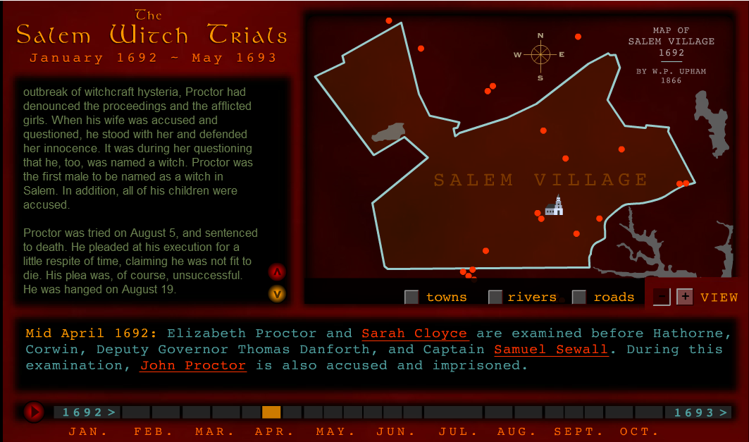
John Proctor (p. 2)

Slide 26
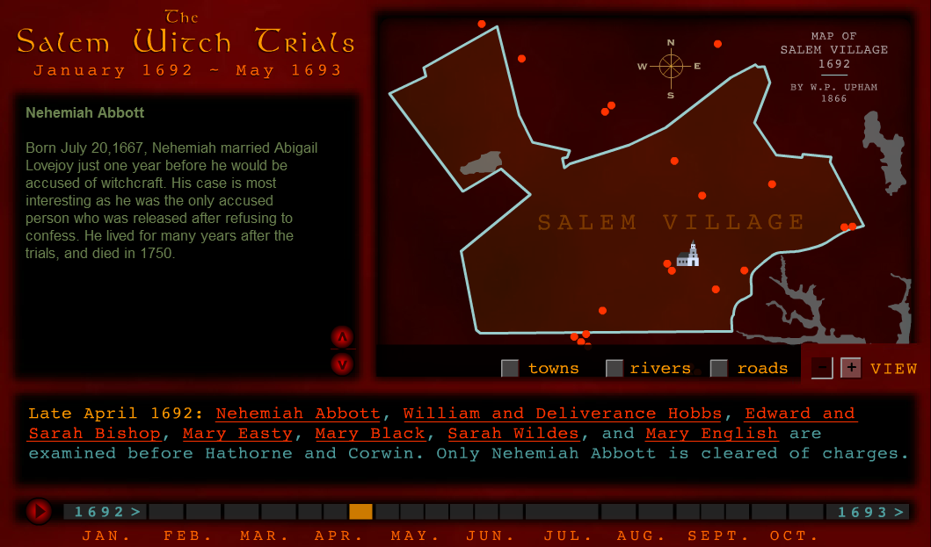
I copied this slide so you could see the timeline, but the people are not asked about on the chart and there are so many of them that I didn't copy and paste each person’s description.

Slide 27
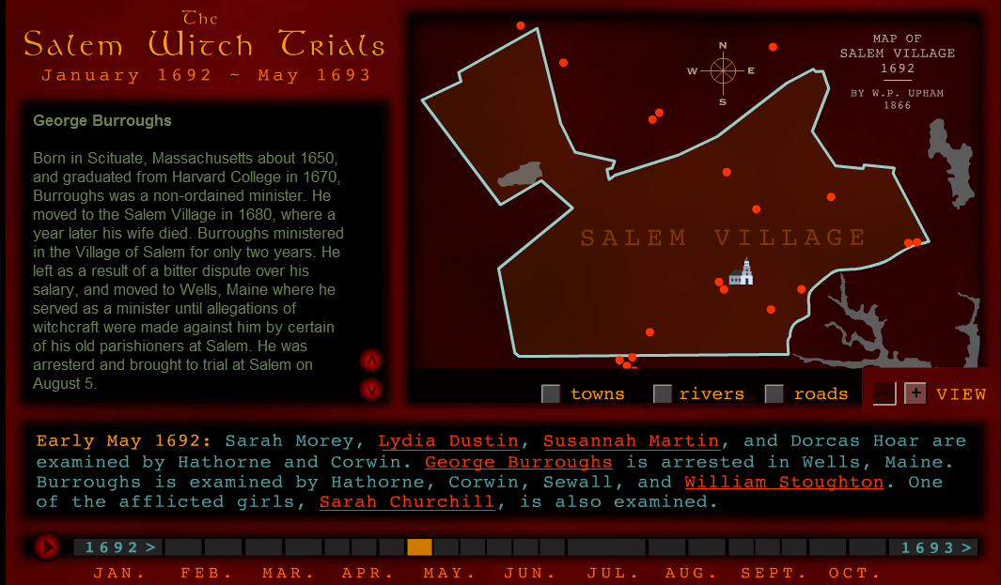
George Burroughs (p. 1)

Slide 28
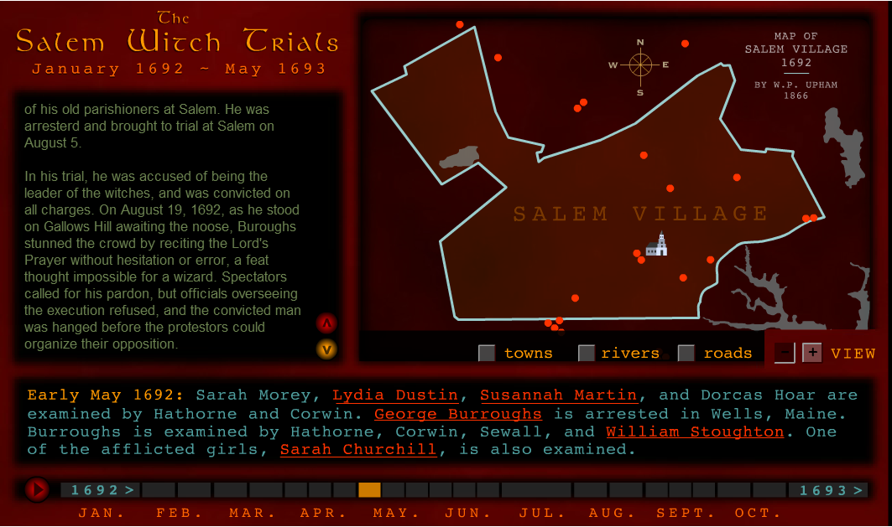
George Burroughs (p. 2)

Slide 29
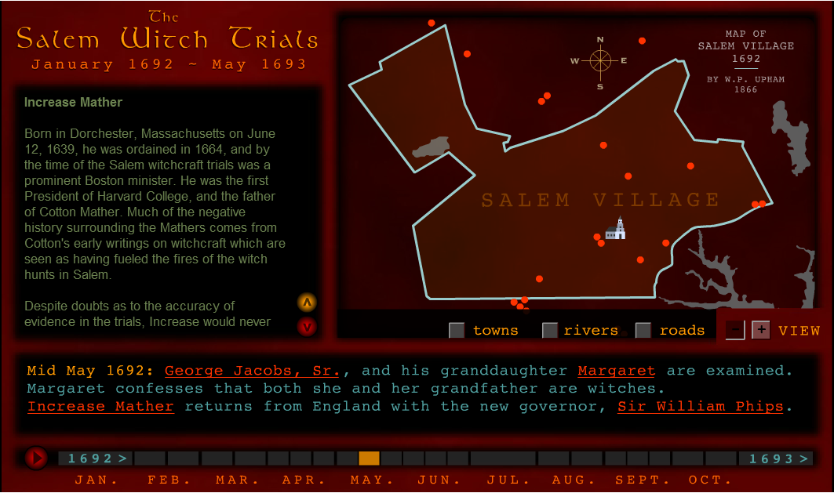
Increase Mather (p. 1)

Slide 30
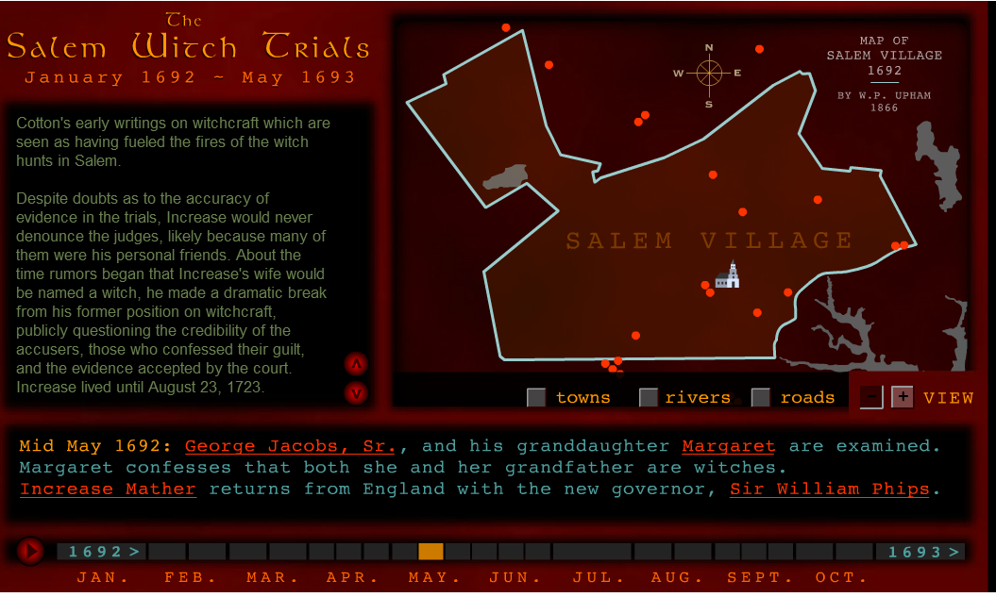
Increase Mather (p. 2)

Slide 31
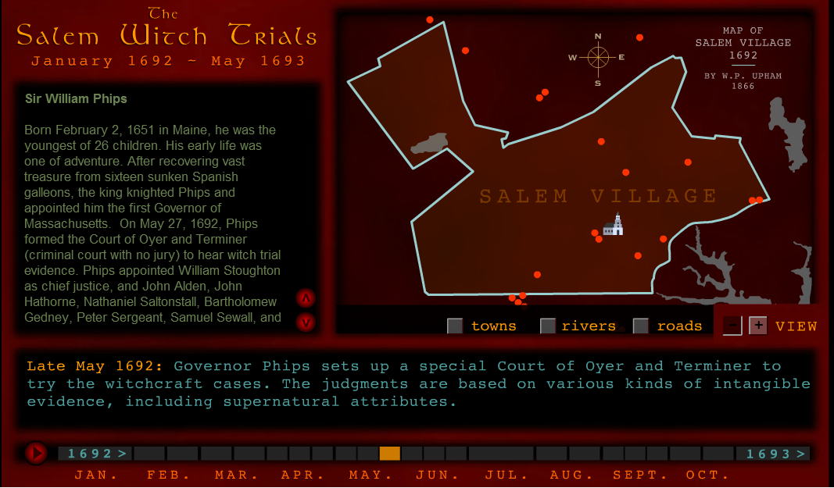
Timeline info / Gov. Phips

Slide 32
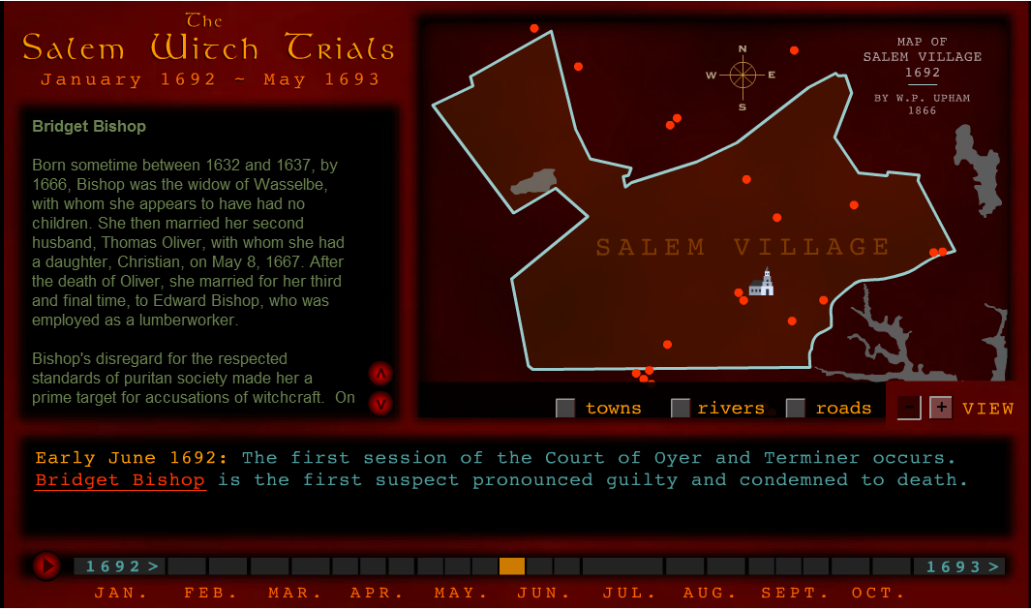
Timeline / Bridget Bishop

Slide 33
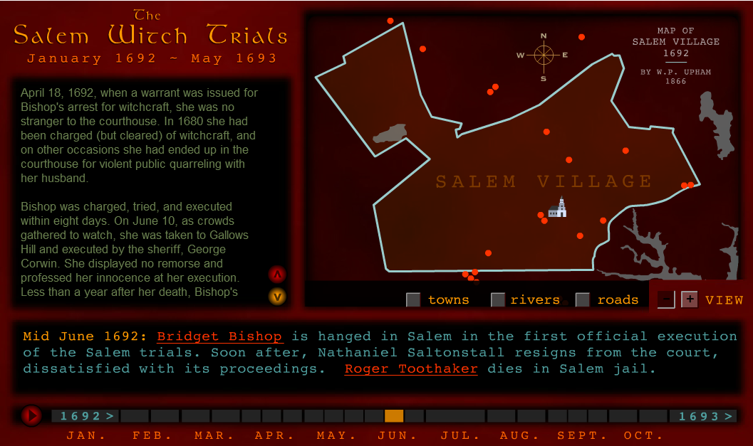
Timeline / More on Bishop

Slide 34
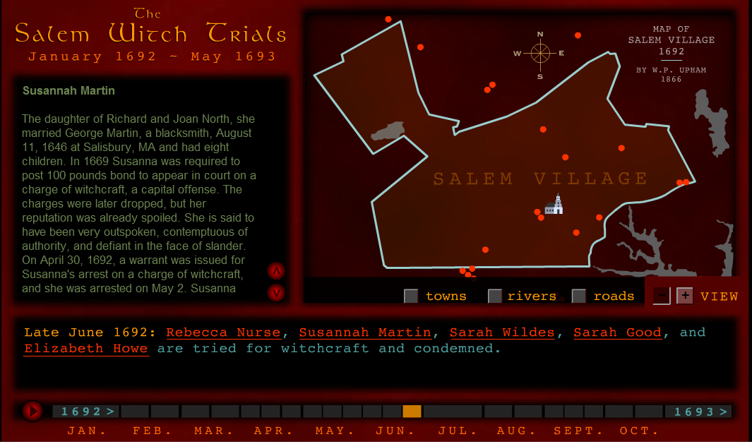
Timeline / Susannah Martin

Slide 35
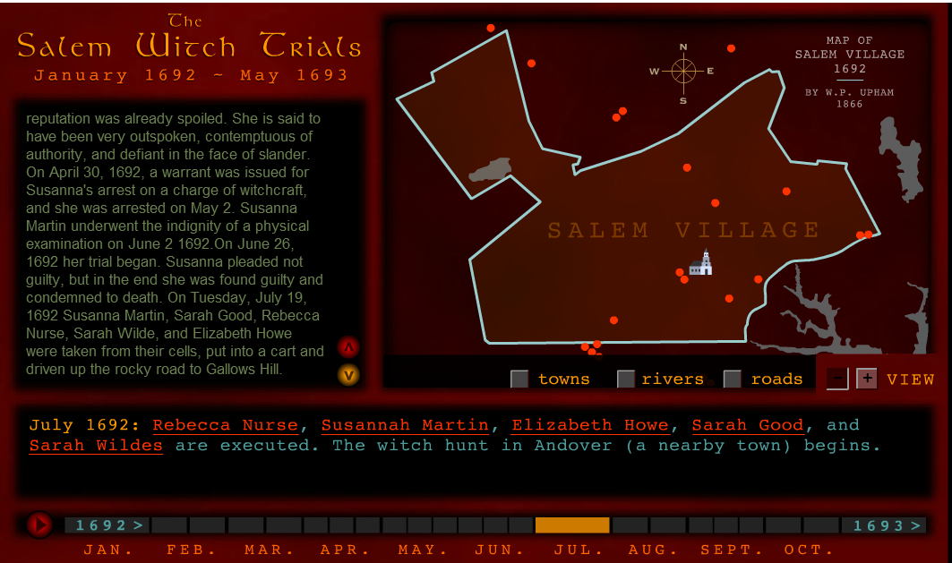
Timeline / more on Martin

Slide 36
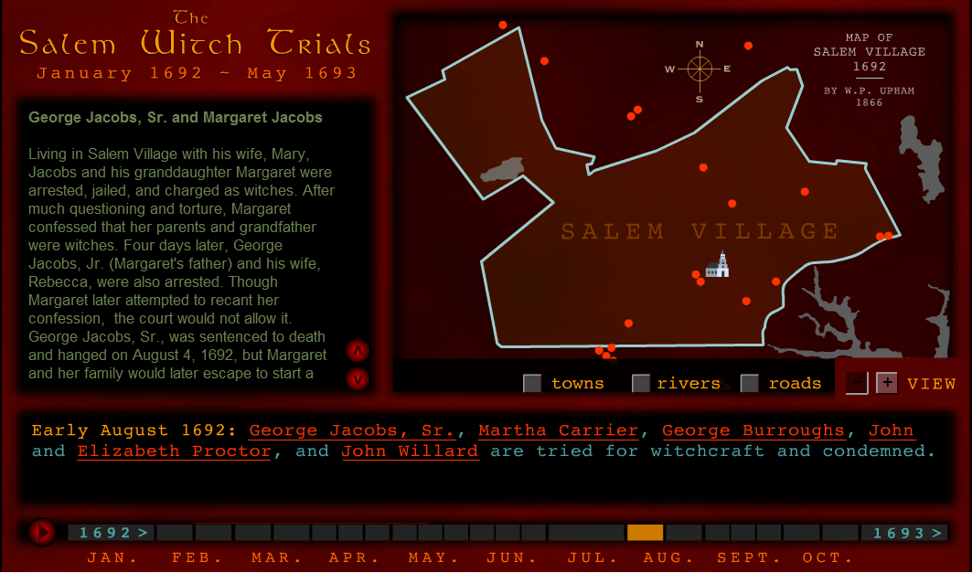
Timeline / George Jacobs

Slide 37
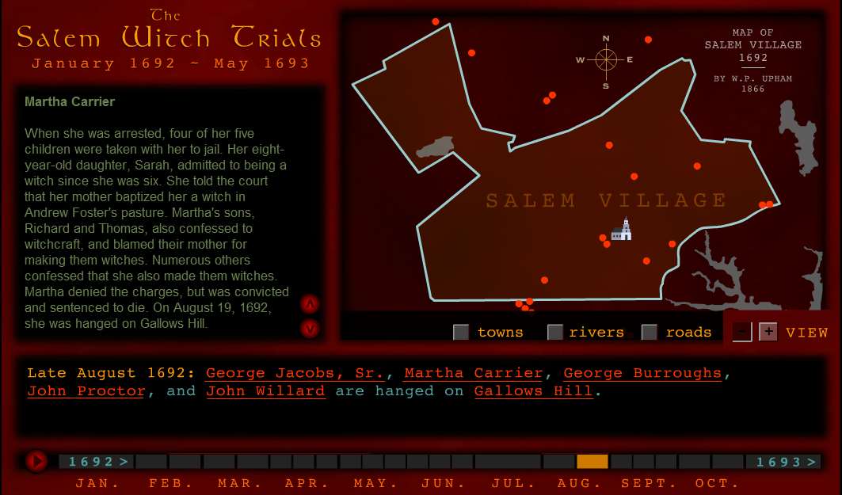
Timeline / Martha Carrier

Slide 38
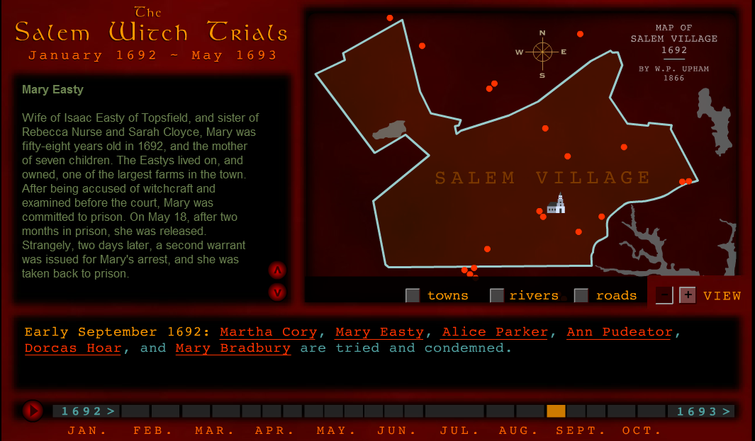
Timeline / Mary Easty

Slide 39
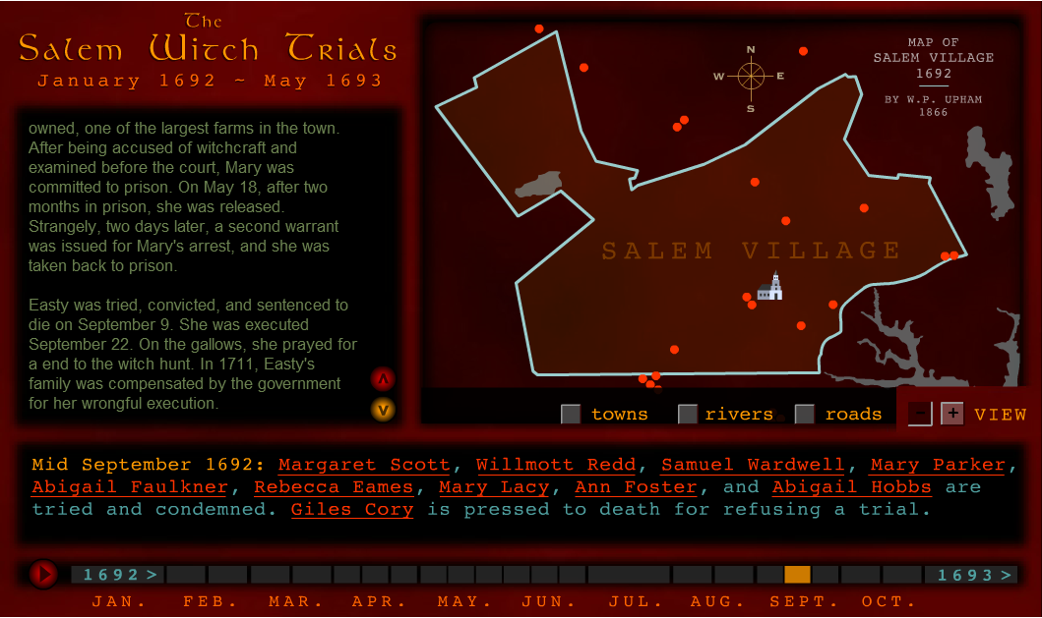
Timeline / More on Mary Easty

Slide 40
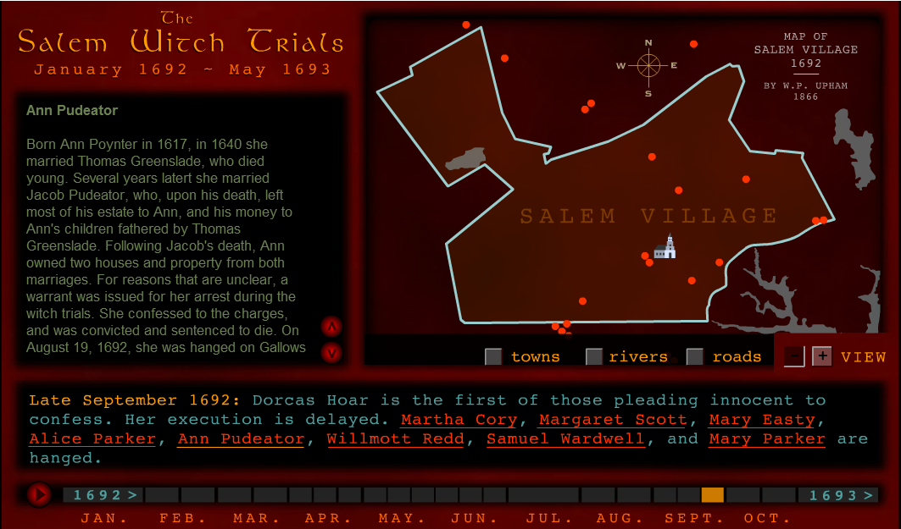
Timeline / Ann Pudeator

Slide 41
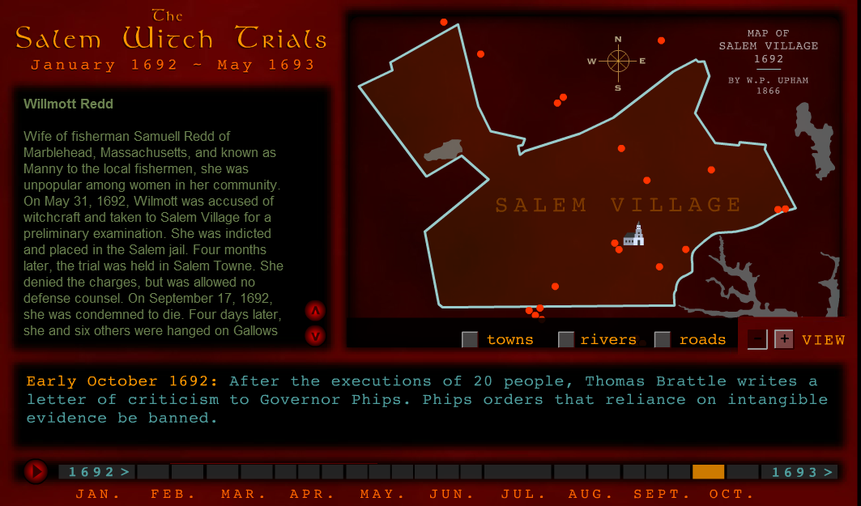
Timeline / Wilmott Redd

Slide 42
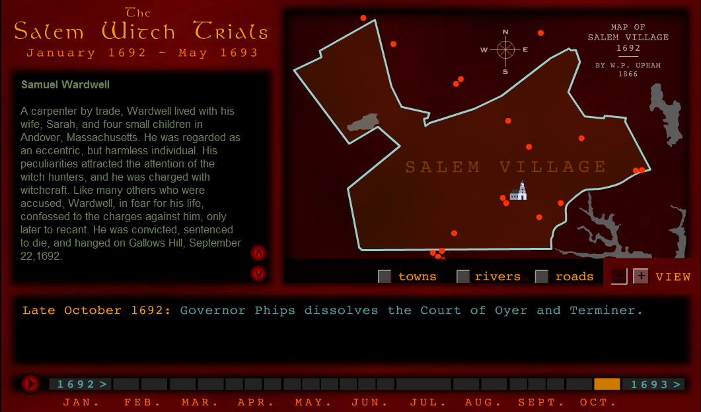
Timeline / Samuel Wardwell

Slide 43
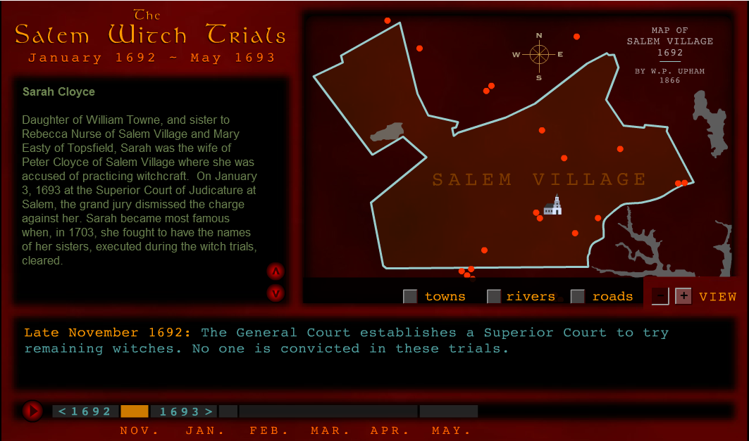
Timeline / Sarah Cloyce

Slide 44
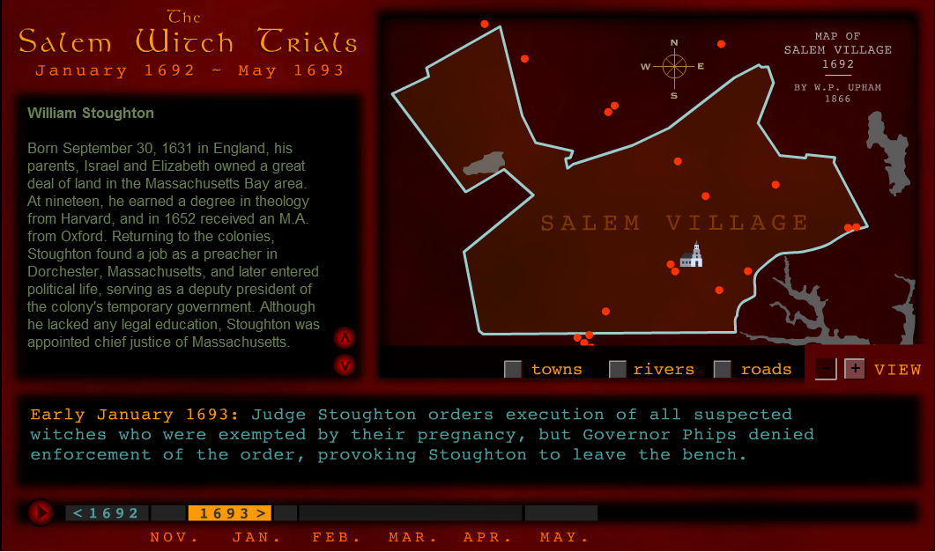
Timeline / William Stoughton

Slide 45
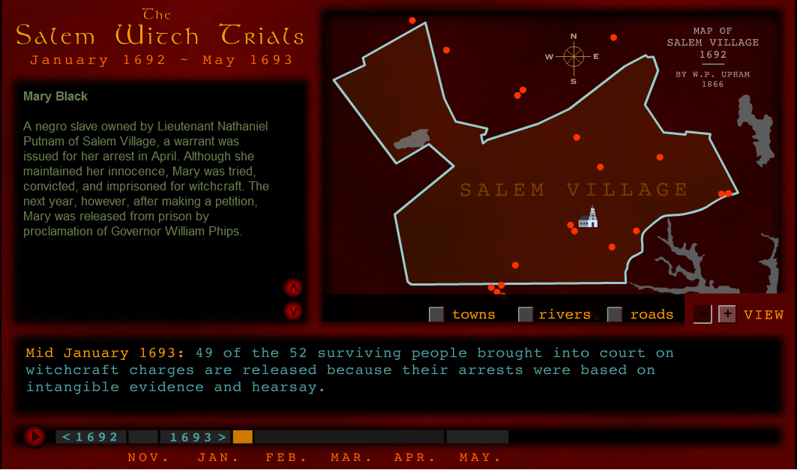
Timeline / Mary Black

Slide 46
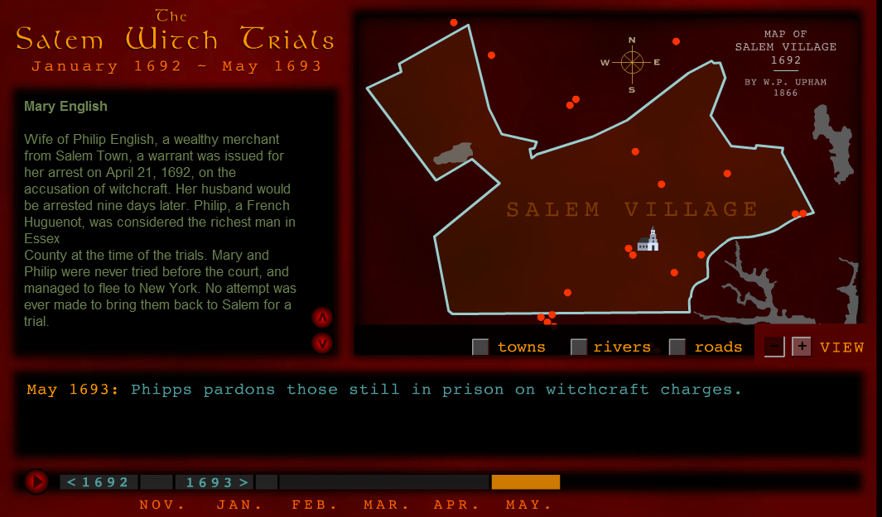
End of Timeline / Mary English

