Slide 1
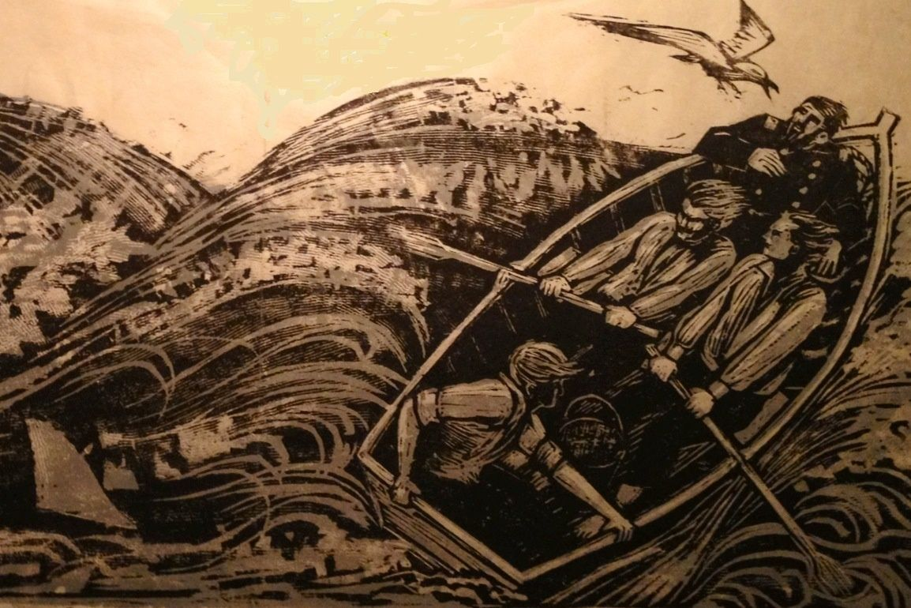
“The Open Boat”
By Stephen Crane

Slide 2
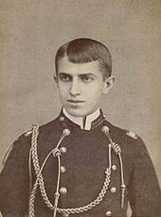
Stephen Crane – Early Life
born in Newark, New Jersey on November 1, 1871
fourteenth and last child of a Methodist minister, Dr. Jonathan Townley Crane
Father’s death in 1880; family moved to Asbury Park, New Jersey.
fascinated with military history as a child
In school, not really interested in academics; known mainly for baseball
failed five of six subjects ( got an A in English Literature) during his one semester at Syracuse
frequent visitor to the local brothels and gambling halls
Cadet Crane at age 17

Slide 3
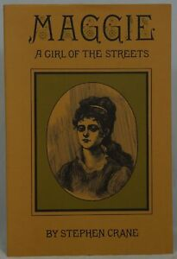
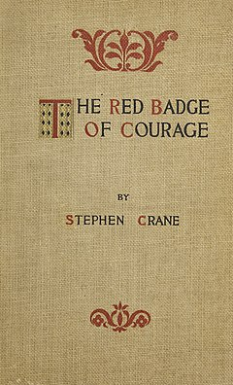
A Rough and Vagabond Life
1888 - brother hired him to work as a reporter for a news agency in Asbury Park
enjoyed journalism, which would be his main means of support throughout his life
Also wrote fiction - the novel Maggie: A Girl of the Streets written while he was at Syracuse
couldn’t find a publisher for Maggie, too grim - about a young girl forced into prostitution
borrowed the funds to self-publish under the pen name "Johnston Smith"
1891 – mother’s death; failure at Syracuse – moved to New York City to work as a free-lance reporter
lived a “rough and vagabond” life; by some accounts nearly starved
1895 – published his masterpiece, The Red Badge of Courage
an unromanticized look at the American Civil War
the first modern war novel
brought him celebrity

Slide 4
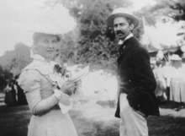
Cora Howarth Stewart – aka Cora Crane
November 1896, in Jacksonville, Florida, Crane was searching for a suitable vessel to take him to Cuba.
There, he met Cora Howarth Stewart, alias Cora Taylor, the madam at the Hotel de Dream.
A friend of Crane’s introduced them; she, by chance, had been reading Crane’s novel George's Mother. She presented the book to Crane for his autograph, and he inscribed it "To an unnamed sweetheart."

Slide 5
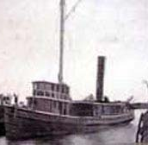
Sinking of the Commodore
Ship smuggling goods to Cuban rebels
Signed on as a sailor, cover for his real mission as a reporter
Set out on December 31, 1896, and sank the following night
Crane, the injured captain, and two other sailors in a lifeboat about 12 miles off the coast of Daytona Beach
See lighthouse at Mosquito Inlet, men guide boat to shore
Basis of one of Stephen Crane's most famous short stories, "The Open Boat”

Slide 6
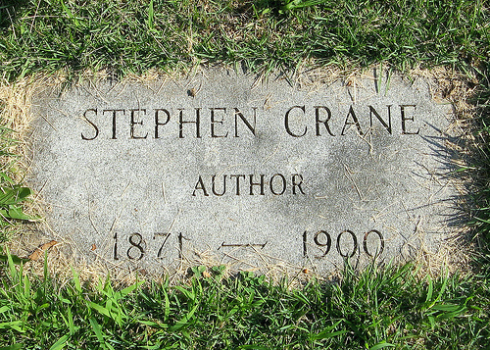
Crane’s Death
End years of his life were plagued by financial and health problems
Covered various wars (Greco-Turkish War; Spanish-American War) but could not earn enough to pay his debts
Yellow fever, malaria, pulmonary hemorrhages
Remained with Cora although they never officially married
June 5, 1900 - Died at a “spa” in Germany (trying to treat his health) at the age of 28; he left everything to Cora

Slide 7
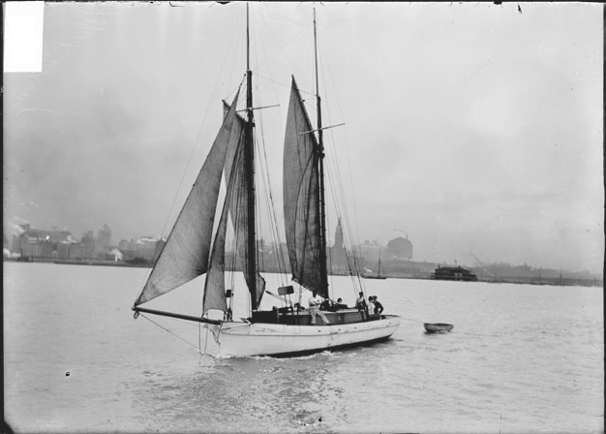
A Dinghy Pulled by a Sailboat

Slide 8
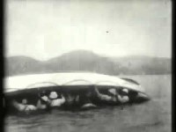
Video: Capsize of a Lifeboat (1897)

Slide 9
The Characters & Conflict
Who are the story’s characters? What do we know about them?
Think of the stereotypical men who fulfill the role of a ship’s captain or of a war correspondent. How are they often portrayed?
What is the conflict? What type of conflict is it?
As with many stories, Crane use a journey motif. What journey are the men on? What is their goal?

Slide 10
The Setting & Imagery
Look at the opening scene. What are some of specific words Crane uses to set the scene?
What does it mean that "None of them knew the color of the sky"? What kind of mood does this set for the story?
What kind of story does this opening suggest will unfold?
What does this opening make you feel as a reader? What kind of imagery does the scene present?

Slide 11
Point of View
What point-of-view does Crane use to tell the story - first or third person?
Does the narrator focus on any one character more or less? In what way do some characters have more significance than others?
Does the narrator describe the characters' thoughts and emotions? How does he do so—with certainty or speculatively?
How would this passage be different if it were narrated via first-person point of view? Would the story change?
Why emphasize the correspondent over any of the other characters? What is the significance in this choice?

Slide 12
Range of Emotions
“Then the captain, in the bow, chuckled in a way that expressed humor, contempt, tragedy, all in one. ‘Do you think we've got much of a show, now, boys?’ said he.”
How do the varying emotions build upon each other to create the mood?
How does the third-person narration aid in creating the mood?
What is the relationship between man and nature as evoked in the story? (Consider different parts.)
Darwin’s “survival of the fittest” – How does this story turn that idea on its head?

