Slide 1
The Faerie Queene
Edmund Spenser

Slide 2
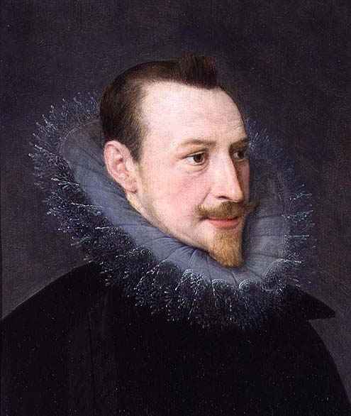
Edmund Spenser (1552-1599)
generally regarded as the greatest nondramatic poet of the
Elizabethan Age
assistant to the provincial governor in Ireland
enforced martial law to root out sedition and rebellion
outlined his authoritarian views on governing the Irish in pamphlets
given an Irish estate as a reward for his services
wanted to advance his career at court
The Faerie Queene won him a small pension but not the great favors he craved.
castle burned down by Irish rebels in 1598
moved back to London (1599); died at age 46
career as a politician unsuccessful, but reputation as a poet outstanding.
tomb next to Geoffrey Chaucer’s in Westminster Abbey

Slide 3
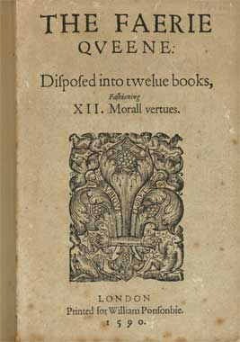
Faerie Queene
Sir Walter Raleigh, friend of Spenser’s, encouraged him to publish it
Planned 12 books; only finished 6
First 3 published in 1589
All six published in 1596
Each book to have a knight who performs noble deeds and represents a different virtue
holiness, temperance, chastity, friendship, justice, and courtesy
five men; one woman
on a quest

Slide 4
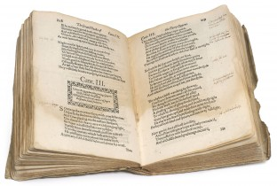
Terms to know
Epic
Canto
Allegory
Spenserian stanza
Alexandrine

Slide 5
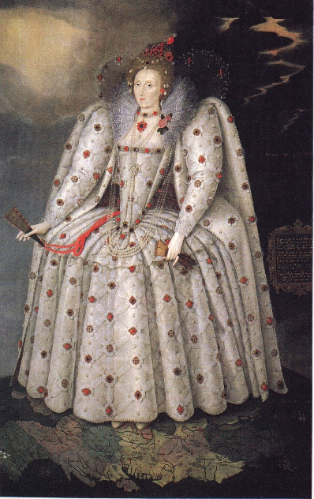
The Dedication
TO THE MOST HIGH, MIGHTIE, AND MAGNIFICENT
EMPERESSE
RENOWNED FOR PIETIE, VERTVE, AND ALL GRATIOVS GOVERNMENT
ELIZABETH
BY THE GRACE OF GOD
Queen of England, Fraunce and Ireland, and of Virginia,
Defender of the Faith etc.
HER MOST HUMBLE SERVAUNT
EDMVND SPENSER
DOTH IN ALL HUMILITIE
DEDICATE, PRESENT, AND CONSECRATE THESE HIS LABOVRS
TO LIVE WITH THE ETERNITIE OF HER FAME.

Slide 6
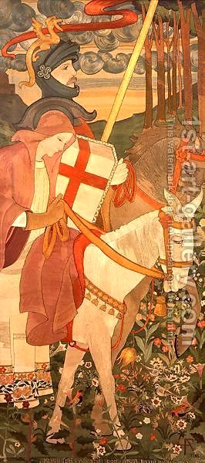
Book I - Redcrosse Knight - Holiness
I.
A Gentle Knight was pricking on the plaine, Y cladd in mightie armes and silver shielde, Wherein old dints of deepe wounds did remaine, The cruell markes of many a bloudy fielde; Yet armes till that time did he never wield: His angry steede did chide his foming bitt, As much disdayning to the curbe to yield: Full iolly knight he seemd, and faire did sitt, As one for knightly giusts and fierce encounters fitt.

Slide 7
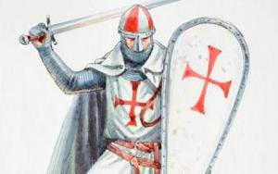
Book I – Redcrosse Knight - Holiness
But on his brest a bloudie Crosse he bore, The deare remembrance of his dying Lord, For whose sweete sake that glorious badge he wore, And dead as living ever him ador'd: Upon his shield the like was also scor'd, For soveraine hope, which in his helpe he had: Right faithfull true he was in deede and word, But of his cheere did seeme too solemne sad; Yet nothing did he dread, but ever was ydrad.

Slide 8
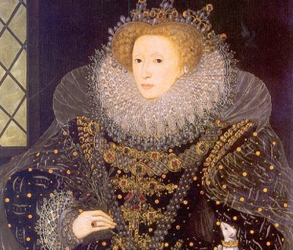
Book I – Redcrosse Knight - Holiness
Upon a great adventure he was bond, That greatest Gloriana to him gave, That greatest Glorious Queene of Faerie lond, To winne him worship, and her grace to have, Which of all earthly things he most did crave; And ever as he rode, his hart did earne To prove his puissance in battell brave Upon his foe, and his new force to learne; Upon his foe, a Dragon horrible and stearne.

Slide 9
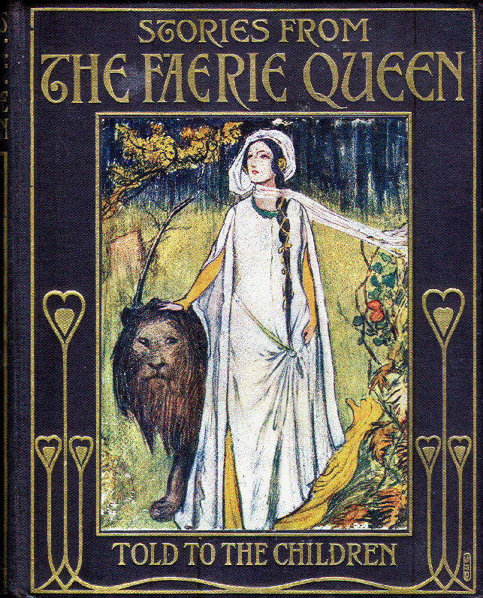
Allegorical Meanings
the literal adventure story wherein Redcrosse is an actual character
the more general Christian allegory wherein Redcrosse is a symbol of the Everyman sinner trying to achieve holiness
the specific historical-political allegory about the Protestant Reformation wherein Redcrosse is a specifically Protestant hero who is seduced into Catholic idolatry
the courtly allegory about Queen Elizabeth's court wherein Redcrosse is Spenser's proxy for winning the grace of the queen

Slide 10
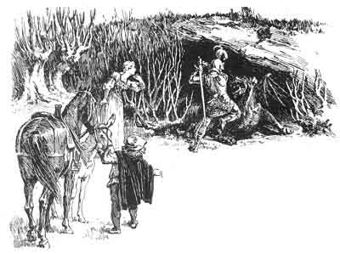

Slide 11
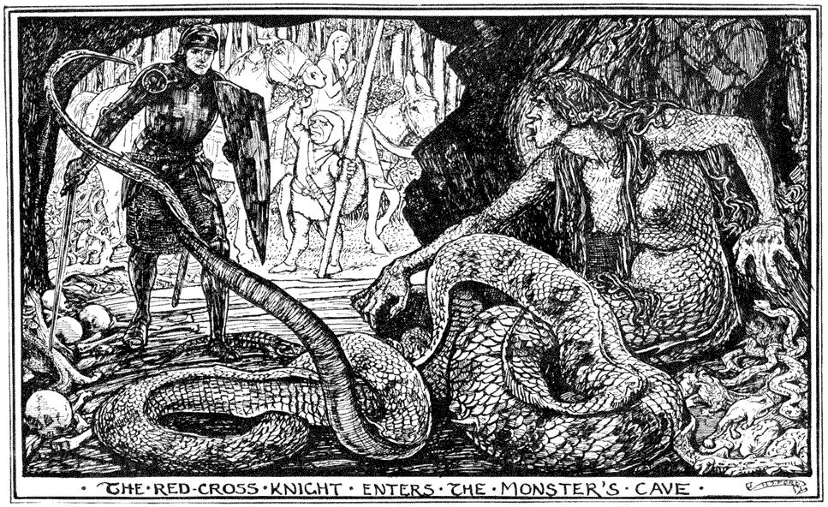

Slide 12
Book I, Canto I
Read through the selected stanzas.
Note both the literal and the allegorical meaning.
Notice Spenser’s language and imagery.
Create The Faerie Queene for modern audiences based upon these stanzas.
Try to capture as much of the essence of Spenser’s original.
You can select the medium in which the story will be told.
Each stanza should be represented with both visuals and text.

