Slide 1
Spenserian sonnets
Review of The Faerie Queene
by Edmund Spenser
and

Slide 2
Review of Spenser – True or False
TRUE
1. generally regarded as the greatest nondramatic poet of the Elizabethan Age
2. supported the Irish in their quest for independence from the British
3. lived in an castle in Ireland
4. criticized Queen Elizabeth’s policies
5. sought to write a vast allegory with 12 books, but only completed 6
6. returned to London after his castle was burned by Irish rebels in 1598
7. died in 1599 and buried near Chaucer in the Poet’s Corner in Westminster Abbey
FALSE
TRUE
FALSE
TRUE
TRUE
TRUE

Slide 3
THE FAERIE QUEENE BINGO/TIC TAC TOE
We are now going to review some of the key words related to The Faerie Queene.
You will receive a Bingo board with terms inside each box. You will need to create “chips” to use as markers. As I call out the identification/definition, mark the corresponding term if it appears on your card.
When you get three in a row (like in tic-tac-toe), you will call out the last name of the author of this Renaissance masterpiece (i.e., “Spenser”).
When a person calls out “Spenser,” he or she will tell the class the three terms that he/she matched along with their definition. Do not clear your board since we will continue to find a second winner.

Slide 4
So what was Spenser’s point?
Remember two of the overarching question we asked at the beginning of this unit:
What is the IDEAL SOCIETY?
Should religion be tied to POLITICS?
Spenser comments on both of these questions in The Faerie Queene. What do you think his response to these questions would be and why?
Now, we will present our own allegories based on Spenser’s Faerie Queene. Explain what you’re group was trying to do and then present your project.

Slide 5
Reflecting on Allegory and The Faerie Queene
In thinking about Edmund Spenser, The Faerie Queene, and my group’s allegory
3 things I learned
2 ways I contributed
1 question I have or connection I make

Slide 6
Why is love so complicated?
That’s another one of those overarching questions we asked at the beginning of this unit.
For centuries, writers have explored this topic and the many forms of love. We have discussed various love metaphors and what those metaphors suggest.
We also looked at Sir Thomas Wyatt’s “Whoso List to Hunt,” a sonnet about his love for Anne Boleyn. What metaphor did Wyatt use in his sonnet? What was this metaphor suggesting?
Today, we are going to look at two more sonnets that look at various aspects of love. Each sonnet uses metaphors to express their main ideas.

Slide 7
Sonnet 30 & Sonnet 75 (pp. 218-219)
Spenser wrote a series of 89 love sonnets called Amoretti (“little love poems”) recording a man’s two-year courtship of a woman named Elizabeth (perhaps Spenser’s courtship of his bride, Elizabeth Boyle, an Anglo-Irish woman whom Spenser married after his first wife died).
What metaphor does the sonnet employ?
What does this metaphor suggest about love?
What paradoxical idea does each sonnet contain? How does this paradox actually make sense?

Slide 8
Conceits
A fanciful comparison of two apparently very different things
Remember, Edward Taylor’s poem “Huswifery” that we read last year in which he compared God’s grace to the process of making cloth.
The Petrarchan conceit - a man's love interest is referred to in hyperbole. For instance, the lover is a ship on a stormy sea, and his mistress is either “a cloud of dark disdain” or the sun.
Once inventive images in the early sonnets became clichés in the poetry of later imitators. Romeo uses hackneyed Petrarchan conceits when describing his love for Rosalind as “bright smoke, cold fire, sick health.”
In “Sonnet 75,” Spenser uses what is called the eternizing conceit - making the human subject of a poem immortal through poetry.

Slide 9
Images of Love
In Sonnet 30, what images suggest desire or indifference?
In Sonnet 75, what images suggest love’s impermanence?
What are some comparisons you might make about love?
Love’s passion is like ____________.
Falling out of love is like ____________.
Commitment even in the rough times is like ___________.

Slide 10
Sonnet Structure
Type | Stanzas | Rhyme Scheme
Italian or Petrarchan | Octave and a sestet with “turn” or “volta” after octave | abbaabba cdecde abbaabba cdcdee abbaabba ccddee
English or Spenserian | 3 quatrains and a couplet (theme in couplet) | abab bcbc cdcd ee
Elizabethan or Shakespearean | 3 quatrains and a couplet (theme in couplet) | abab cdcd efef gg
Number of lines?
Meter?
Rhyme?
Revisit your sonnet and write it in the chart provided to show how it conforms to the sonnet structure.
Line # | ˘ | / | ˘ | / | ˘ | / | ˘ | / | ˘ | / |  | Rhyme
3. | Is | not | dis- | solved | through | my | so | hot | de- | sire |  | A
4. | But | har- | der | grows | the | more | I | her | en- | treat |  | B

Slide 11
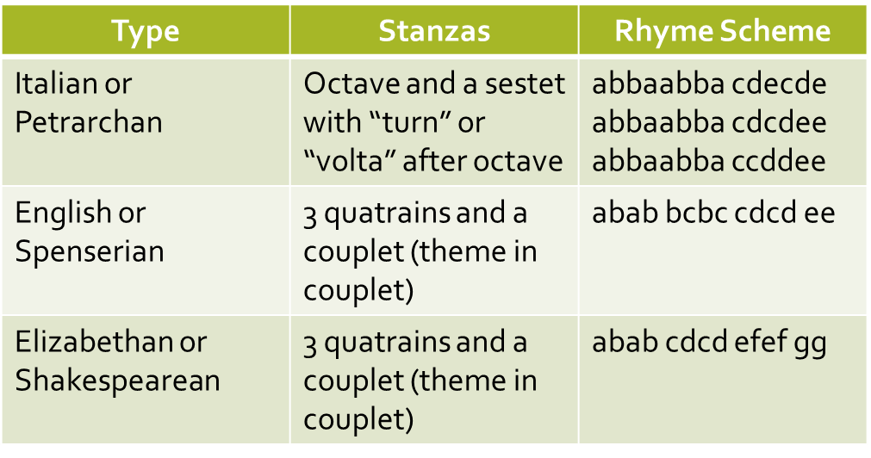
Sonnet Overview

Slide 12
Shakespearean Sonnet Presentation
Read the sonnet carefully as well as any surrounding notes or text in the literature book.
Write a line by line paraphrase of the sonnet.
Discuss the sonnet’s meaning, structure, literary elements & their effects, and theme.
Research the poem. Find and read at least two credible and scholarly articles about your group’s sonnet. Consider searching the literature databases. Do not use Wikipedia. You will need to include something from your research in your presentation.
Create a multimedia presentation to teach your group’s sonnet to the class. You may use PowerPoint or other presentation method, but should include visuals and sound to enhance your presentation. You may wish to browse YouTube or other internet sites to see what others’ have done with the sonnet and you may even choose to incorporate one of these videos into your presentation. Make the presentation as interesting, engaging, and thorough as you can. Be sure to cite information from your research in your presentation (e.g., you could include parenthetical citations within a PowerPoint with a Works Cited slide at the end).
This presentation counts as a quiz grade.

Slide 13
Writing an Original Sonnet
As an individual, you are going to write an original sonnet.
You may use Petrarchan, Spenserian, or Shakespearean rhyme scheme. Of course, your sonnet needs to be written in iambic pentameter and have 14 lines.
Think about the meaning of your sonnet and how you will use the structure of the sonnet to develop your main idea.
Use various literary elements such as the ones you’ve seen in the sonnets we’ve read (conceit, paradox, metaphor, imagery).
Type your sonnet and decorate the page to reflect the poem’s theme.
On the back, include a sonnet chart with your sonnet filled in to show its structure.
Your sonnet counts as a quiz grade.

Slide 14
Reflection Acronym
Today we examined two sonnets by Edmund Spenser. Thinking about what we’ve learned about sonnets, write an acronym using the word “Sonnet” that lists or describes some of the sonnet’s key features.
S
O
N
N
E
T

