Slide 1
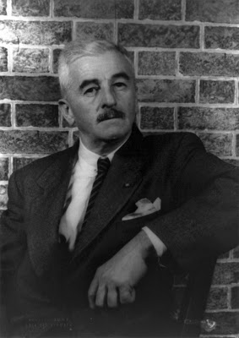
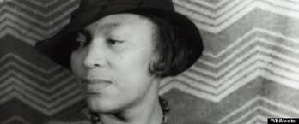
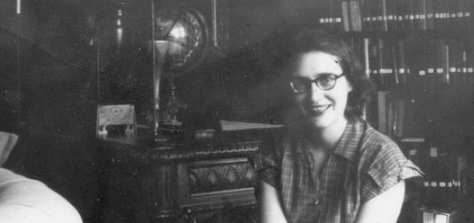
Southern Gothic
in American Literature

Slide 2
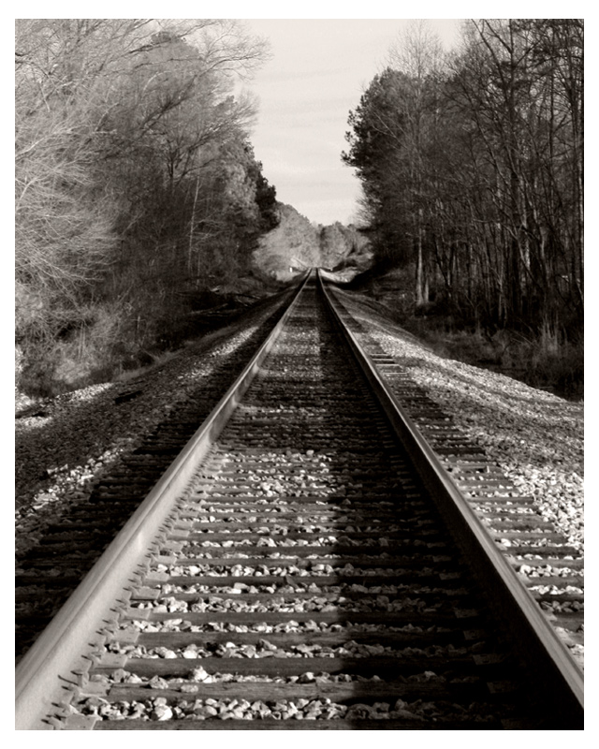
Background
Sub-genre of the Gothic style
Popular in Europe in 1800s
Frankenstein by Mary Shelley
Dracula by Bram Stoker
Unique to American literature
relies on supernatural, ironic, or unusual events to guide the plot
uses these to explore social issues and reveal the cultural character of the American South
focuses largely on themes of terror, death, and social interaction
plantation houses represent quasi-feudal order in times of prosperity contrasting their eventual decay, like ruined castles of 19th-century Gothic romances, with both symbolically signaling the end of an era

Slide 3
Background
Takes classic Gothic archetypes, such as the monster or the heroic knight, and turns them into American Southerners
a spiteful, reclusive spinster; an uneducated drunk
a quiet, wise lawyer
Most notable feature is the “grotesque”
a character whose negative qualities allow the author to highlight unpleasant aspects in Southern culture
Something in the town, the house, the farm is bizarre and often falling apart
"fiction evocative of a sublime and picturesque landscape ... depict(ing) a world in ruins,"

Slide 4
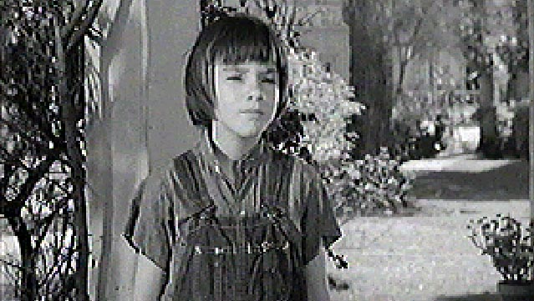
Defining Feature
Cast of “off-kilter” characters
Broken bodies, minds or souls
Used to symbolize problems created by the established pattern
Used to question established pattern’s morality and ethical justification
The “Innocent” is a common character, who may or may not be “broken,” but who often acts as a redeemer for others

Slide 5
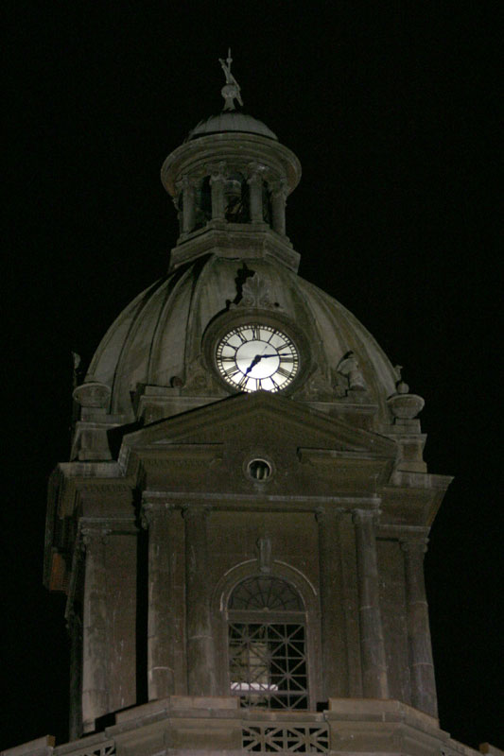
Other Specific Features of Southern Gothic
Freakishness
Outsider
Imprisonment
Violence
Sense of Place

Slide 6
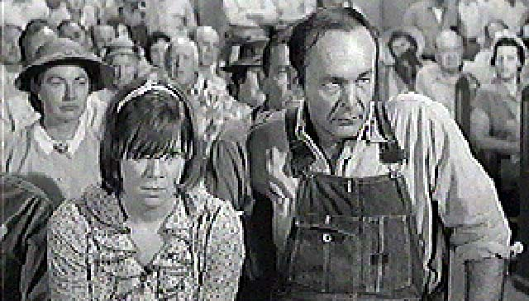
Freakishness
an important character set apart from the world in a negative way by a disability or an odd and often negative way of seeing the world

Slide 7
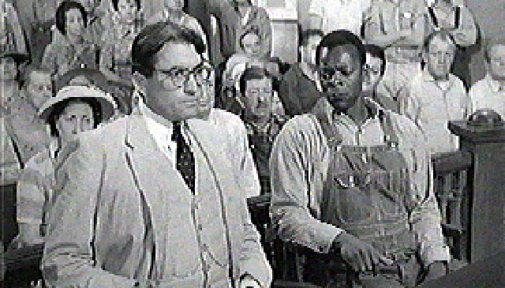
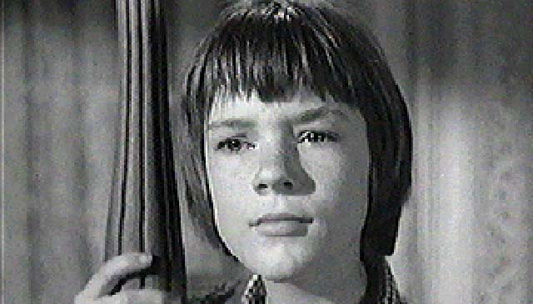
Outsiders
characters set apart from the established cultural pattern but end up being heroes because their difference allows them to see new ways of doing things that ultimately help to bring people out of the “dark”

Slide 8
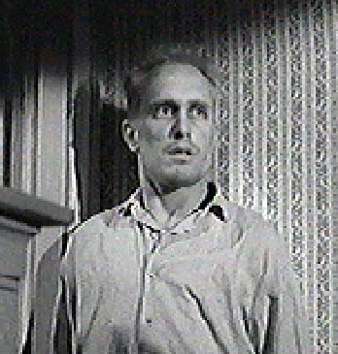
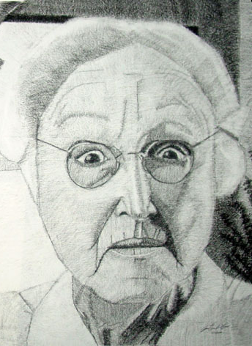
Imprisonment
This is often both literal and figurative.
Many Southern Gothic tales include an incident where a character is sent to jail or locked up.
There are also Southern Gothic characters who live in fate's prison.

Slide 9
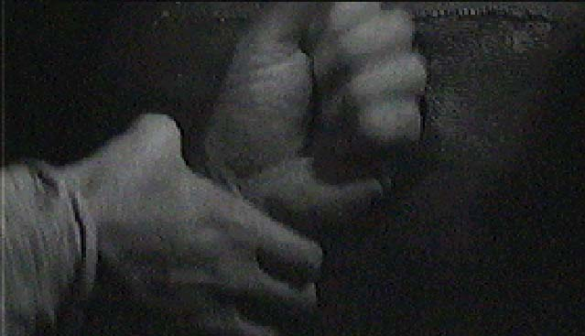
Violence
Racial, social, and class differences often create underlying tension that threatens to, and usually does, erupt in violent ways

Slide 10
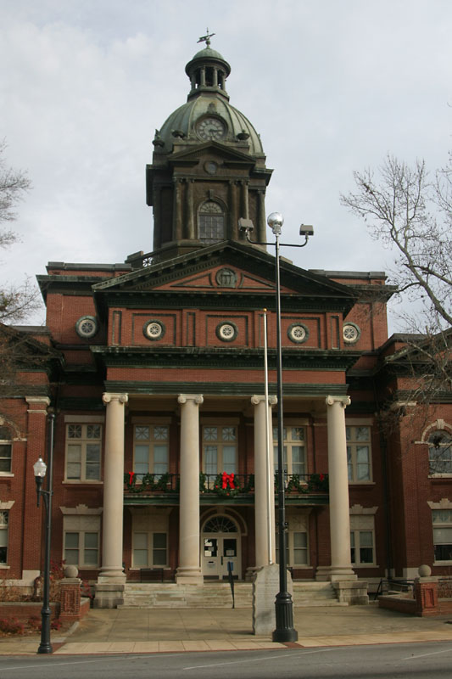
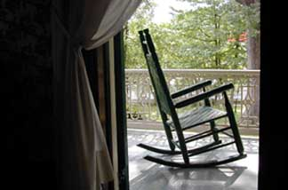
Sense of Place
old small towns
Houses with front porches with rocking chairs
Old downtown with stately but worn-down buildings

Slide 11
The novelist with Christian concerns will find in modern life distortions which are repugnant to him, and his problem will be to make them appear as distortions to an audience which is used to seeing them as natural; and he may be forced to take ever more violent means to get his vision across to this hostile audience. When you can assume that your audience holds the same beliefs you do, you can relax a little and use more normal ways of talking to it; when you have to assume that it does not, then you have to make your vision apparent by shock — to the hard of hearing you shout, and for the blind you draw large and startling figures. — Flannery O'Connor

Slide 12
Sources
GENRE: Southern Gothic. (2014).Oprah.com. Retrieved from https://www.oprah.com/oprahsbookclub/southern-gothic-distinguising-features
"Southern Gothic Literature." Twentieth-Century Literary Criticism, edited by Janet Witalec, vol. 142, Gale, 2003. Gale Literature Resource Center, link.gale.com/apps/doc/H1410001028/LitRC?u=tel_k_madisonaca&sid=bookmark-LitRC&xid=8371dee7.
Southern gothic. (n.d.) In Wikipedia. Retrieved from http://en.wikipedia.org/wiki/Southern_Gothic

