Slide 1
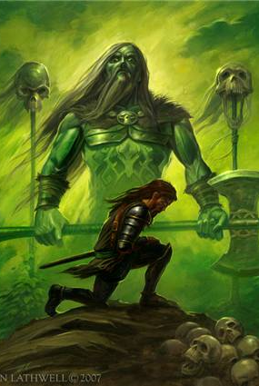
Sir Gawain and the Green Knight
By the “Pearl Poet”

Slide 2
The Pearl Poet
Sir Gawain and the Green Knight, perhaps the most sophisticated alliterative romance in Middle English, appears in a single manuscript—a small quarto volume that also includes Patience, Cleanness (or Purity), and Pearl.
Written near the end of the 14th century and preserved in a scribal hand of the early 15th century, the four works are often attributed to one anonymous author, known as The Pearl Poet, an aristocratic contemporary of Chaucer.

Slide 3
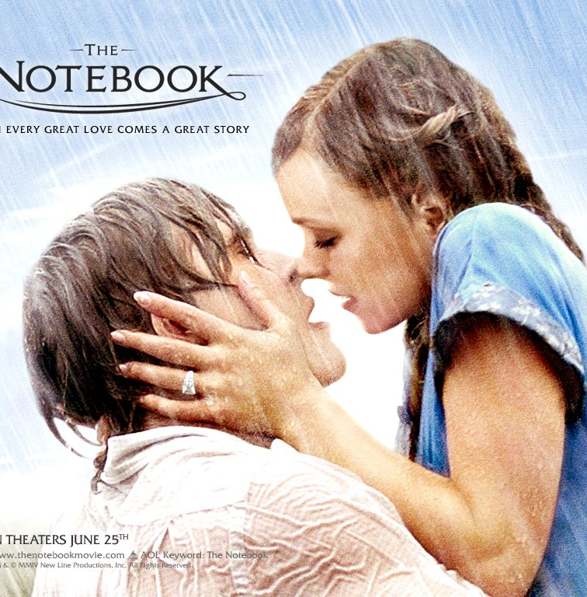
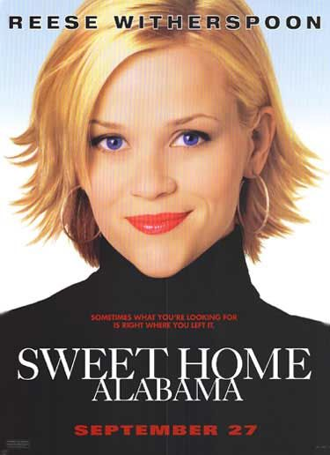
So, what kind of story is this?
It’s a ROMANCE (but not like the movies The Notebook and Sweet Home Alabama).
ROMANCE:
a narrative set in a world of pure wish fulfillment
superhuman heroes fight and almost always conquer the forces of evil
the hero undertakes a hard journey in search of something valuable (a quest…remember that?)

Slide 4
Stanza Form
bob and wheel
a group of typically five rhymed lines following a section of unrhymed lines.
The bob - the first line in the group; shorter than the rest
the wheel - the quatrain that follows the bob

Slide 5
Bob and Wheel
Look at the first stanza of the excerpt in our book on p. 159. Notice lines 1-24 do not rhyme.
Then, you’ll see the short line (the bob) in line 25, followed by the quatrain (the wheel) in lines 26-29. The bob and wheel has an ABABA rhyme scheme. (Remember some of our pronunciation has changed so rhymes may have been closer as spoken in the Middle Ages. Also, we are reading a translation, which may affect the rhymes.)

Slide 6
Main Characters
King Arthur
Legendary king of Britain
Husband of Guinevere
Uncle of Gawain
Over the famous Knights of the Round Table at Camelot
Brave, courageous, chivalrous

Slide 7
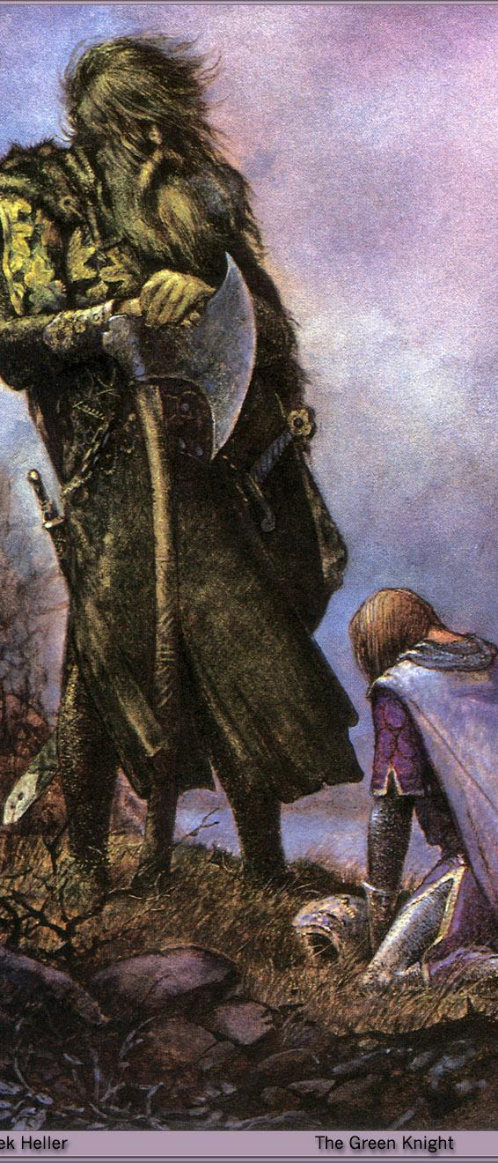
Main Characters
Sir Gawain
Arthur’s nephew and one of the most loyal, brave knights
Follows the chivalrous code (humility, piety, integrity, loyalty, honesty)
Courtly lover
One flaw: loves his life so much that he will lie to protect it (obviously breaking the code)

Slide 8
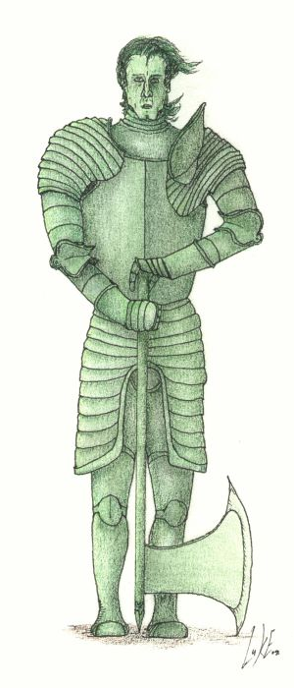
Main Characters
The Green Knight:
Yes…he is a green man.
Huge guy with big muscles/carries a huge axe
Says he comes in friendship but proposes that someone step forward to play the “beheading game.”
Expects the knights to be courageous and step forward to play

Slide 9
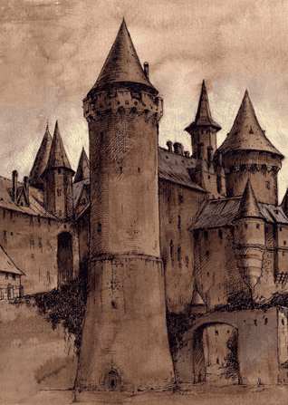
Other Characters
Lord and Lady Bertilak
Queen Guinevere: Arthur’s wife and queen
Knights of the Round Table

Slide 10
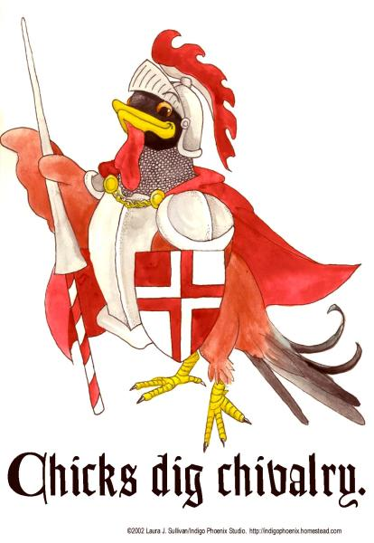
Major theme
Chivalry
The world of Sir Gawain and the Green Knight is governed by well-defined codes of behavior.
The code of chivalry, in particular, shapes the values and actions of Sir Gawain and other characters in the poem.
The ideals of chivalry come from the Christian concept of morality.

Slide 11
Major Theme
Arthur's court depends heavily on the code of chivalry, and Sir Gawain and the Green Knight gently criticizes the fact that chivalry values appearance and symbols over truth.
Arthur is introduced as the “most courteous of all,” indicating that people are ranked in this court according to their mastery of a certain code of behavior and good manners.
When the Green Knight challenges the court, he mocks them for being so afraid of mere words, suggesting that words and appearances hold too much power over the company.
The members of the court never reveal their true feelings, instead choosing to seem beautiful, courteous, and fair-spoken.

Slide 12
Major Theme
The lesson Gawain learns as a result of the Green Knight's challenge is that, at a basic level, he is just a physical being who is concerned above all else with his own life.
Chivalry provides a valuable set of ideals toward which to strive, but a person must above all remain conscious of his or her own mortality and weakness.
Gawain's faults throughout this story teach him that though he may be the most chivalrous knight in the land, he is nevertheless human and capable of error.

Slide 13
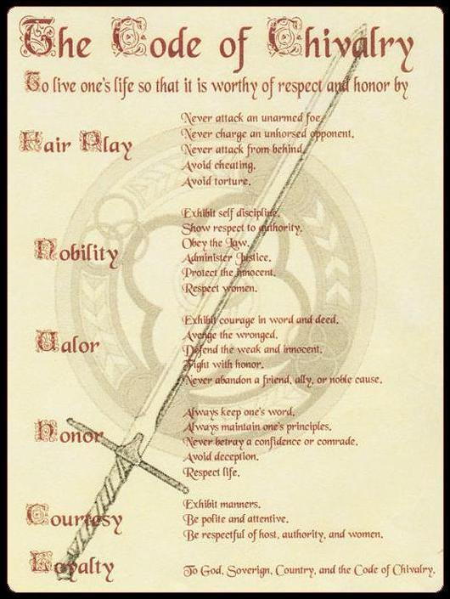
Fair Play
Never attack an unarmed foe
Never charge an unhorsed opponent
Never attack from behind
Avoid cheating
Avoid torture

Slide 14
Nobility
Exhibit self-discipline
Show respect to authority
Obey the law
Administer justice
Protect the innocent
Respect women

Slide 15
Valor
Exhibit courage in word and deed
Avenge the wronged
Defend the weak and innocent
Fight with honor
Never abandon a friend, ally, or noble cause

Slide 16
Honor
Always keep one’s word
Always maintain one’s principles
Never betray a confidence or comrade
Avoid deception
Respect life

Slide 17
Courtesy
Exhibit manners
Be polite and attentive
Be respectful of host, authority, and women
Loyalty
To God, Sovereign, country, and the Code of Chivalry

Slide 18
Sir Gawain's Shield
The ideals of Christian morality and knightly chivalry are brought together in Gawain’s symbolic shield.
The pentangle represents the five virtues of knights: friendship, generosity, chastity, courtesy, and piety.
Gawain’s adherence to these virtues is tested throughout the poem, but the poem examines more than Gawain’s personal virtue; it asks whether heavenly virtue can operate in a fallen world.

Slide 19
Setting up the story…
During a New Year's Eve feast at King Arthur's court, a strange figure, referred to only as the Green Knight, pays the court an unexpected visit.
He challenges the group's leader or any other brave representative to a game.

Slide 20
Setting up the story…
The Green Knight says that he will allow whoever accepts the challenge to strike him with his own axe, on the condition that the challenger find him in one year and a day to receive a blow in return.
Stunned, Arthur hesitates to respond, but when the Green Knight mocks Arthur's silence, the king steps forward to take the challenge.

Slide 21
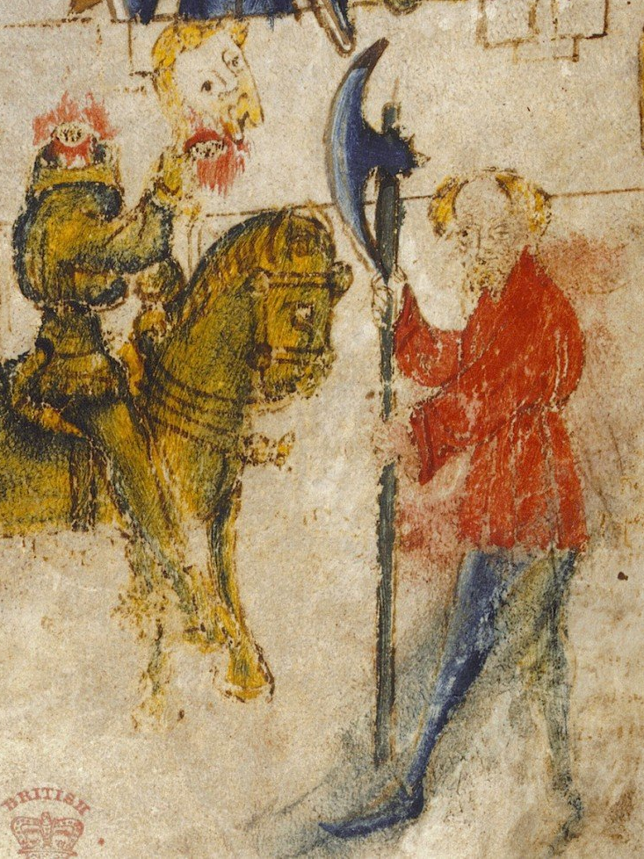
Setting up the story…
As soon as Arthur grips the Green Knight's axe, Sir Gawain leaps up and asks to take the challenge himself. He takes hold of the axe and, in one deadly blow, cuts off the knight's head.
To the amazement of the court, the now-headless Green Knight picks up his severed head.

Slide 22
Setting up the story…
Before riding away, the head reiterates the terms of the pact, reminding the young Gawain to seek him in a year and a day at the Green Chapel.
After the Green Knight leaves, the company goes back to its festival, but Gawain is uneasy……..and away we go from there!
The Green Knight Arrives
Reading the Challenge
(Stop at 2:14)
Gawain Accepts the Challenge

Slide 23
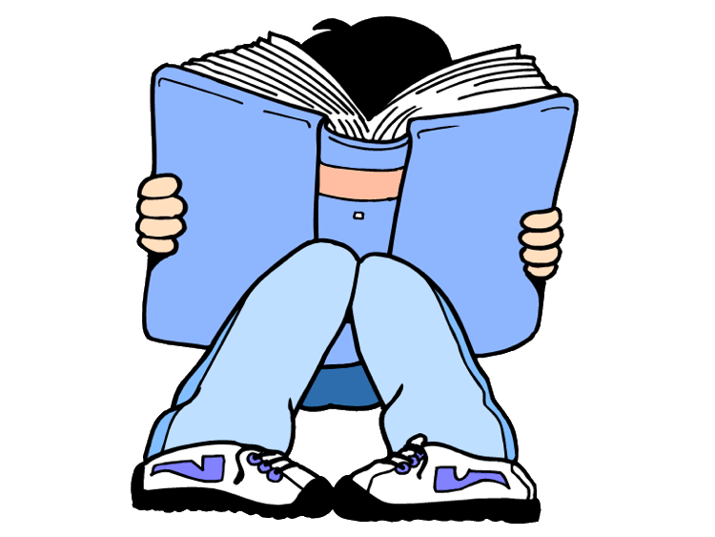
Turn to page 158 in your literature books for “Sir Gawain and the Green Knight.” Be sure to read all of the info on p. 158 before starting the excerpt.

