Slide 1
The Renaissance: 1485–1660 Introduction to the Literary Period
Feature Menu
Interactive Time Line
Milestone: Humanism
Milestone: Henry VIII Breaks with the Church
Milestone: The Reign of Elizabeth I
Milestone: The Defeat of the Spanish Armada
Milestone: Decline of the Renaissance
What Have You Learned?

Slide 2
The Renaissance: 1485–1660
Choose a link on the time line to go to a milestone.
1588
Defeat of the Spanish Armada
1534
Henry VIII Breaks with Church
1450
1500
1550
1600
1650
1700
1558–1603
Reign of Elizabeth I
1600s
Decline of the Renaissance
1500s Humanism

Slide 3
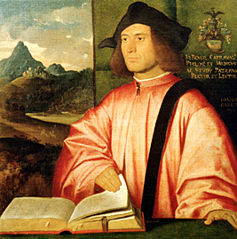
Humanism
Humanism—intellectual movement that greatly influenced Renaissance thinkers, writers, artists
The humanists
revived old Greek and Latin classics
studied the Bible and the classics to explore questions such as “What is a good life?”
made history, literature, and philosophy popular again
Notes:
QUESTIONS
• The Renaissance world was a Christian world. What objections might some people have raised to the revived interest in ancient Greek and Latin texts written before the time of Christ?
[Possible response: People might say that these old texts were pagan or heathen and couldn’t be any good for Christians to read. Others may have been worried that the ideas expressed in the texts would lead people astray from church teachings.]
• How do you think Renaissance scholars overcame this objection?
[Possible response: They also studied the Bible, and they looked for Christian ideas in the ancient texts. They used the ancient texts to support Christian teachings and to show that questions of morality and virtue were important to people of both ages.]
• How might reading ancient texts—about philosophy, rhetoric, ethics, and virtue—expand people’s understanding of the world?
[Possible response: These texts would offer people a different perspective about the world, one that wasn’t tied to Christian beliefs but that still dealt with issues of right and wrong, ethics, and proper behavior. They would also gain a better understanding of history.]
BACKGROUND
• The term renaissance—French for “rebirth”—refers particularly to the renewed interest in classical learning sparked by the writings of the humanists. The new intellectual movement led to a gradual renewal of the human spirit as well, a rebirth of curiosity and creativity. This new creative spirit started in Italy in the fourteenth century and spread across Europe.
• Unlike earlier educators, who had emphasized rote memorization, humanists stressed insight and reasoning.
• The humanists also established universities and libraries in order to foster the spread of classical studies; by the 1500s, there were about eighty universities in Europe.
• The movement took its name from the studia humanitatis (humane studies)—the fields of study we today call the humanities (philosophy, history, languages, literature, the arts).

Slide 4
Humanism
Two Friends—Two Humanists
Sir Thomas More
Desiderius Erasmus
English lawyer
Dutch monk
wrote Utopia
traveled throughout Europe
held important offices
taught Greek
beheaded by order of Henry VIII
Both men wrote in Latin; loved life, laughter, and classical learning; were dedicated to the church.
Notes:
BACKGROUND
• Defying custom, More taught Latin to his daughter Meg; few women in Renaissance Europe were given any kind of higher education.
• Book I of Utopia is a dialogue analyzing the social, economic, penal, and moral problems in England. Book II is a narrative describing Utopia. More coined the word utopia from the Greek words ou (“not”) and topos (“place”). Etymologically, therefore, utopia means “nowhere.” In Utopia, which is nowhere or nonexistent, poverty, crime, injustice, and other problems do not exist.
• Utopia became immediately popular. It has been translated into many languages, and hundreds of writers have imitated or parodied it. From the title of this work we get the word utopian, a useful adjective for describing impractical social schemes.
• More and Henry VIII were friends, and More became lord chancellor, one of the king’s chief ministers. After Henry broke with the Roman Catholic Church, More felt he could not legally recognize Henry as the head of the Church. For More’s stubbornness, Henry ordered that his lord chancellor be executed.

Slide 5
Humanism
Printing Press Plays Part in Spreading Humanist Ideas
Around 1455 . . .
printing press invented by Johannes Gutenberg
In 1476 . . .
press set up in England by William Caxton
By 1500 . . .
books widely available throughout western Europe
Notes:
QUESTIONS
• Before the invention of the printing press, all books were laboriously written out by hand. What can be assumed about writing books by hand?
[Possible response: Writing books by hand would be a slow and tedious task. It would also be very expensive. Because of the time and cost involved in producing books, I would assume that only the rich and powerful would have access to books.]
• After the invention of the printing press, books were more common and less expensive. What changes do you think began to happen now that more people could have books?
[Possible response: More books probably meant more people than ever before took the time to learn to read. People could learn about the things that interested them—literature, poetry, science, and so on. Writers could get their ideas out to more people than before.]
• The first complete book Gutenberg printed was a Latin Bible. Why does this choice make sense for this period in history?
[Possible response: The church was so important at this time—it had as much power as kings, and it united Europe in a common belief. So the Bible was probably the most widely read book and the most logical choice for the first book printed with this new technology.]

Slide 6
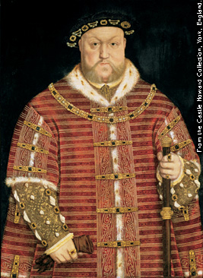
Henry VIII Breaks with the Church
Henry VIII (reigned 1509—1547)
“Renaissance man”—poet, musician, athlete
supported humanism
had six wives
created Royal Navy (ended foreign invasions, increased England’s power)
coarse and arrogant in his old age
Notes:
QUESTIONS
• Henry VIII is known as a Renaissance man. In addition to being a successful ruler, he wrote poetry, played musical instruments, and was an athlete and hunter and a patron of the arts. What does the term Renaissance man mean today?
[Renaissance man refers to someone who is well rounded, has knowledge of many different subjects, and has many different talents.]
BACKGROUND
• Henry’s six wives were Catherine of Aragon, Anne Boleyn, Jane Seymour, Anne of Cleves, Catherine Howard, and Catherine Parr. The fates of these women are summarized in a jingle:
Divorced, beheaded, died,
Divorced, beheaded, survived.

Slide 7
Henry VIII Breaks with the Church
The Reformation in Europe
In various countries . . .
reformers reject authority of pope and Italian churchmen
In Germany . . .
Martin Luther founds new kind of Christianity, based on personal understanding of Bible
In England . . .
strong national identity makes English people resent financial burdens imposed by Vatican
Notes:
QUESTIONS
• What does the word reform mean?
[Reform means “change for the better.”]
• Against the Roman Catholic Church’s wishes, Martin Luther translated the Bible into German. Why did this change in language matter?
[Possible response: Gutenberg’s Bible was in Latin, like nearly all the Bibles in England then, so only people who knew that language could read it or understand it when someone else read it aloud. But once people could read the Bible for themselves, they could also think for themselves about what it meant to them, without waiting for a priest to translate and explain.]
BACKGROUND
• This was a time of internal reform in the Church as well as a time of criticism by those who chose to break away. Pope Paul III, for example, convened the Council of Trent in 1545 to investigate the selling of indulgences, or religious pardons.
• Martin Luther founded the Lutheran Church. Soon other faiths, including the Anglican, Calvinist, and Anabaptist churches, sprang up. These faiths and the denominations that developed from them (such as Episcopalian, Methodist, and Presbyterian) have come to be called Protestant.
• In England during this time, humanists like Sir Thomas More and Desiderius Erasmus were ridiculing old superstitions as well as the ignorance and idleness of monks and the loose living and personal wealth of priests and bishops. In 1509, Erasmus wrote his satire, The Praise of Folly. In this work he makes fun of greedy merchants and mincing scholars, and suggests people return to a simple code of Christian ethics.

Slide 8
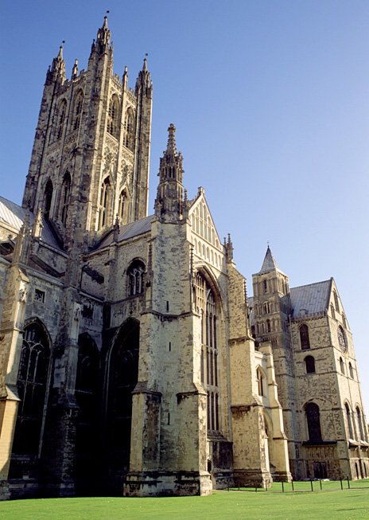
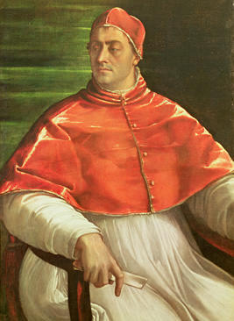
Henry VIII Breaks with the Church
1533
Pope refuses Henry VIII’s request for annulment
Henry appoints new archbishop of Canterbury, who grants annulment
1534
Henry declares himself head of the Church of England
Notes:
BACKGROUND
• Henry had two reasons for wanting to get rid of his Spanish wife, Catherine of Aragon: (1) she could not give him a male heir and (2) he had fallen for Anne Boleyn and now wanted to marry her.
• Divorce was not allowed, so Henry was looking for a loophole. He asked Pope Clement VII to declare that he was not properly married to Catherine because she had previously been married (for five months) to his now-deceased older brother, Arthur.
• The pope could not have granted the annulment, even if he had wanted to, because he was controlled by Queen Catherine’s nephew, the emperor of Spain.

Slide 9
Henry VIII Breaks with the Church
Annulment
An annulment cancels or puts an end to a marriage. The children of an annulled couple become illegitimate.
Divorce was not allowed, so Henry was looking for a loophole. He asked Pope Clement VII to annul his marriage, that is, declare that he was not properly married to Catherine of Aragon.

Slide 10
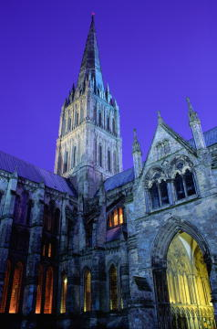
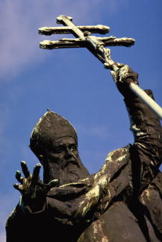
Henry VIII Breaks with the Church
Protestant Reformation After 1534
Henry closes monasteries
Protestantism begins in England
Some people want to
get rid of “popish” things (bishops, prayer book, priests’ vestments)
make religion solely a matter between the individual and God
Notes:
BACKGROUND
• The word Protestant was first used in April 1529. At that time, it was applied to a number of German protestors who disagreed with the Catholic majority’s decision to have Lutheranism condemned. Later, the word came to refer to anyone vocally “protest-ant” or to those who belonged to a Christian church or sect other than the Catholic or Orthodox Church.
• The vast majority of Henry’s subject’s agreed with Henry’s changes in the Church. There were, however, those who remained loyal to the pope as well as those who wanted greater reform.

Slide 11
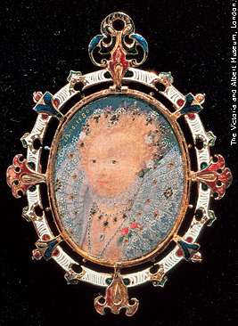
The Reign of Elizabeth I
Heirs of Henry
Edward VI (r. 1547–1553)
Elizabeth I (r. 1558–1603)
the “boy king”
rules in name only
the “virgin queen”
a brilliant, successful monarch
Mary Tudor (r. 1553–1558)
“Bloody Mary”
restores pope’s power
hunts down and executes Protestants
Notes:
QUESTIONS
• Mary Tudor was a devout Catholic and the daughter of the Spanish princess Catherine of Aragon, Henry’s first wife. What might have motivated Mary’s brutal treatment of Protestants?
[Possible response: As a devout Catholic, she probably would have disagreed with her father’s decision to break away from the Roman Catholic Church and thought he and other Protestants were heretics. Also, she was probably very angry about Henry and her mother’s divorce, and she may have wanted to avenge her mother in some way.]
BACKGROUND
• Edward was the son of Jane Seymour, Henry’s third wife.
• Elizabeth was the daughter of Anne Boleyn, Henry’s second wife, who had been executed.

Slide 12
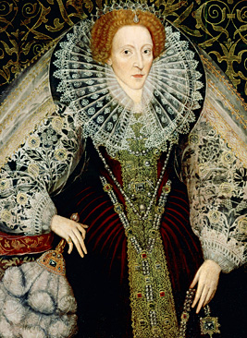
The Reign of Elizabeth I
Elizabeth I—literary connoisseur; beloved symbol of peace, security, prosperity
restores law and order
reestablishes Church of England; rejects pope’s authority
never marries
survives numerous assassination plots
Notes:
QUESTIONS
• Why do you think Elizabeth I never married?
[Possible response: If she had married, she probably would have lost some of her power to rule because she would have had to share it with her husband. Maybe she never met a royal suitor that she cared for enough to marry.]
BACKGROUND
• The fact that Elizabeth inherited a kingdom torn by fierce religious feuds makes her accomplishments all the more remarkable.
• Elizabeth was a person of wide learning and something of a writer herself.
• In the latter part of her reign, Elizabeth provided inspiration to scores of English authors, who represented her mythologically in poetry, drama, and fiction and dedicated works to her.

Slide 13
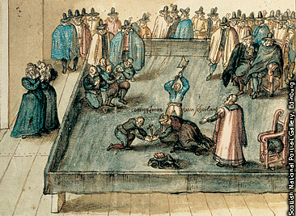
The Reign of Elizabeth I
Mary, Queen of Scots
Elizabeth’s cousin, heir to English throne
Catholic, deposed from throne in Scotland
initiates several plots to kill Elizabeth
In 1587 . . .
after enduring Mary and her plots for twenty years, Elizabeth sends her to the chopping block
Notes:
BACKGROUND
• Mary Stuart, Queen of Scots, was the daughter of a French mother and Henry VIII’s nephew, James V. Married to the aged Francis II of France, Mary returned to Scotland in 1560, after her husband’s death, to reclaim the throne of Scotland, which was still independent from England. Mary Stuart’s ties to France and Spain through family and religion made her a powerful threat to Elizabeth’s England.

Slide 14
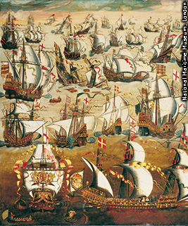
The Defeat of the Spanish Armada
1588
Vast fleet of warships from Spain (Spanish Armada) sent to invade England
England’s smaller ships defeat the Armada
Elizabeth’s finest moment
Assures England’s independence from Catholic countries of the Mediterranean
Notes:
QUESTIONS
• Spain was, at this time, a staunchly Roman Catholic country. What was at stake, beyond possession of the throne, when the Spanish Armada attempted to invade England?
[If Spain had been successful in its invasion, then it would have restored the power of the Roman Catholic Church in England. Getting England back would have increased the Church’s power, money, and influence.]
• The Spanish Armanda had been believed to be the greatest naval force of Europe. How do you think the defeat of the Spanish Armada made the people of Spain and England feel?
[Possible response: The Spanish probably felt embarrassed, shocked, and angry. The people of England probably felt proud of their country, excited about the victory, and more loyal to the Queen.]
BACKGROUND
• In the 1500s, Spain was the world’s wealthiest and most powerful nation. It saw itself as the defender of the Roman Catholic faith against the growing forces of Protestantism.
• At the time, the Spanish Armada was the largest fleet of ships that had ever been assembled. The Spanish expected to defeat the English fleet, which was composed of fewer and smaller ships. The English ships, however, were faster, so the English strategy was to scatter the Spanish fleet in order to gain an advantage. The English set ablaze eight small frigates and sailed them into the Armada, thereby scattering the Spanish ships and forcing them to retreat.
• England was also aided by nasty weather; heavy winds wrecked many Spanish ships off the coast of Ireland.
• In the end, only 67 of the 130 ships in the Armada returned to Spain.
• The defeat of the Spanish Armada was a great turning point in history. It was the most decisive event in England’s emergence as a naval power and independent political force in northern Europe. If Spain had prevailed, history would have been quite different: All of North America, like most of South America, might be speaking Spanish instead of English.

Slide 15
The Spanish Armada
The Armada was the largest fleet of ships ever assembled.
England set eight small frigates ablaze and sailed them into the Armada.
Heavy winds wrecked Spanish ships off the coast of Ireland.

Slide 16
Decline of the Renaissance
James I (r. 1603–1625)
1649–1660
benevolent but uninspiring ruler
patron of the arts
spendthrift
England ruled by Parliament and by the Puritan dictator Oliver Cromwell
Charles I (r. 1625–1649)
During this time . . .
remote, autocratic, self-destructive
beheaded by powerful subjects
Renaissance values gradually erode
Renaissance energies gradually give out
Notes:
QUESTIONS
• By the time Charles I came to power, the Puritans had risen to prominence, and their parliamentary party had gained power. By 1642, England was embroiled in civil war between the parliamentary party, led by Oliver Cromwell, and the Royalist party, led by the king. How do you think the British felt about the beheading of their king and the dissolution of the monarchy?
[Possible response: Both of these actions were revolutionary. Some people were probably happy to see the end of the king and monarchy because it signaled an opportunity for change. Others, however, were probably appalled by such a demonstration of revolution and worried about what the future might hold.]
BACKGROUND
• The reign of James is called the Jacobean period. (Jacobus is the Latin form of James.]

Slide 17
Decline of the Renaissance
spendthrift n. someone who is wasteful and lavish in his or her spending

Slide 18
What Have You Learned?
Match the achievement or description to the Renaissance ruler.
Elizabeth I
James I
Henry VIII
_________ established the Church of England, separate from the Roman Church
_________ benevolent ruler, patron of the arts, spendthrift
_________ united England so that it could achieve military victory over Spain
Henry VIII
James I
Elizabeth I

Slide 19
END

Slide 20
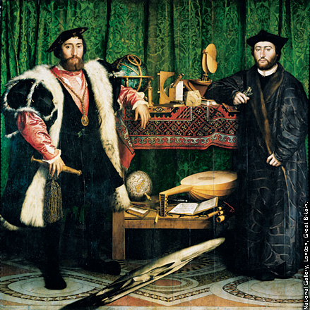
Viewing the Art
Renaissance Learning
The instruments shown in the painting suggest that the ambassadors have mastered astronomy, mathematics, and music.
Activity: The elongated object at the bottom is a skull, a symbol of death. What might it seem to say about the accomplishments of the ambassadors?
The Ambassadors (1533) by Hans Holbein the Younger. Oil on canvas.
Notes:
Possible response: Viewed from the extreme right, the elongated object looks like a skull, and the rest of the painting seems incoherent. The skull is a symbol of death. The message the skull brings to the painting may be that even great accomplishments in learning become meaningless in the face of death.

Slide 21
Notes:
Hans Holbein the Younger (c. 1497–1543) was born into a family of German artists. He gained a reputation in England and Switzerland as one of the most important portrait painters in northern Europe.

