Slide 1
Ralph Waldo Emerson
Transcendentalism & Self-Reliance

Slide 2
objective
Before you leave today, you will be able to identify some of the key ideas of Transcendentalism by examining some of the writings of Emerson.
What is Transcendentalism?
Who is Ralph Waldo Emerson?
What were some of the ideas Emerson advocated in his writings?

Slide 3
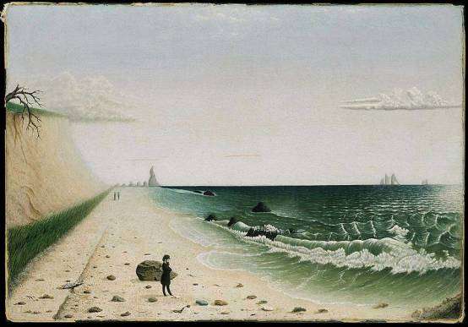
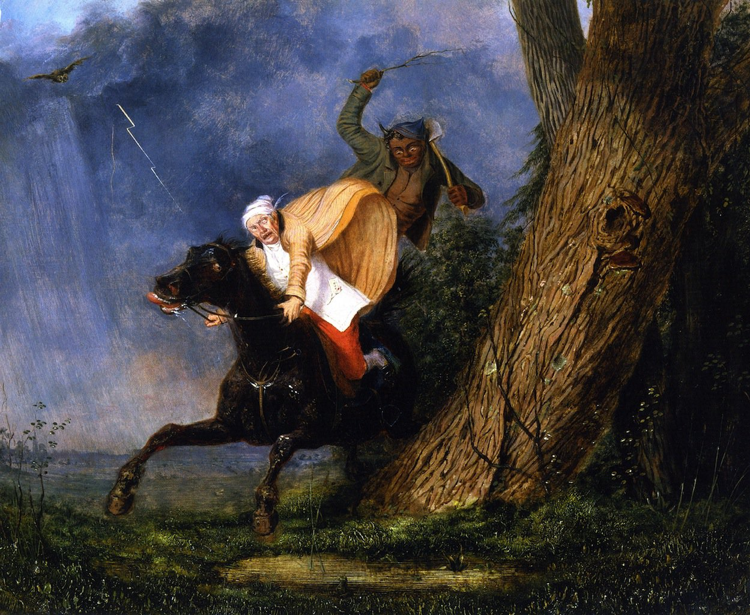
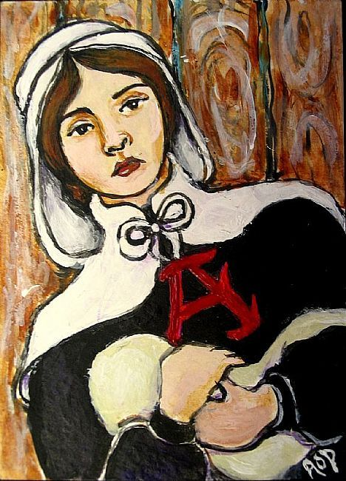
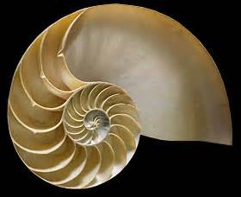
Romanticism
“The Tide Rises, The Tide Falls”
“The Devil and Tom Walker”
“Thanatopsis”
The Scarlet Letter
“The Chambered Nautilus”

Slide 4
Romanticism

Slide 5
transcendentalism
Root word?
If Romanticism focuses on
individualism,
inspiration in nature, &
intuition,
then you might think of Transcendentalism as
“extreme Romanticism.”
You will see those same ideas, plus one more “I” word—
Idealism.

Slide 6
transcendentalism
Idealistic philosophy, spiritual position, and literary movement that advocates reliance on romantic intuition and moral human conscience
Belief that humans can intuitively transcend the limits of the senses and of logic to a plane of 'higher truths'
Value spirituality (direct access to benevolent God, not organized religion or ritual), divinity of humanity, nature, intellectual pursuits, social justice

Slide 9
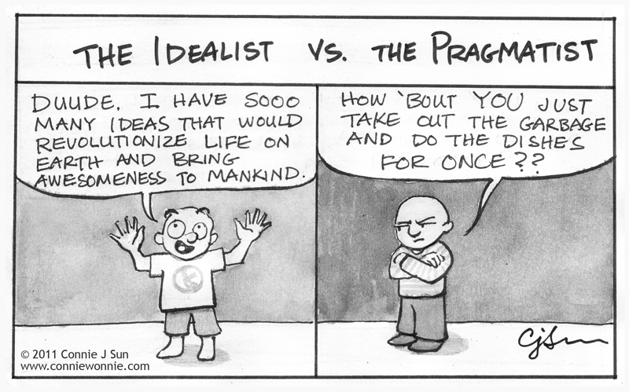

Slide 10
Ralph Waldo Emerson
Born May 25, 1803, in Boston, MA
Descended from a line of clergymen
Attended the Boston Latin School, followed by Harvard University (from which he graduated in 1821) and the Harvard School of Divinity
Licensed as a minister in 1826 and ordained to the Unitarian church in 1829

Slide 11
Emerson’s change
He married Ellen Tucker in 1829, but she she died of tuberculosis in 1831.
Grief-stricken and struggling with his faith, he resigned from the clergy.
In 1832, he traveled to Europe, where he met with influential literary figures such as William Wordsworth.
When he returned home in 1833, he began to lecture on topics of spiritual experience and ethical living.
He married Lydia Jackson in 1835.
Lydia Jackson Emerson

Slide 12
Emerson the Transcendentalist
The central figure of his literary and philosophical group, now known as the American Transcendentalists.
Key belief - each individual could transcend, or move beyond, the physical world of the senses into deeper spiritual experience through free will and intuition.
God is not remote and unknowable; believers understood God and themselves by looking into their own souls and by feeling their own connection to nature.

Slide 13
Emerson in the 1840s
Founded and co-edited the literary magazine The Dial
Published two volumes of essays in 1841 and 1844 (including “Self-Reliance”)
Had four children—two sons and two daughters

Slide 14
Emerson’s Later LIfe
The Conduct of Life (1860) favored a more moderate balance between individual nonconformity and broader societal concerns.
He advocated for the abolition of slavery and continued to lecture across the country throughout the 1860s.
By the 1870s the aging Emerson was known as “the sage of Concord.”
Despite his failing health, he continued to write, publishing Society and Solitude in 1870 and a poetry collection titled Parnassus in 1874.
Emerson died on April 27, 1882, in Concord.
His beliefs and his idealism were strong influences on the work of his protégé Henry David Thoreau and his contemporary Walt Whitman, as well as numerous others. His writings are considered major documents of 19th-century American literature, religion and thought.

Slide 15
Self-reliance
On whom or what should people rely to make choices in life?
What is “self-reliance”? Who has it?
At what age and/or in what types of situations does one become self-reliant?
When is it good to be self-reliant? When or in what situations is it bad or not important to be self-reliant?

Slide 17
From Self-Reliance – pg. 225
In your group, have one group member read the first paragraph aloud.
At the end of the first paragraph, stop and on a sheet of paper, record a “tweet” for that paragraph. You can create the tweet based on the ideas in the paragraph, or you can use a direct quote from the paragraph that you feel would make a good tweet because it concisely expresses an inspirational truths or nugget of wisdom.
After your group has recorded a “tweet” for paragraph one, have someone else in the group read the second paragraph, and repeat the process.
Remember you’re trying to identify some of the key ideas of Emerson’s essay so that we can begin to identify some characteristics of Transcendentalism. At the end of the activity, we will share some of our tweets to see what Emerson’s ideas about Self-Reliance were.

Slide 18
Revisit the objective
Before you leave today, you will be able to identify some of the key ideas of Transcendentalism by examining some of the writings of Emerson.
What is Transcendentalism?
(Write at least two characteristics on the bottom of your Tweet Sheet.)
Who is Ralph Waldo Emerson?
(In a complete sentence, identify Emerson and his significance in American literature.)
What were some of the ideas Emerson advocated in his writings?
(In your own words, what are at least two main ideas from the passage read today.)

Slide 19
Exit Slip
On a post-it, write your name. Then, write one key idea you got from Emerson’s “Self-Reliance” and a short response to that idea.
Ideas for response:
Do you agree or disagree? Why?
Does this idea remind you of something else we’ve read?
Does this idea remind you of something from your personal experience?
Would you follow “Dr. Ralph” on Twitter? Who else do you think would follow him?
On the front bulletin board is a numbered grid. Stick your post-it on the square containing your number before you leave.

