Slide 1
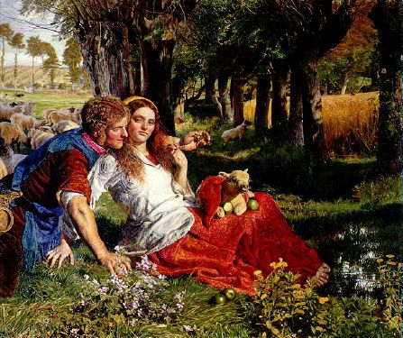
The Passionate Shepherd to His Love & The Nymph’s Reply to the Shepherd

Slide 2
Pastoral
From pastor, Latin for “shepherd”
Set in an idealized countryside
Characters are often blends of the naïve and the sophisticated
Most famous of all English pastorals – “The Passionate Shepherd to His Love” by Christopher Marlowe

Slide 3
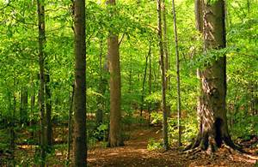
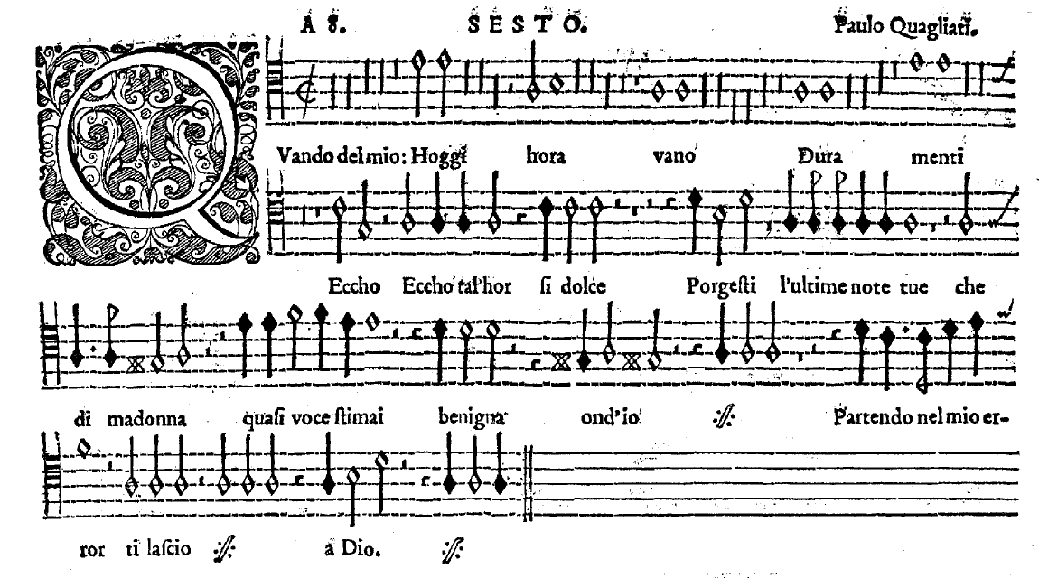
Grove
Madrigal

Slide 4
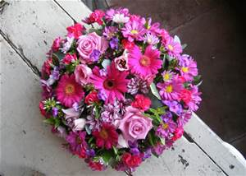
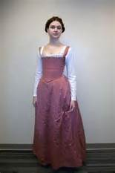
Posies
Kirtle

Slide 5
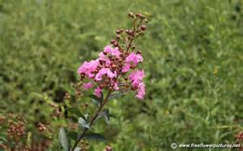
Myrtle
Madrigal

Slide 6
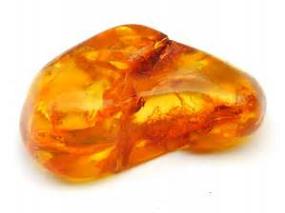
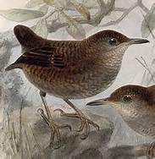
Amber
Philomel

Slide 7
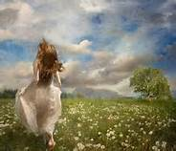
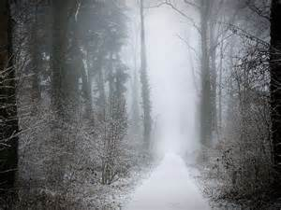
Wanton fields
Wayward winter reckoning

Slide 8
Heart of gall
Folly

