Slide 1
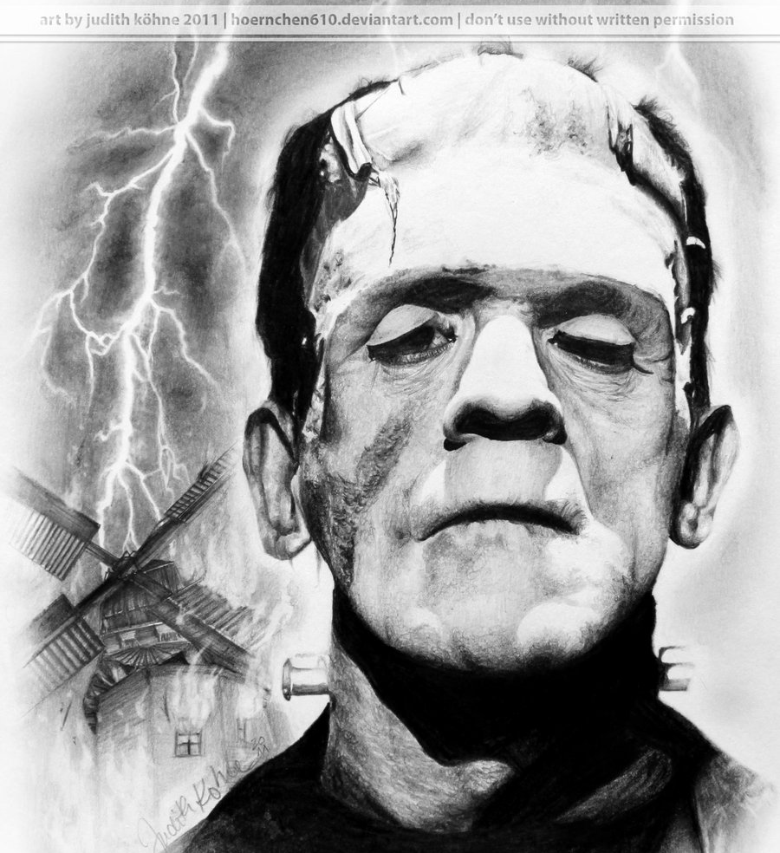
Mary Shelley’s Frankenstein
This Photo by Unknown Author is licensed under CC BY-NC-ND

Slide 2
Mary Wollstonecraft Shelley
Daughter of two of England’s leading intellectual radicals.
Her father, William Godwin, was an influential political philosopher and novelist.
Her mother, Mary Wollstonecraft, the author of A Vindication of the Rights of Woman, was a pioneer in promoting women’s rights and education.
Her future husband, the admired poet Percy Shelley, was one of her father’s frequent visitors.
When she was sixteen, she and Percy eloped to France.
She gave birth to four children in five years, three of whom died as infants.
Percy died eight years later, due to a boating accident.

Slide 3
The “Birth” of Frankenstein
When Mary was nine, she hid under a sofa to hear Samuel Taylor Coleridge recite his poem “The Rime of the Ancient Mariner”, which later influenced her as she developed her ideas for Frankenstein.
Due to the loss of her children, many critics have pointed out that thoughts of birth and death were much on Shelley’s mind at the time she wrote Frankenstein.
Summer of 1816
Mary and Percy Shelley were living near the poet Lord Byron and his doctor-friend John Polidori on Lake Geneva in the Swiss Alps.
During a period of incessant rain, the four of them were reading ghost stories to each other when Byron proposed that they each try to write one.
For days Shelley could not think of an idea. Then, while she was listening to Lord Byron and Percy discussing the probability of using electricity to create life artificially, according to a theory called galvanism, an idea began to grow in her mind: Perhaps a corpse would be re-animated; galvanism had given token of such things: perhaps the component parts of a creature might be manufactured, brought together, and [endued] with vital warmth.
The next day she started work on Frankenstein. A year later, she had completed her novel. It was published in 1818, when Shelley was nineteen years old.

Slide 4
“Rime of the Ancient Mariner”
A seven-part poem written by Samuel Coleridge, a friend of Mary Shelley's father, it is often alluded to in Frankenstein, and has much influence over the story. According to accounts, Mary Shelley would stay up late at night to hear Coleridge himself recite the poem at her house.
This epic poem is about a mariner who, after killing an albatross--a sea bird of good luck, undergoes a torturing experience that is meant to be punishment for his deeds. Mary Shelley alludes to the albatross in her story, and the idea of an outcast scorned and enduring suffering is again repeated. The sailor learns (through spiritual and supernatural events) to respect the sea (the natural world). His disregard for nature and tradition leads to his and every other sailor’s demise.

Slide 5
“The Modern Prometheus”
Prometheus
In Greek mythology, he was a titan who created man in the image of the gods.
Stole the gift of fire from Mt. Olympus and gave it to man
Punished by Zeus and chained to a rock on a mountain. Every day for 30 years, Zeus’ eagle would eat his liver.

Slide 6
Elements of the Gothic Novel
Setting in a castle
An atmosphere of mystery and suspense
An ancient prophecy
Omens, signs, visions
Supernatural or otherwise inexplicable events
High, even overwrought emotion
Women in distress
Women threatened by a powerful, impulsive, tyrannical male
Atmosphere of gloom and horror

Slide 7
Romanticism
1798-1832
Movement contrary to Enlightenment and Industrialization which emphasized how man’s reason and logic can improve society
Emphasized the importance of the individual, subjectivity, imagination, and expression of emotions

Slide 8
Romantic Quest
During the Romantic period, a journey to find one’s self through nature, isolation, and meditation
Natural science should lead to discovery
Could be a physical journey or a mental, psychological, or spiritual one

Slide 9
Epistolary
A story told by means of a series of letters
Purpose is to suspend disbelief

Slide 10
Frame Story

Slide 11
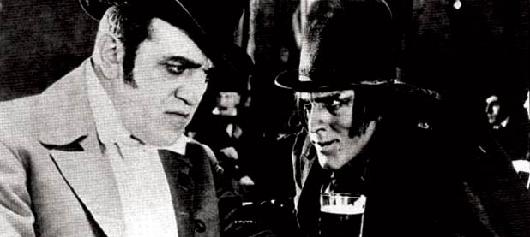
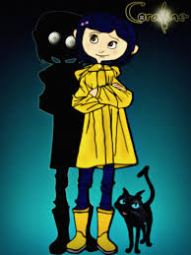
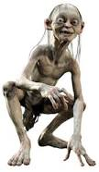
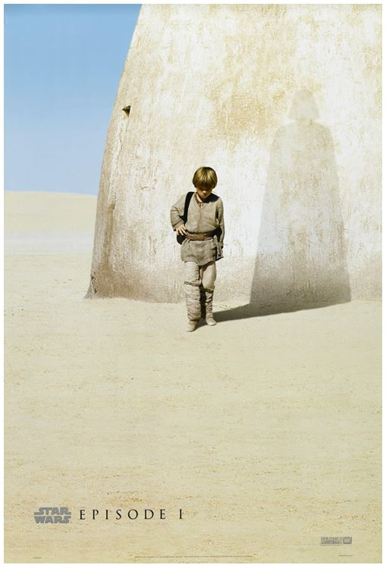
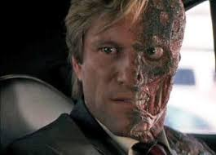
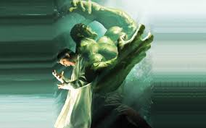
Doppelgangers… Which is the Man? Which is the Monster?
This Photo by Unknown Author is licensed under CC BY-SA

