Slide 1
Levels of Questions
Levels 1, 2, & 3

Slide 2
Three Levels of Questions
There are 3 levels of questions you can ask about a text:
Level 1: Recall
Level 2: Analyze/Inference
Level 3: Synthesis
Think about the story Cinderella. We will use this as our sample "text" to illustrate the different levels of questions.

Slide 3
An excerpt from Cinderella ...
A rich man's wife became sick, and when she felt that her end was drawing near, she called her only daughter to her bedside and said, "Dear child, remain pious and good, and then our dear God will always protect you, and I will look down on you from heaven and be near you." With this she closed her eyes and died.
The girl went out to her mother's grave every day and wept, and she remained pious and good. When winter came the snow spread a white cloth over the grave, and when the spring sun had removed it again, the man took himself another wife.
This wife brought two daughters into the house with her. They were beautiful, with fair faces, but evil and dark hearts. Times soon grew very bad for the poor stepchild.
"Why should that stupid goose sit in the parlor with us?" they said. "If she wants to eat bread, then she will have to earn it. Out with this kitchen maid!"

Slide 4
Level 1 - Recall
Level 1 questions often:
clarify vocabulary or basic facts
check for understanding
ask for more information
deal with the "What? Who? Where?"
The answer is usually “right there” in the text.
There is usually one correct answer.

Slide 5
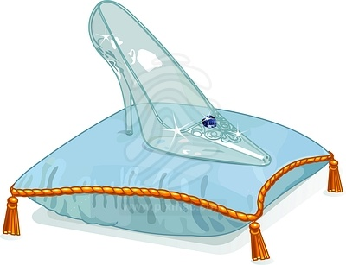
Sample Level 1 Questions - Cinderella
With whom did Cinderella live?
What did Cinderella lose on the palace steps?
What were Cinderella's slippers made out of?
How did Cinderella get to the ball?
What is the meaning of "pious" in paragraph 2?
"The girl went out to her mother's grave every day and wept, and she remained pious and good. "

Slide 6
Level 2 - Analysis
Level 2 questions often:
analyze the text
interpret the text
deal with the How? and Why?
have more than one answer
Answer is understood though not directly expressed.
Answer may be found BETWEEN the lines, requiring us to make an inference.

Slide 7
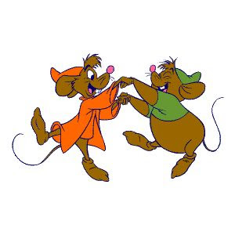
Sample Level 2 Questions - Cinderella
Why does Cinderella get special treatment from the fairy godmother?
Why does the stepmother hide Cinderella when the prince comes?
Why is Cinderella treated differently than her stepsisters?
How is the setting used symbolically?
How is the metaphor of the "white cloth" effective? What does it express about the man's grief?
"When winter came the snow spread a white cloth over the grave, and when the spring sun had removed it again, the man took himself another wife."

Slide 8
Level 3 - Synthesis
Level 3 questions often:
Apply to the bigger world
Have no right or wrong answers
Provoke thinking and feeling
Deal with values and opinions
There are multiple answers and perspectives. Some may seem to have no definitive answer and may remain "questions" with multiple possibilities.
Answers are BEYOND the lines and connect to the world outside the book.

Slide 9
Sample Level 3 Questions - Cinderella
Is there such a thing as “love at first sight”?
Does a woman need to marry a prince in order to find happiness?
Are we responsible for our own happiness?
What does it mean to live happily ever after?
Does good always overcome evil?
"When she stood up the prince looked into her face, and he recognized the beautiful girl who had danced with him. He cried out, 'She is my true bride.'"

