Slide 1
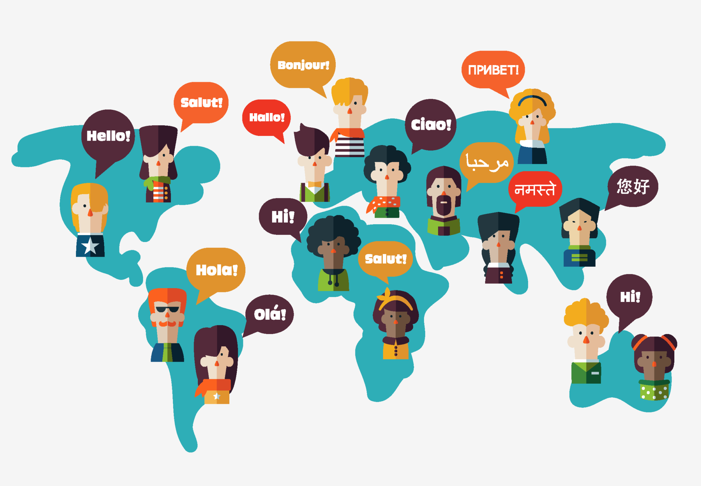
The Language Closest to English
Top 10 Most Commonly Spoken Languages in the World

Slide 2
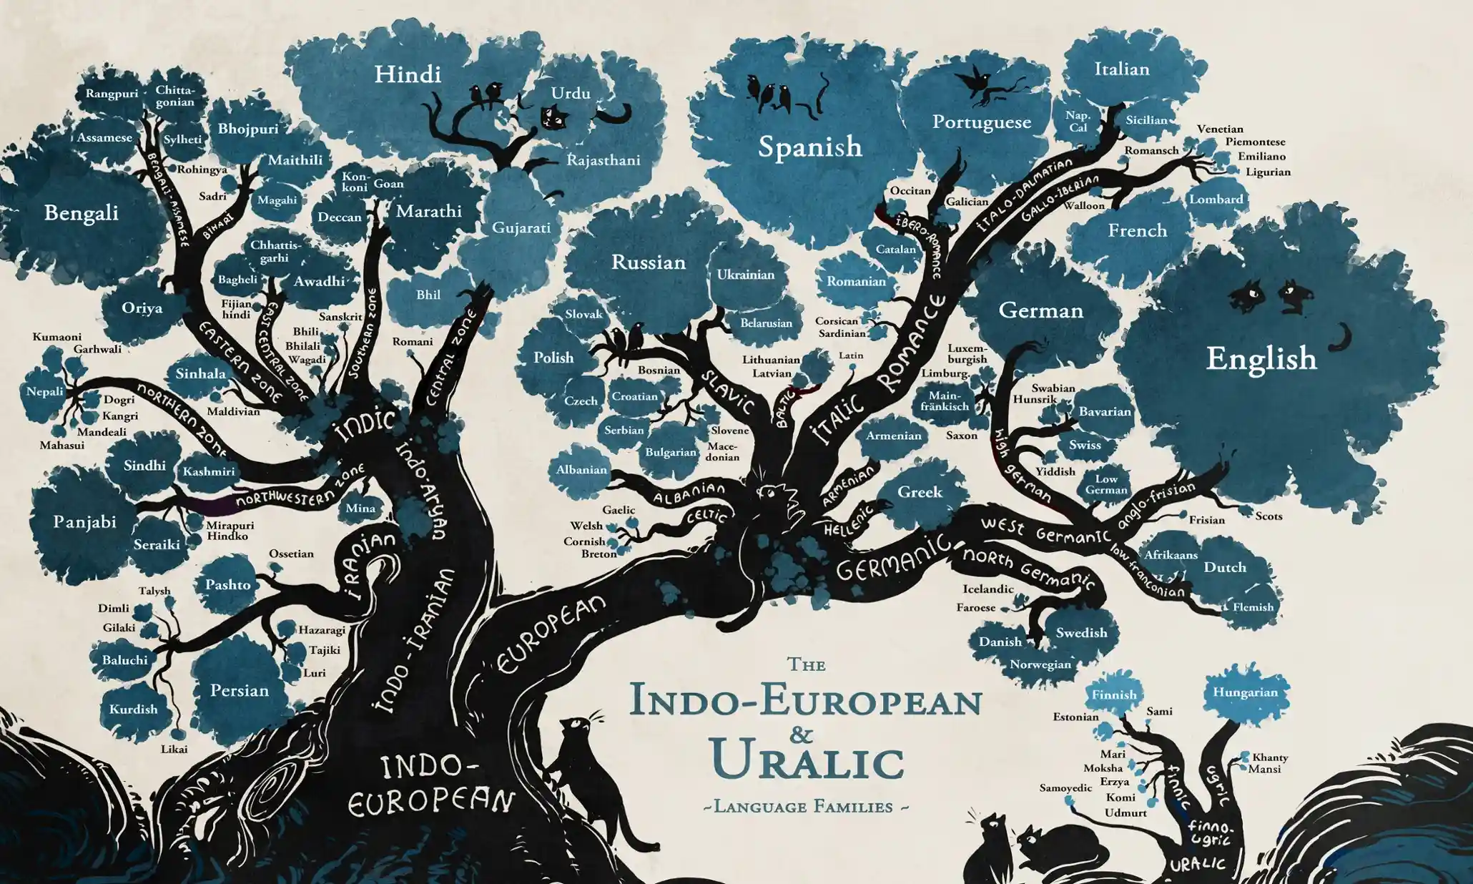

Slide 3
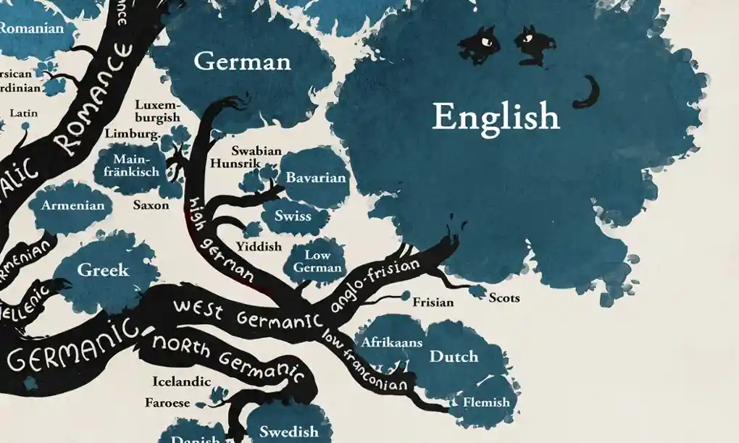

Slide 4
Scots
The closest language to English is Scots . . . assuming you consider Scots a language, that is. According to a 2010 study by the Scottish government, a majority (64%) of Scottish people don’t.
The UK government classifies it as a regional language, and it is protected under the European Charter for Regional or Minority Languages.
Scots began to diverge from English as far as back as the Middle English period.

Slide 5
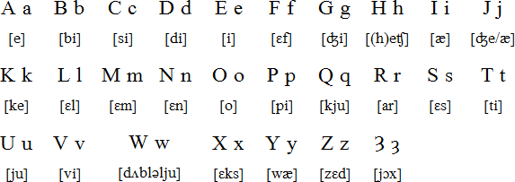
Fast Facts About the Scots Language
Scots is spoken by about 1.5 million people
Technically, the Scots alphabet has one more letter than the English alphabet. The last letter, called yough, looks like a backward “3.” The letter “z” usually replaces it.
Scots has been primarily an oral language for so long that it does not have a standard spelling system.

Slide 6
How easy is it for an English speaker to read Scots? Try it for yourself!
Aw human sowels is born free and equal in dignity and richts. They are tochered wi mense and conscience and shuld guide theirsels ane til ither in a speirit o britherheid.
Got that? It’s Article 1 of the Universal Declaration of Human Rights. Here’s the English translation:
All human beings are born free and equal in dignity and rights. They are endowed with reason and conscience and should act towards one another in a spirit of brotherhood.

Slide 7
Frisian
Frisian is actually a group of 3 languages spoken in parts of the Netherlands, Denmark, and Germany.
English, Scots, and the Frisian languages are the only living members of the Anglo-Frisian language group.

Slide 8
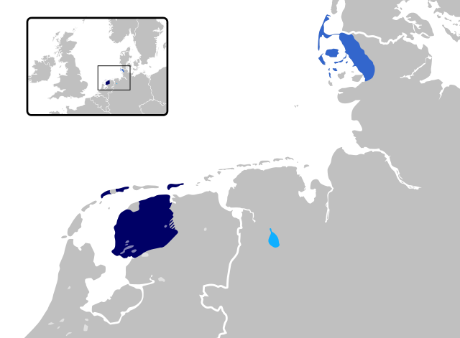
Fast Facts about Frisian
In the Middle Ages, Frisian was spoken all along the southern coast of the North Sea.
The Frisians shared a common ancestry and a mutually intelligible language with the Angles, Saxons, and Jutes who settled England.
Frisian was used as a written language until around 1500, when Dutch became the language of government in most Frisian lands. However, Frisians continued to speak the language even when they didn’t write it. Frisian writers and poets revived the written language in the 19th century.
Today, there are about 480,000 Frisian native speakers.

Slide 9
English/Frisian comparison
And here's the first article of the Universal Declaration of Human Rights, this time in West Frisian:
Alle minsken wurde frij en gelyk yn weardigens en rjochten berne. Hja hawwe ferstân en gewisse meikrigen en hearre har foar inoar oer yn in geast fan bruorskip te hâlden en te dragen.
And again, the English translation:
All human beings are born free and equal in dignity and rights. They are endowed with reason and conscience and should act towards one another in a spirit of brotherhood.

Slide 10
Dutch
You might have heard that Dutch is the closest language to English. Indeed, it’s the closest “major” language and is sometimes said to be “in-between” English and German.
Because it’s so closely related to English, Dutch is one of the easiest languages for English speakers to learn.

Slide 11
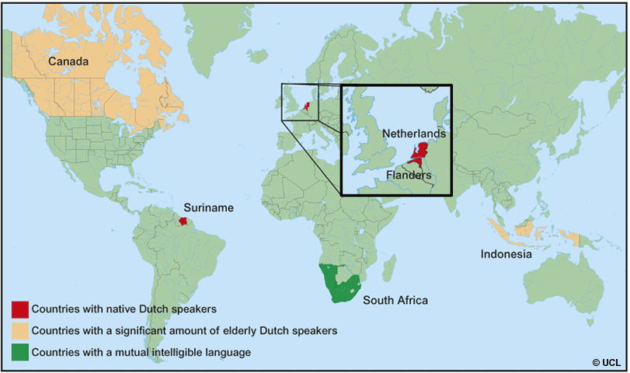
Fast Facts about Dutch
There are 23 million Dutch speakers in the world.
Dutch is spoken mainly in the Netherlands, Belgium and Suriname, as well as parts of France and some parts of the Caribbean.
Dutch is mutually intelligible with Afrikaans, but Afrikaans is considered a separate language.
US President Martin van Buren was from a Dutch family and spoke Dutch, not English, as his first language.
The longest word in the Dutch dictionary is “meervoudigepersoonlijkheidsstoornissen,” or “multiple personality disorders.” It is 38 letters long!

Slide 12
English/Dutch comparison
And here's the first article of the Universal Declaration of Human Rights, this time in Dutch:
Alle mensen worden vrij en gelijk in waardigheid en rechten geboren. Zij zijn begiftigd met verstand en geweten, en behoren zich jegens elkander in een geest van broederschap te gedragen.
And again, the English translation:
All human beings are born free and equal in dignity and rights. They are endowed with reason and conscience and should act towards one another in a spirit of brotherhood.

Slide 13
German
German is also closely related to English. English is, after all, a Germanic language.
German is spoken primarily in Germany, but it’s also officially recognized in other localities around the world, even places as far-flung as Brazil.

Slide 14
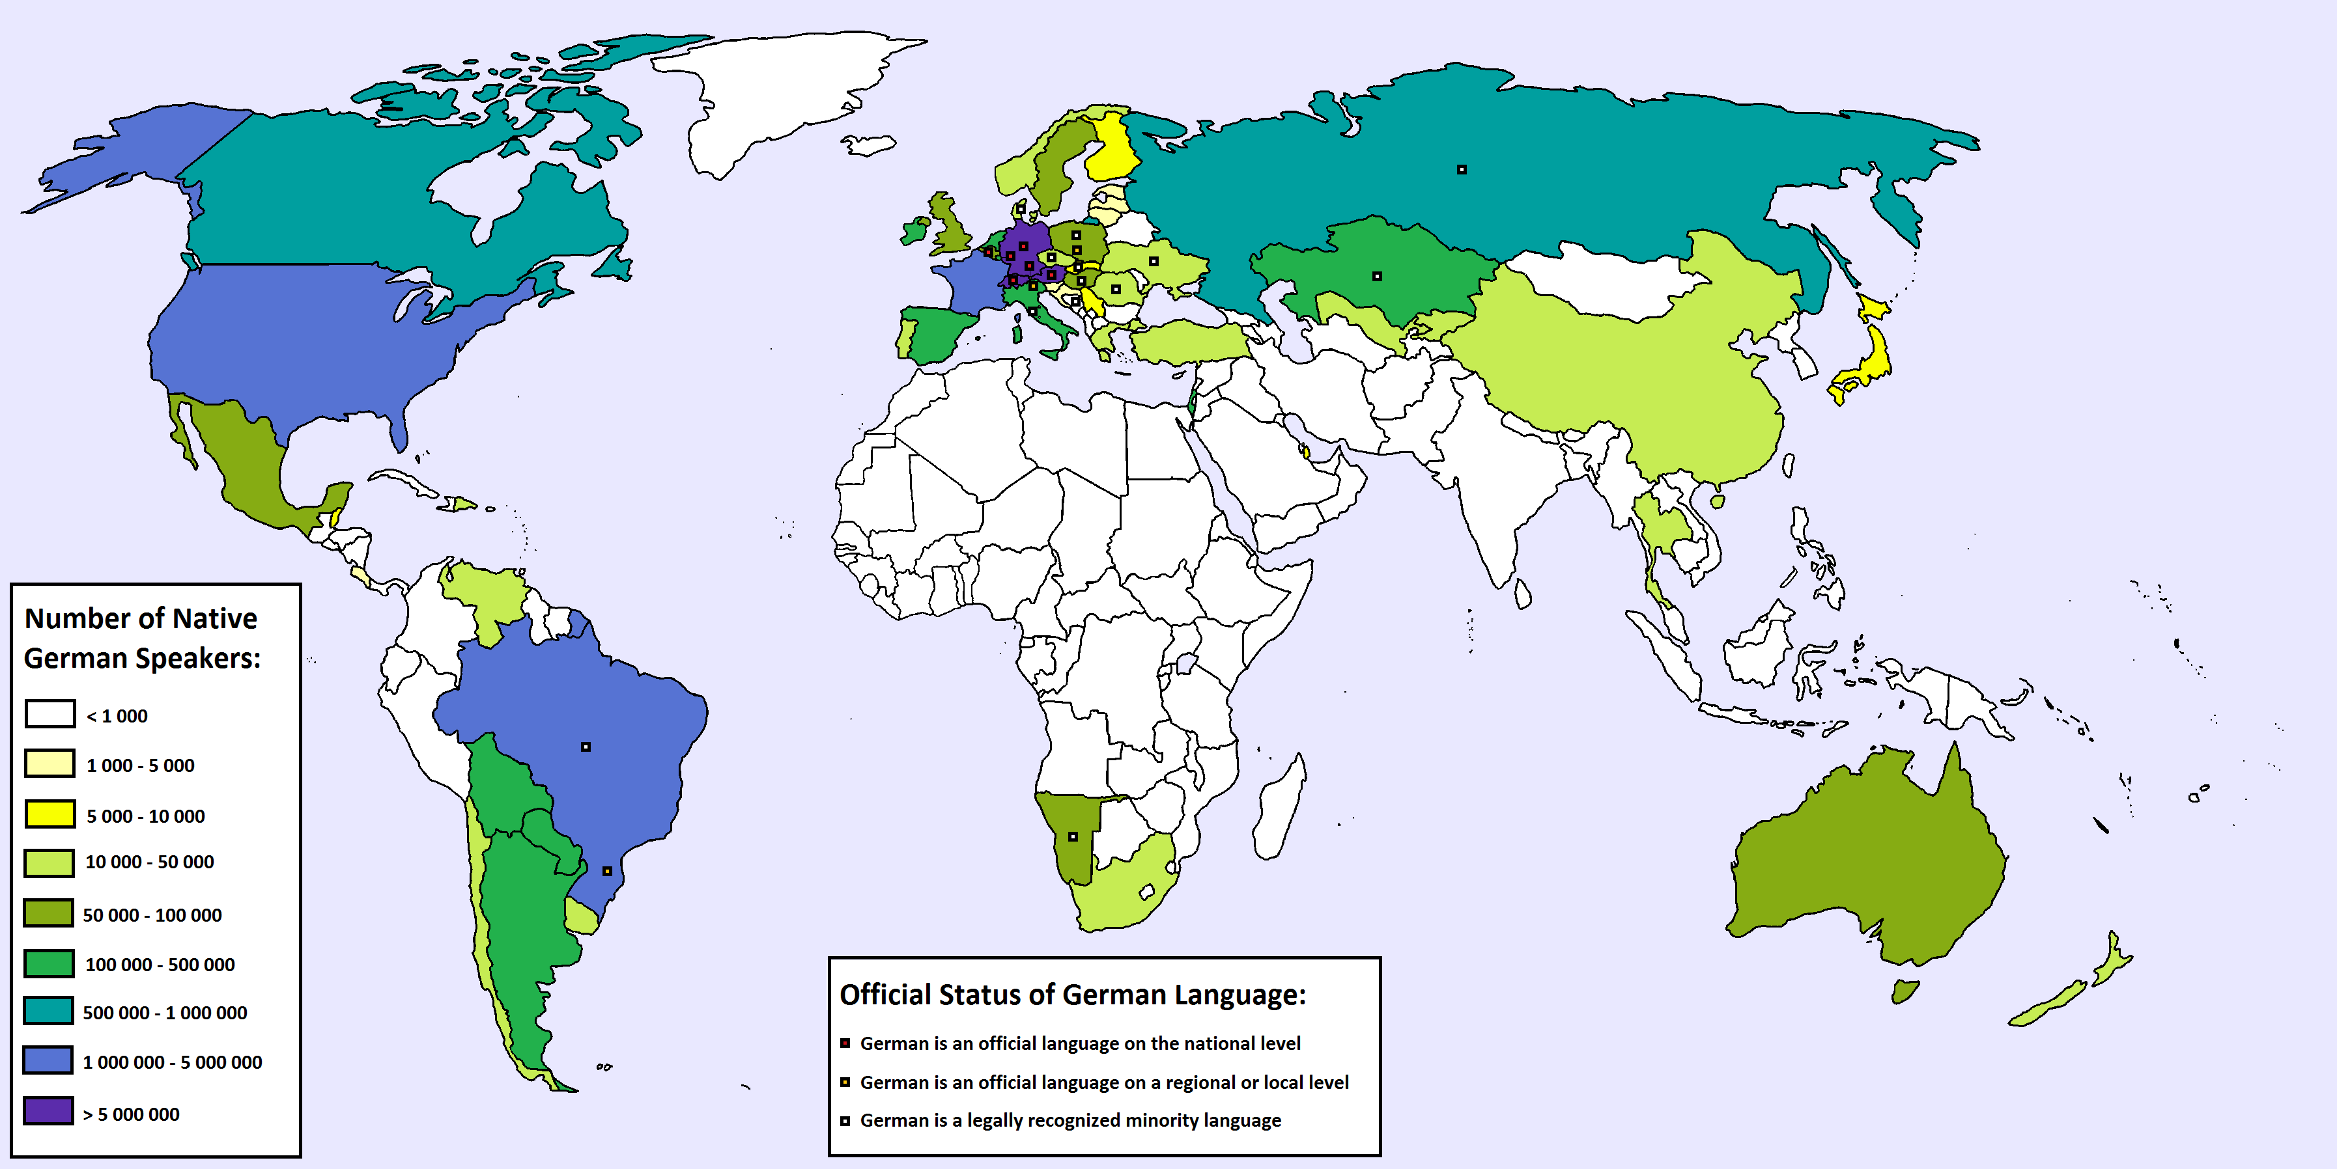
Fast Facts about German
German is the second-most commonly spoken Germanic language. The most common, of course, is English.
It has 95 million native speakers.
Some people think it sounds angry.
The first printed book, the Gutenberg Bible, is in German.

Slide 15
English/German comparison
And here's the first article of the Universal Declaration of Human Rights, this time in German:
Alle Menschen sind frei und gleich an Würde und Rechten geboren. Sie sind mit Vernunft und Gewissen begabt und sollen einander im Geist der Brüderlichkeit begegnen.
And again, the English translation:
All human beings are born free and equal in dignity and rights. They are endowed with reason and conscience and should act towards one another in a spirit of brotherhood.

Slide 16
Does language matter?

Slide 17
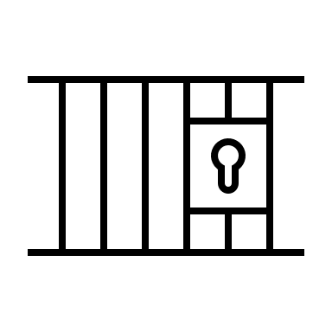
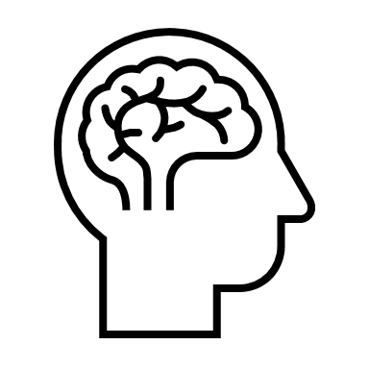
Think of all the ways we use language…
Intimidate
Inspire
Educate
Control
Apologize
Flirt
Insinuate
Read
Understand
Write
Argue
Progress
Comfort
Manipulate
Hurt
Deceive
Flatter
Encourage
Inform
Negotiate

Slide 18
Linguistics
The scientific study of language
How does the human capacity for language/communication actually work...
In the brain
In society
In child development
Across cultures
Across time

Slide 19
Does language matter?
Alex Shashkevich, Stanford University

Slide 20
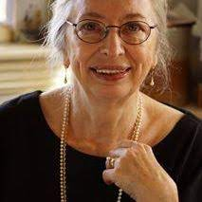
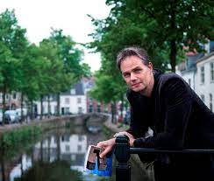
There are two sides to every story.
Frisian woman:
“School and church was in Dutch, but otherwise it was all Frisian.”
“There are Dutch people here, Dutch groups of people here, pretty snobbish…. Dutch people can be sort of stuck up.”
Dutch man:
“I get a bit tired sometimes by Frisians going on about how special their language is.”
“The typical wording that you hear is that Frisian is a language while the other reasonable lingos are mere dialects. That is just not true.”
Host:
There’s a theme here. Frisians and other Dutch people, they don’t seem to like each other that much.

Slide 21
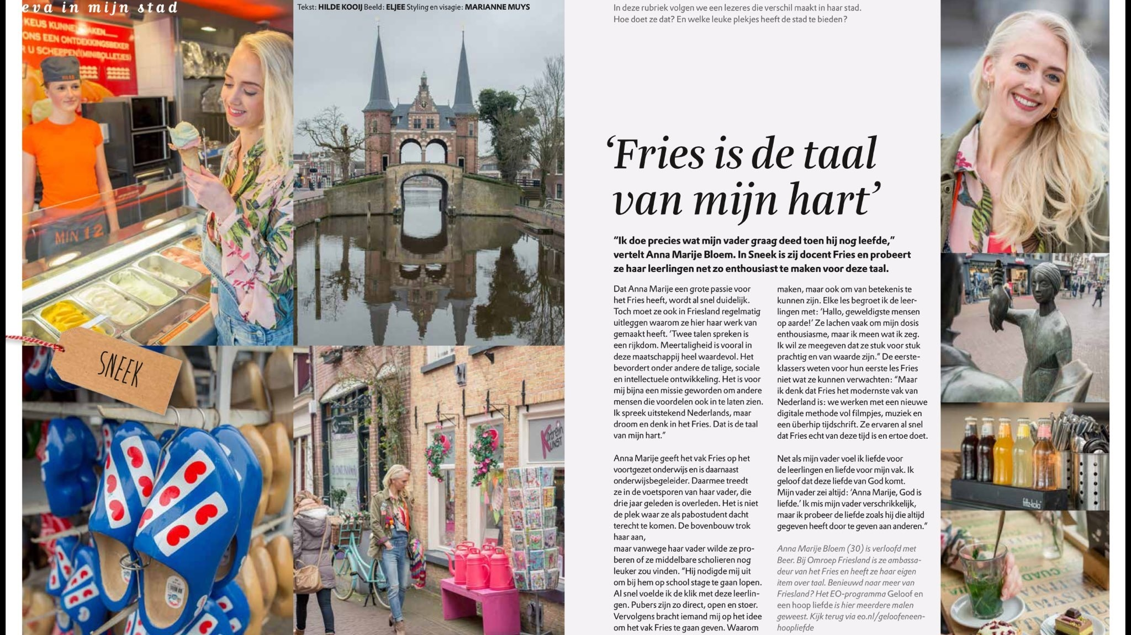
Two views of Frisians
Frisian – dialect or language?
Frisian people – stubborn? defending and preserving their identity/heritage?

Slide 22
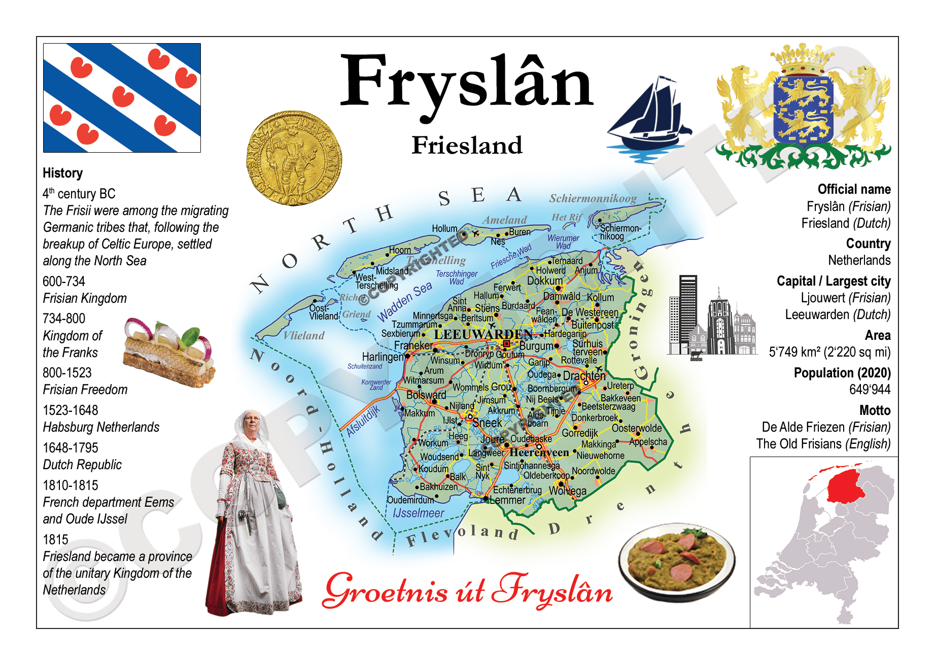
So what’s the problem?
“Of course, in its heyday 1400 years ago, Frisian didn’t have official status. People just spoke it. and because the Frisians were fantastically successful at buying and selling stuff, they became rich, and other people want a bit of the action. So they started speaking Frisian too.
“Then, . . . along came the Dutch. They were getting rich themselves and they didn’t want to speak Frisian. They wanted to speak Dutch.
“School was in Dutch, that was the language of instruction. In the large towns, people mainly spoke Dutch. Frisian was pushed into the villages, the farms, homes.”

Slide 23
The Language of Power
https://www.ucl.ac.uk/atlas/dutch/who.html

Slide 24
Colonization
Language is often a central question in postcolonial studies. During colonization, colonizers usually imposed their language onto the peoples they colonized, forbidding natives to speak their mother tongues. In some cases, colonizers systematically prohibited native languages. Many writers educated under colonization recount how students were demoted, humiliated, or even beaten for speaking their native language in colonial schools. (Shakib 1).

Slide 25
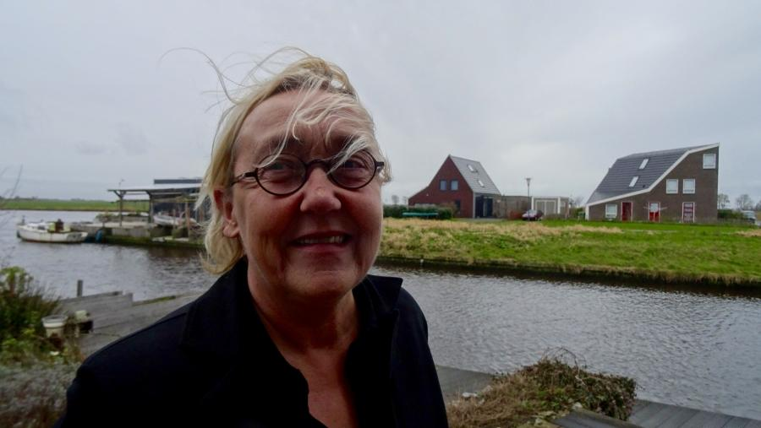
Language Activism
“Clubbing Friday” - police action in response to a group of demonstrators at the trial of a Frisian man
Lutz Jacobi – member of Parliament who spoke in Frisian at the swearing-in of the new King of the Netherlands, Willem-Alexander, in 2013

Slide 26
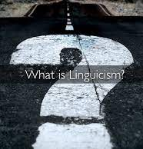
But that’s in the Netherlands…
Linguicism is discrimination based on language or dialect: linguistically argued racism. It's also known as linguistic discrimination. The term was coined in the 1980s by linguist Tove Skutnabb-Kangas, who defined linguicism as "ideologies and structures that are used to legitimate, effectuate and reproduce an unequal division of power and resources between groups which are defined on the basis of language."
Can you think of ways that “linguicism” manifests in the United States?

Slide 27
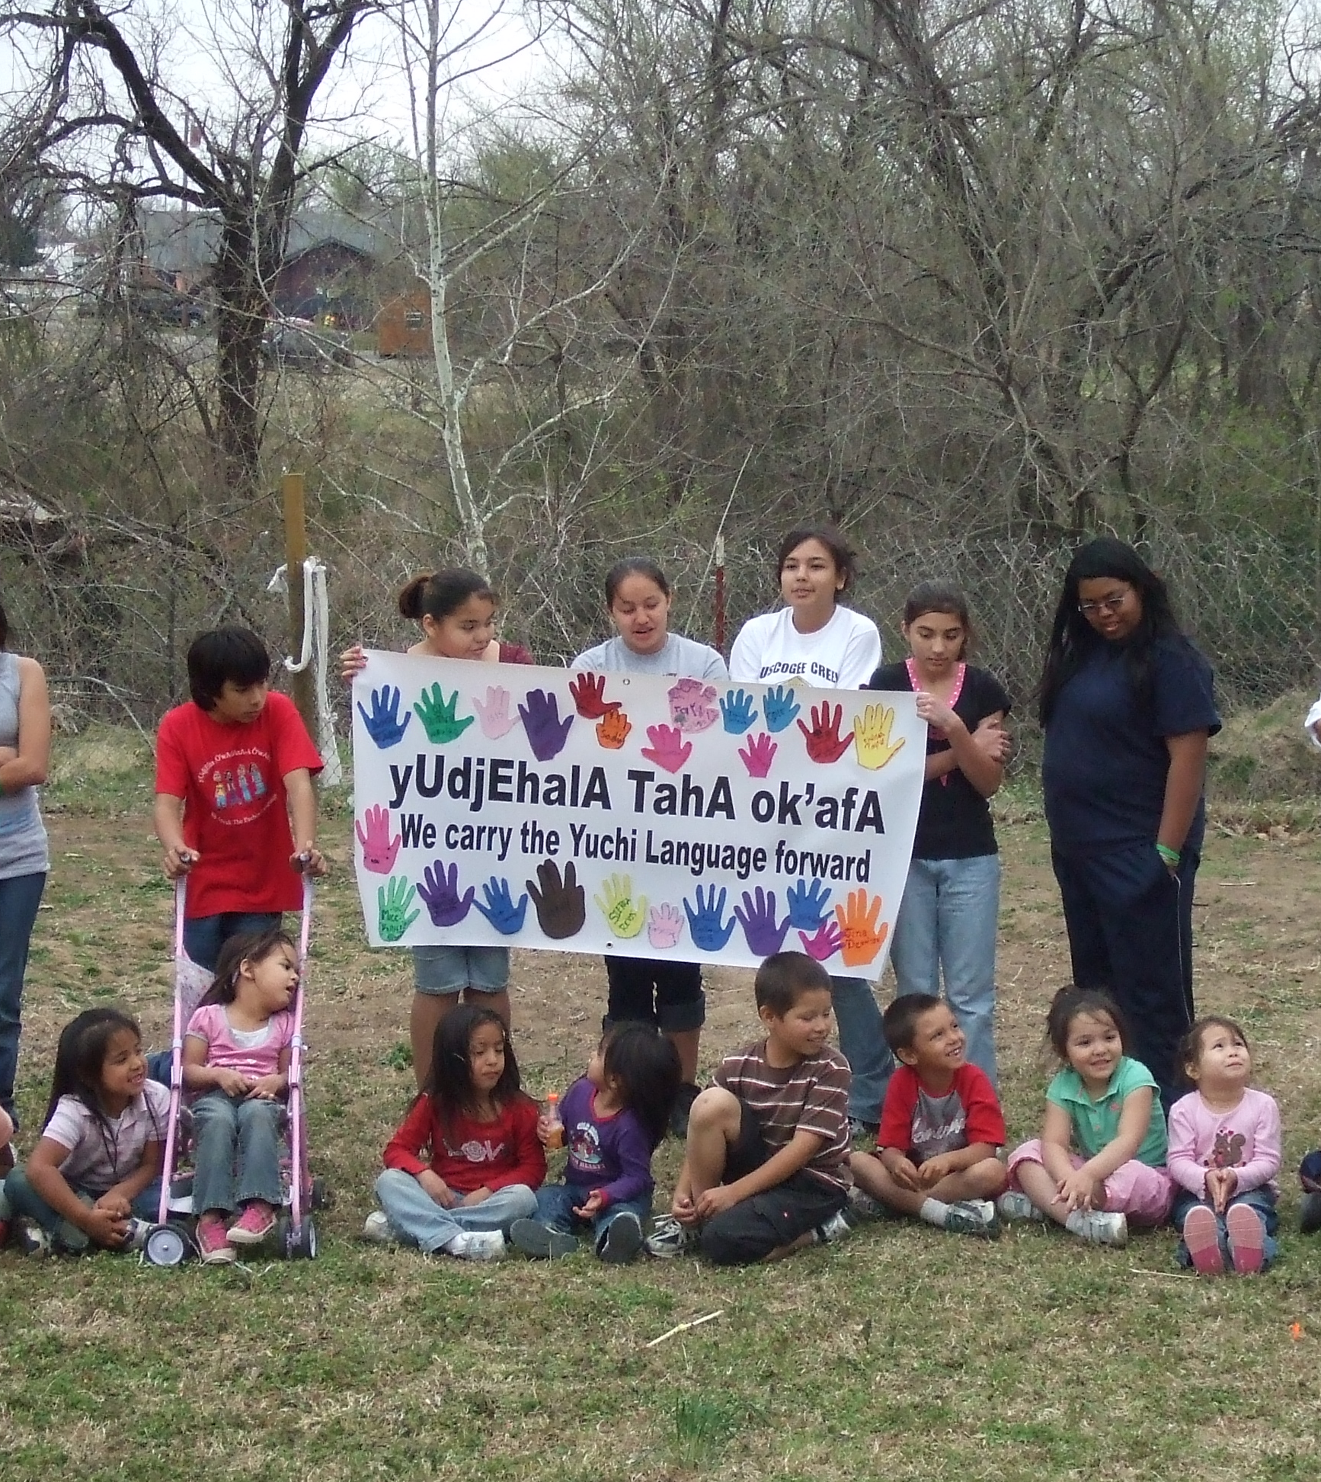
Native Americans lost control of the education of their children when the United States government forcibly enrolled them in residential schools designed for assimilation into an “American” mold. This policy began in the 1870s and continued on a large scale through the 1970s; a few schools are still operating today. In these institutions, children were severely punished, both physically and psychologically, for using their own languages instead of English. These experiences convinced entire generations of Native people that their children would be better off learning to speak only English. Hoping to spare their children the pain they once went through, parents stopped passing their languages on to their children, and thereby stopped creating fluent speakers of those languages. As a result, numerous languages indigenous to America are now severely in danger of losing their last native speakers.

Slide 28
Linguistic Profiling

Slide 29
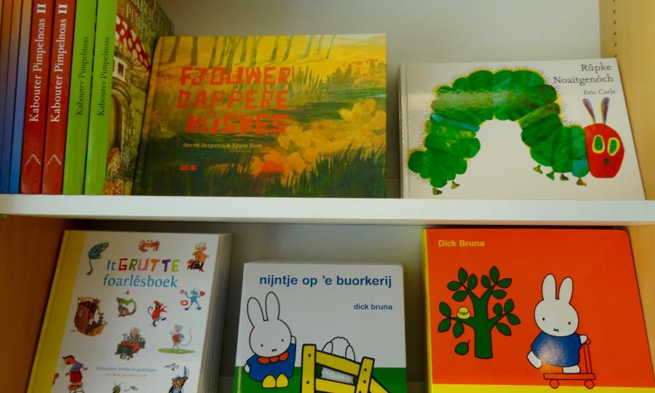
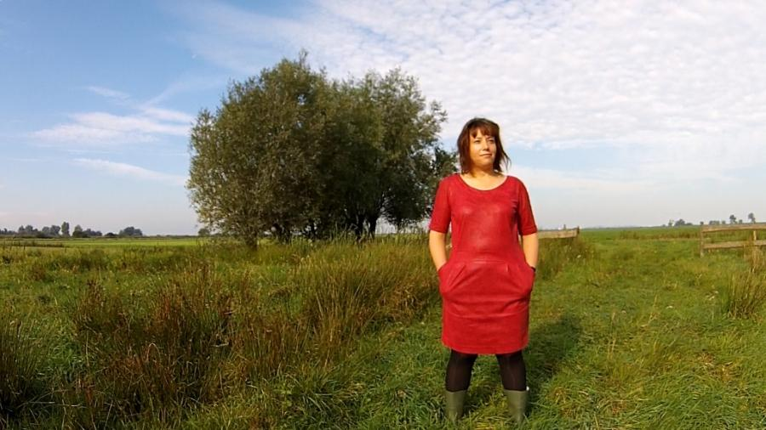
“It’s the right of people to experience art in their language.”
“Halbertsma . . . wrote Frisian much more like it was spoken. It was a big inspiration for Frisians who wanted a bit more respect for their language.”
Play about Frisian speed skating race (200 kilometers)
Willem Schoorstra – writes novels in Frisian. “His Frisian vocabulary — and . . . his ability to express himself — is about as expansive as it gets.”
Baldrs Draumar – Frisian metal band – “It’s the band’s signature, almost, that they sing in Frisian.”

Slide 30
The Language of the Educated
“Most people don’t write in Frisian. It’s been that way for hundreds of years, ever since the Dutch imposed their language on schools. And so Frisian is mainly a spoken language. It’s why people dismiss it as a “dialect.” But the Frisians think they have a solution. Trilingual schools.
Frisian student: “I feel comfortable when I speak Frisian but when I write Frisian it contains a lot of mistakes.”
A couple students tell me they’re sort of weirded out at the very idea of being able write in Frisian, but then they turn around and say how excited they are by that too because it’s their mother tongue — the language they best can express their thoughts in.

Slide 31
Language and Social Media
“The Frisian Academy recently surveyed 2-thousand young people. They found that very few of them have confidence in their writing skills. Fewer than 15% said their written Frisian was good. But despite that, more than half of them chose Frisian when it came to messaging friends or posting updates on Facebook or Twitter.”
“The language is changing. And that’s a thing you can’t stop. It’s like nature, so to say. It’s developing itself, it’s a living thing. In 100 years or 200 years our language will be very different. But I think it still will be there. I think we will be fine. I really do.”

Slide 32
Sources
“20/20 Linguistic Profiling.” YouTube, uploaded by Catherine Davies, 24 April 2006.
Brooks, Richard. “Which Languages Are Closest to English?” The Language Blog, K-International, 10 Jan. 2017, https://www.k-international.com/blog/languages-closest-to-english/.
Klug, Kelsey. “Native American Languages Act: Twenty Years Later, Has It Made a Difference?” Cultural Survival, 18 July 2012, https://www.culturalsurvival.org/news/native-american-languages-act-twenty-years-later-has-it-made-difference.
“Linguistic Profiling.” YouTube, uploaded by LBloggie Awakened, 28 March 2008.
Nordquist, Richard. “What Is Linguicism (or Linguistic Discrimination)?” ThoughtCo, ThoughtCo, 13 Apr. 2017, https://www.thoughtco.com/what-is-linguicism-1691238#:~:text=Linguicism%20is%20discrimination%20based%20on,also%20known%20as%20linguistic%20discrimination.
Sas, Christine. “Dutch: Who Speaks It?” ATLAS, 2003, https://www.ucl.ac.uk/atlas/dutch/who.html.
Shakib, Mohammad Khosravi. “The Position of Language in Development of Colonization Journal of Languages and Culture, vol. 2, no. 7, 2011, http://www.academicjournals.org/JLC.
Shashkevich, Alex. “The Power of Language: How Words Shape People, Culture.” Stanford News, Stanford University, 27 Aug. 2019, https://news.stanford.edu/2019/08/22/the-power-of-language-how-words-shape-people-culture/.
“The Closest Language to English.” Subtitle from Linguistic Society of America, 30 March 2021, https://subtitlepod-62956.medium.com/who-speaks-the-language-closest-to-english-80f8fa3b81f8.
“Why Study Linguistics.” YouTube, uploaded by Martin Hilpert, 30 May 2020, https://www.youtube.com/watch?v=oLbpu-UHzI4.
Young, Holly. “A Language Family Tree - in Pictures.” The Guardian, Guardian News and Media, 23 Jan. 2015, https://www.theguardian.com/education/gallery/2015/jan/23/a-language-family-tree-in-pictures.

