Slide 1
Frankenstein
Chapters 13-21

Slide 2
Perspective and Point of view
Perspective refers to how narrators, characters, or speakers see their circumstances, whereas point of view refers to the position from which a narrator or speaker relates the events of a narrative.
Although point of view refers to vantage point of the narrator, it often encompasses the broader meaning of perspective. Perspective cannot be definitively labeled like point of view, but instead can be described and used to study characterization and other literary elements.
We’ll look at two excerpts that both describe pursuits of knowledge and self-discovery; however, the key difference is the perspective of each narrator.

Slide 3
Point of view & Perspective Explain the function of contrasting characters. .
Read and annotate the two excerpts on your handout, one from Victor and one from the Creature.
After you read, consider what similarities exist between the two narrators and/or their points of view.
What are the major differences? Go beyond differences in character, but instead consider differences in narrative perspective.

Slide 4
Perspective and Point of view
Victor’s perspective is of an ambitious man finally reaping the rewards of countless hours of study and work. He uses an abundance of imagery and figurative language to describe how hard he worked to reach his goals. While he maintains a point of view of someone looking back on his life, he still maintains a gleeful perspective in this narrative.
Conversely, the creature uses a self-deprecating tone as he recalls his tale. He refers to himself as “foolish wretch” and calls himself a monster. He too has goals, in this case to grow in his language skills and befriend the people in the cottage. However, his narrative has a more hopeless and self-loathing perspective to it.

Slide 5
The Creature vs. The World
What are the results of the creature’s encounters with men?
Abandoned by his creator
Frightens an old man eating breakfast, who shrieks and runs away
Finds a village, frightens children, women faint, villagers throw stones
How does the creature react to these encounters? Does he blame mankind or himself?

Slide 6
Growing Pains
Abandoned and alone, the creature learns about the wilderness and nature of man all by himself. Examine his lessons in:
Sound (the birds’ sounds compared to his own voice)
Fire “How strange, I thought, that the same cause should produce such opposite effects.”
Beauty (the creature’s thoughts when he sees his own appearance in the pool of water on – perhaps the most poignant in the whole novel!)
Happiness (the creature understands that the DeLacey family is not happy, yet does not know why)
Love – What acts of love does the creature witness? How does he show his own love for the DeLacey family?

Slide 7
Discussion Questions
Victor calls the creature a demon and accuses him of only evil, but this narrative proves that the creature has a benevolent heart. What acts of goodness and charity does he do?
What is the function of the DeLacey family in terms of characterization, theme, and plot?
The creature asks himself, “Was I, then, a monster, a blot upon the earth, from which all men fled and whom all men disowned?” Discuss how the creature is a monster, and also how he is not.

Slide 8
The Creature’s Books
Sorrows of Werter
Plutarch’s Lives
Letters from a young artist who feels loneliness and despair of unrequited love
The creature empathizes with Werter, who feels that he has no one who is meant for him.
He also recognizes that if he were to carry out suicide, he would not be missed by anyone.
A series of biographies of great men displaying their common virtues or failures
Opens the creature’s eyes about the world and its expansiveness
Nurtures his morality, as he “felt the greatest ardour for virtue rise within me, and abhorrence for vice”

Slide 9
Powerful Words: Paradise Lost
“But Paradise Lost excited different and far deeper emotions. I read it, as I had read the other volumes which had fallen into my hands, as a true history. It moved every feeling of wonder and awe that the picture of an omnipotent God warring with his creatures was capable of exciting. I often referred the several situations, as their similarity struck me, to my own. Like Adam, I was apparently united by no link to any other being in existence; but his state was far different from mine in every other respect. He had come forth from the hands of God a perfect creature, happy and prosperous, guarded by the especial care of his Creator; he was allowed to converse with and acquire knowledge from beings of a superior nature, but I was wretched, helpless, and alone. Many times I considered Satan as the fitter emblem of my condition, for often, like him, when I viewed the bliss of my protectors, the bitter gall of envy rose within me."

Slide 10
Paradise Lost
An epic poem about the fall of man
The creature empathizes with both Adam and Satan
Adam is new and alone in the world, but loves those around him
Satan was created good and pure, but fell from good graces from his creator
“I ought to be thy Adam, but I am rather the fallen angel, whom thou drivest from joy for no misdeed.”

Slide 11
Paradise Lost
Read the excerpt from Paradise Lost on your handout.
Consider how both the Creature and Victor share similarities with Satan, Adam, and God from this narrative.
Finally, spend a few minutes responding to the questions posed on your handout.

Slide 12
Quotes to Consider
“God, in pity, made man beautiful and alluring, after his own image; but my form is a filthy type of yours, more horrid even from the very resemblance. Satan had his companions, fellow devils, to admire and encourage him, but I am solitary and abhorred.” (ch. 15)
“For the first time the feelings of revenge and hatred filled my bosom, and I did not strive to control them, but allowing myself to be borne away by the stream, I bent my mind towards injury and death.” (ch. 16)

Slide 13
“God, in pity, made man beautiful and alluring, after his own image; but my form is a filthy type of yours, more horrid even from the very resemblance. Satan had his companions, fellow devils, to admire and encourage him, but I am solitary and abhorred.”
The creature envies even Satan, who has a league of demons to keep him company. The creature’s main source of anger stems from his loneliness, which contributes to his threat against Victor.
“For the first time the feelings of revenge and hatred filled my bosom, and I did not strive to control them, but allowing myself to be borne away by the stream, I bent my mind towards injury and death.”
After hearing Felix describe their encounter, the creature experiences his first motivation to hurt and destroy. However, it is still not his instinct.

Slide 14
Quotes to Consider
“The wind fanned the fire, and the cottage was quickly enveloped by the flames which clung to it and licked it with their forked and destroying tongues.” (ch. 16)
“This was then the reward of my benevolence! I had saved a human being from destruction, and as a recompense I now writhed under the miserable pain of a wound which shattered the flesh and bone. The feelings of kindness and gentleness which I had entertained but a few moments before gave place to hellish rage and gnashing of teeth. Inflamed by pain, I vowed eternal hatred and vengeance to all mankind.” (ch. 16)

Slide 15
“The wind fanned the fire, and the cottage was quickly enveloped by the flames which clung to it and licked it with their forked and destroying tongues.”
Fire, a common symbol in literature, has two properties. It can help (by creating light and heat) or hurt (by destruction). The creature has only experienced its destructive properties, and he uses it to destroy his memories of the DeLaceys.
“This was then the reward of my benevolence! I had saved a human being from destruction, and as a recompense I now writhed under the miserable pain of a wound which shattered the flesh and bone. The feelings of kindness and gentleness which I had entertained but a few moments before gave place to hellish rage and gnashing of teeth. Inflamed by pain, I vowed eternal hatred and vengeance to all mankind.”
After saving the girl from the stream (showing the creature’s instinctive goodness), he is punished once again. This is the last straw that turns his actions toward evil.

Slide 16
Nature versus nurture
An ongoing debate among psychologists is whether our personality and instincts are inherited (nature) or learned (nurture).
The Creature has shown himself capable of violent and even evil actions. However, the text has shown that he is not evil or violent by nature. Rather, it is a result of his nurture, or lack of nurture, that he lashes out in this way.
What examples can you think of to show that the creature does not have an inherently violent nature?

Slide 17
Discussion Questions
Were you surprised by the DeLacey’s rejection of the creature? Why or why not?
The creature did not give up after he was run out of the DeLacey cottage. What is it that makes him give up forever?
What was the creature’s original intention for William, before he discovered his name? How does this contribute to the Creature’s characterization?
If you were Frankenstein, what would your answer be to the Creature’s demands? What are the pros and cons of each decision?

Slide 18
Quotes to Consider
“His words had a strange effect on me. I compassionated him and sometimes felt a wish to console him, but when I looked upon him, when I saw the filthy mass that moved and talked, my heart sickened and my feelings were altered to those of horror and hatred… I thought that as I could not sympathize with him, I had no right to withhold from him the small portion of happiness which was yet in my power to bestow.” (ch. 17)
“But I am a blasted tree; the bold has entered my soul; and I felt that I should survive to exhibit what I shall soon cease to be—a miserable spectacle of wrecked humanity, pitiable to others and intolerable to myself.” (ch. 19)

Slide 19
Quotes to Know – in your notes, consider the importance of each quote below before we discuss them.
“His words had a strange effect on me. I compassionated him and sometimes felt a wish to console him, but when I looked upon him, when I saw the filthy mass that moved and talked, my heart sickened and my feelings were altered to those of horror and hatred… I thought that as I could not sympathize with him, I had no right to withhold from him the small portion of happiness which was yet in my power to bestow.” p. 126
Victor wants to help the creature, but every time he looks at him he is reminded of his unnatural appearance, and possibly, nature. He cannot be a part of this, and boldly refuses.
“But I am a blasted tree; the bold has entered my soul; and I felt that I should survive to exhibit what I shall soon cease to be—a miserable spectacle of wrecked humanity, pitiable to others and intolerable to myself.” p. 139
Throughout the novel, Shelley equate light with knowledge. Victor now believes he has been destroyed by knowledge. He is the blasted tree that he saw in childhood.

Slide 20
Who is the monster and who is the man?
Some prefer to avoid calling the creature a “monster.” Judging his acts up to now, is it an appropriate name for him? Can any other character be judged a monster? Overall, which character from the novel is more monstrous?
Victor committed evil acts accidentally and indirectly, while the creature willfully committed murder as an act of revenge. Does intention of evil make one character more “monstrous” than another?
Examine the following definitions of the word. Who fits each definition?
Monster 1: one who deviates from normal or acceptable behavior or character; 2: a threatening force; 3: a person of unnatural or extreme ugliness, deformity, wickedness, or cruelty

Slide 21
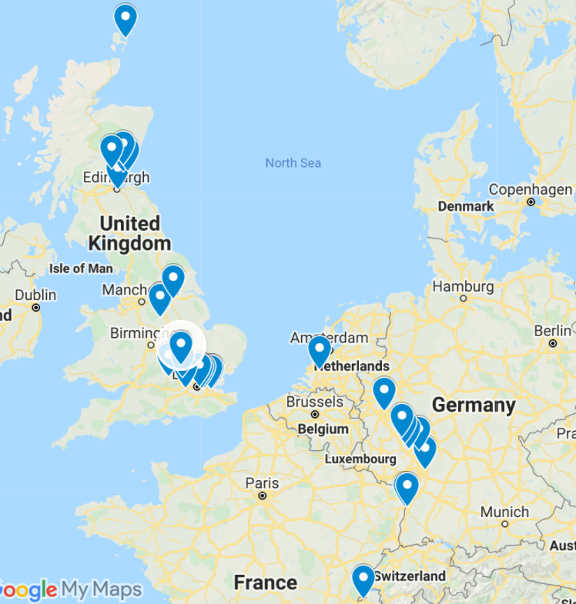
Once again, the novel breaks from suspenseful build-up to focus on Victor’s travels through beautiful scenery. What is the effect of this break in suspense?
What role does Clerval play in this novel? Look beyond his part in the plot and consider him in a more symbolic light.

Slide 22
Conflict Explain the function of a particular sequence of events in a plot.
Spend a few minutes listing Victor’s conflicts in the rising action of Frankenstein.
Review the conflicts on the next slide before reading the first three pages of Chapter 20 as a class in an effort to find catharsis or emotional release.

Slide 23
Tracking the suspense
Victor’s mother dies
Victor sacrifices his health in order to reach his scientific goals
Victor succeeds in reanimating a dead body, but is horrified by his creation. He abandons it and doesn’t see it for two years.
Victor learns that his youngest brother has died and his friend Justine is being charged with his murder.
Victor struggles with his guilt over the deaths of William and Justine, and for allowing his creature to go free.
Victor accuses his creature and wishes to kill him, but cannot stand to look at him either.
Victor is repulsed by the creature’s demands for a mate but also wishes to keep others safe. The Creature assumes his agreement and disappears.
Victor is unable to marry Elizabeth or enjoy the company of Henry Clerval because of the weight of the Creature’s demands.

Slide 24
Read the first few pages of Chapter 20 as a class
Stop at “I shall be with you on your wedding-night.”
How does this new conflict also provide catharsis or emotional release, either for the reader or for Victor?
As you read, record five realizations Victor has that persuade him against completing the female creature.

Slide 25
What were some of the reasons Victor considers stopping his second creation?
“She might become ten thousand times more malignant than her mate, and delight, for its own sake, in murder and wretchedness.”
“He had sworn to quit the neighborhood of man and hide himself in deserts; but she had not; and she, who in all probability was to become a thinking and reasoning animal, might refuse to comply with a compact made before her creation.”
“They might even hate each other; the creature who already lived, loathed his own deformity; and might he not conceive a greater abhorrence for it when it came before his eyes in the female form?”
“She also might turn with disgust from him to the superior beauty of man; she might quit him, and he be again alone, exasperated by the fresh provocation of being deserted by one of his own species.”
“…yet one of the first results of those sympathies for which the demon thirsted would be children, and a race of devils would be propagated upon the earth, who might make the very existence of the species of man a condition precarious and full of terror.”

Slide 26
Demonic Characterization of the Creature
“The wretch saw me destroy the creature on whose future existence he depended on for happiness, and with a howl of devilish despair and revenge, withdrew.”
“gnashed his teeth”
Referred to as “demon” or “daemon” and “Devil”
“I will watch with the wiliness of a snake, that I may sting with its venom”

Slide 27
Victor’s Decision
“I had resolved in my own mind that to create another like the fiend I had first made would be an act of the basest and most atrocious selfishness.”
This decision brings the reader a sense of relief and even catharsis, since Victor has ultimately made a decision. This means the plot can continue its course toward resolution.
Overall, do you believe Victor’s decision was the right one? As a group, criticize or defend his decision.

Slide 28
Discussion Questions
The death of Henry Clerval is tragic and serves as punishment for Victor’s actions. What other role(s) does Clerval serve in this story?
If you were Victor at this point in the story, what would your next move be?

