Slide 1
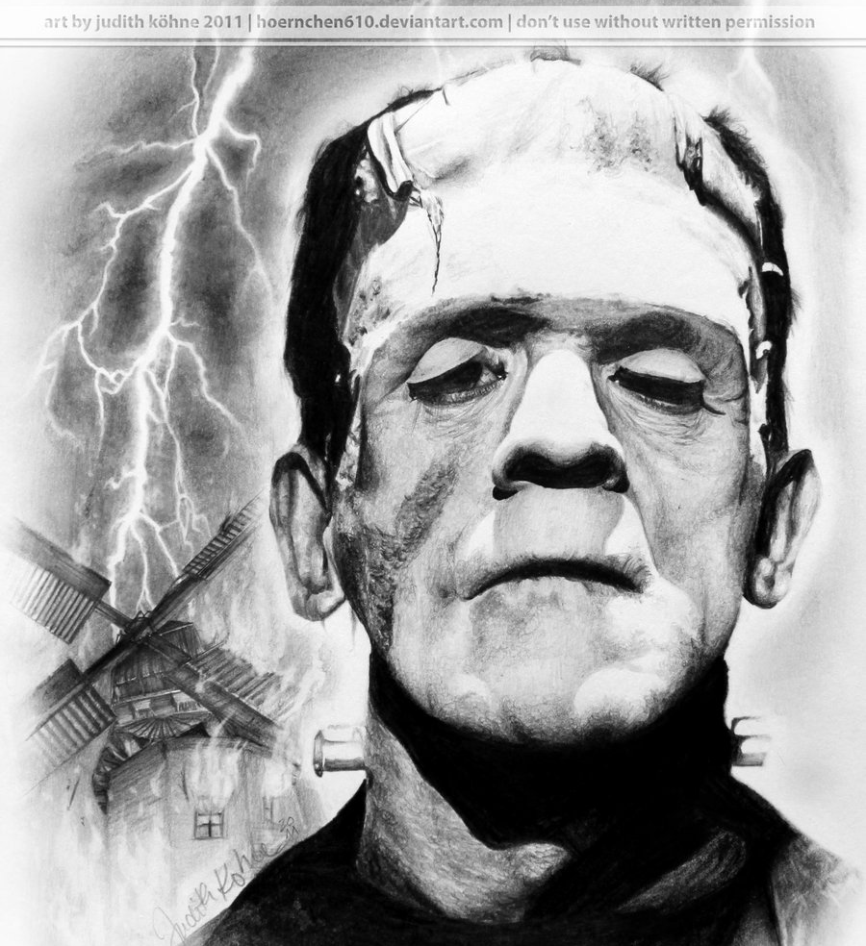
Mary Shelley’s Frankenstein Exploring ch. 1 - 6
This Photo by Unknown Author is licensed under CC BY-NC-ND

Slide 2
Journal (ch. 1-3)
Consider this quote from Victor at the end of ch. 2:
“Destiny was too potent, and her immutable laws had decreed my utter and terrible destruction.”
What do you think of this statement from Victor? What is your idea of destiny so powerful that a person has no recourse but to follow it? If you think there is some possibility of choice, then what factors influence destiny? What effect does a belief in “destiny” have on what a person accomplishes in life?
After journaling for about 7 minutes, discuss your thoughts with the class.

Slide 3
Character Chart
Make a chart that includes a short description of the characters and shows the relationships among them:
Robert Walton Elizabeth Lavenza
Victor Frankenstein Henry Clerval
Alphonse Frankenstein Caroline Beaufort
M. Krempe M. Waldman
After you’ve had time to make a chart, proceed to the next slide and compare your chart.

Slide 4
M. Krempe
cranky, unpleasant professor of natural philosophy
M. Waldman
kind, sympathetic professor of chemistry who encourages V’s interest in science
Robert Walton
Arctic explorer; lonely, idealistic
Tells story to
Professors of
Victor Frankenstein
(novel’s protagonist)
Henry Clerval
foil to Victor; kind & gentle; interested in the humanities rather than science
Alphonse Frankenstein
Father of
BFFs
married
Mother of
His “more than sister”
Caroline (Beaufort) Frankenstein
benevolent, dies
adopts
Elizabeth Lavenza
orphaned, passive

Slide 5
Education – What is it?

Slide 6
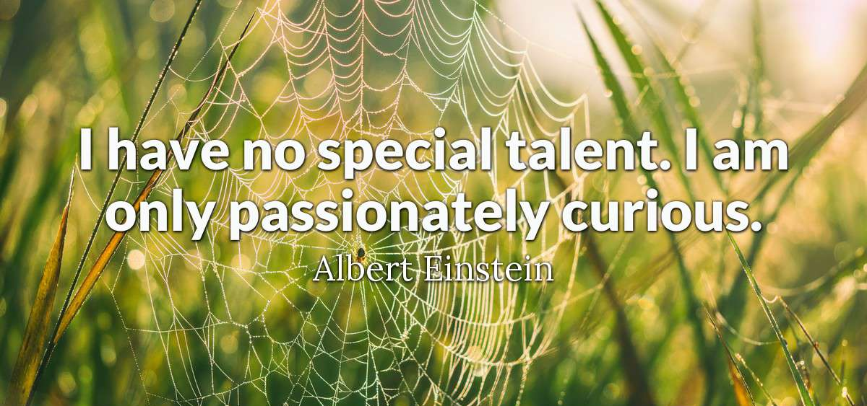
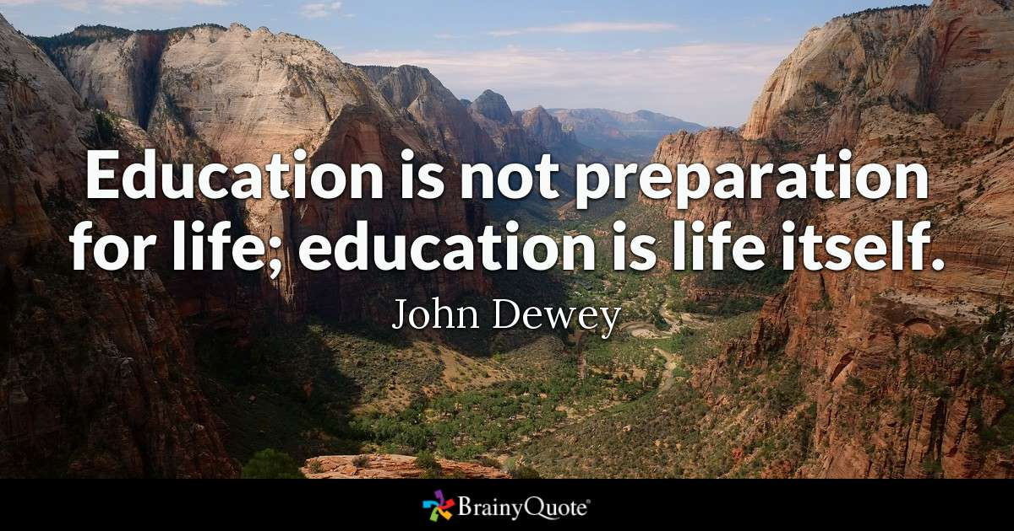
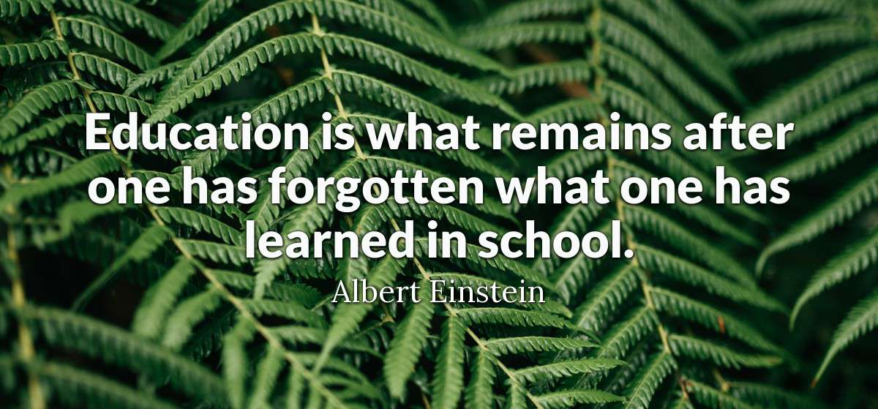

Slide 7
Theories of Education
One motif in the novel is education—the value of education, the process of education, catalysts for learning, and obstacles to learning.
Look at the factors listed on the “Theories of Education” handout. On the front, fill in the chart with the impacts and importance of these factors in Victor’s education along with evidence from the novel. Considering the evidence in the novel, how would you describe Mary Shelley’s theory of education.
On the back, fill in the impacts and importance of these factors in your life or in the lives of those you know. What is your theory of education? In what ways does it align with Shelley’s? In what ways does it contrast?

Slide 8
Journal (ch. 4-6)
How do you feel about Victor Frankenstein’s actions thus far—his quest, treatment of family, reaction to his creation, etc. What are Frankenstein’s good qualities? Bad qualities? Discuss the importance of the events in last night’s chapters to the action of the book. Do you see any parallels to your own life/experiences?
After journaling for about 7 minutes, discuss your thoughts with the class.

Slide 9
Character Chart
Return to your character chart and add additional characters: William Frankenstein, Ernest Frankenstein, Justine Moritz.
After you’ve had time to add these to your chart, proceed to the next slide and compare.

Slide 10
M. Krempe
cranky, unpleasant professor of natural philosophy
M. Waldman
kind, sympathetic professor of chemistry who encourages V’s interest in science
Robert Walton
Arctic explorer; lonely, idealistic
Tells story to
Professors of
Victor Frankenstein
(novel’s protagonist)
Henry Clerval
foil to Victor; kind & gentle; interested in the humanities rather than science
Alphonse Frankenstein
Father of
BFFs
Ernest Frankenstein
Victor’s brother; 6 yrs younger than Victor; gentle
married
Mother of
His “more than sister”
Caroline (Beaufort) Frankenstein
benevolent, dies
William Frankenstein
Victor’s youngest brother; innocent child; murdered by creature
adopts
Justine Moritz
Disliked & mistreated by her own mother; taken in by Frankenstein family; accused of William’s murder
Elizabeth Lavenza
orphaned, passive
Servant & friend

Slide 11
Women
Feminist criticism: Focus particularly on the various female characters thus far in the novel? What roles do they typically play? What are their major characteristics/personality traits, etc.? – Discuss in small group and then share ideas with class.
Review the components of the portfolio project. Select one component you can begin work on and begin.
Tonight – read ch. 7-8

