Slide 1
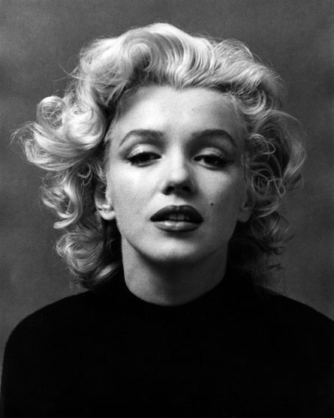
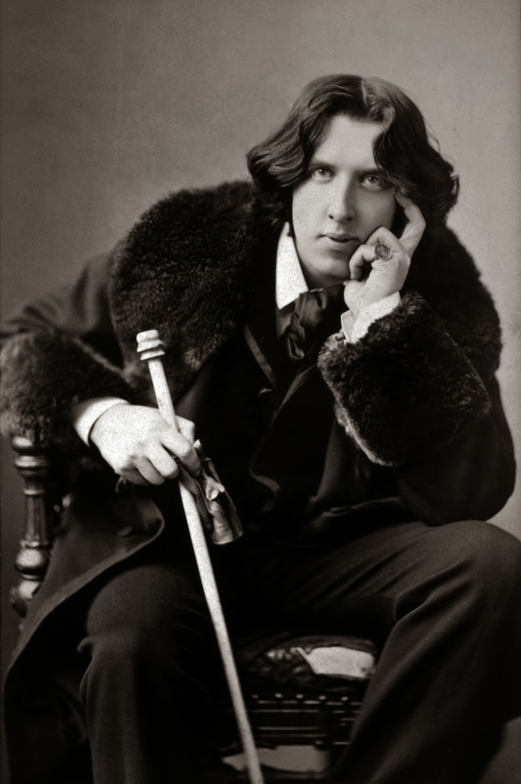
Celebrity Culture’s Role in Society
Why do we idolize celebrities?

Slide 2
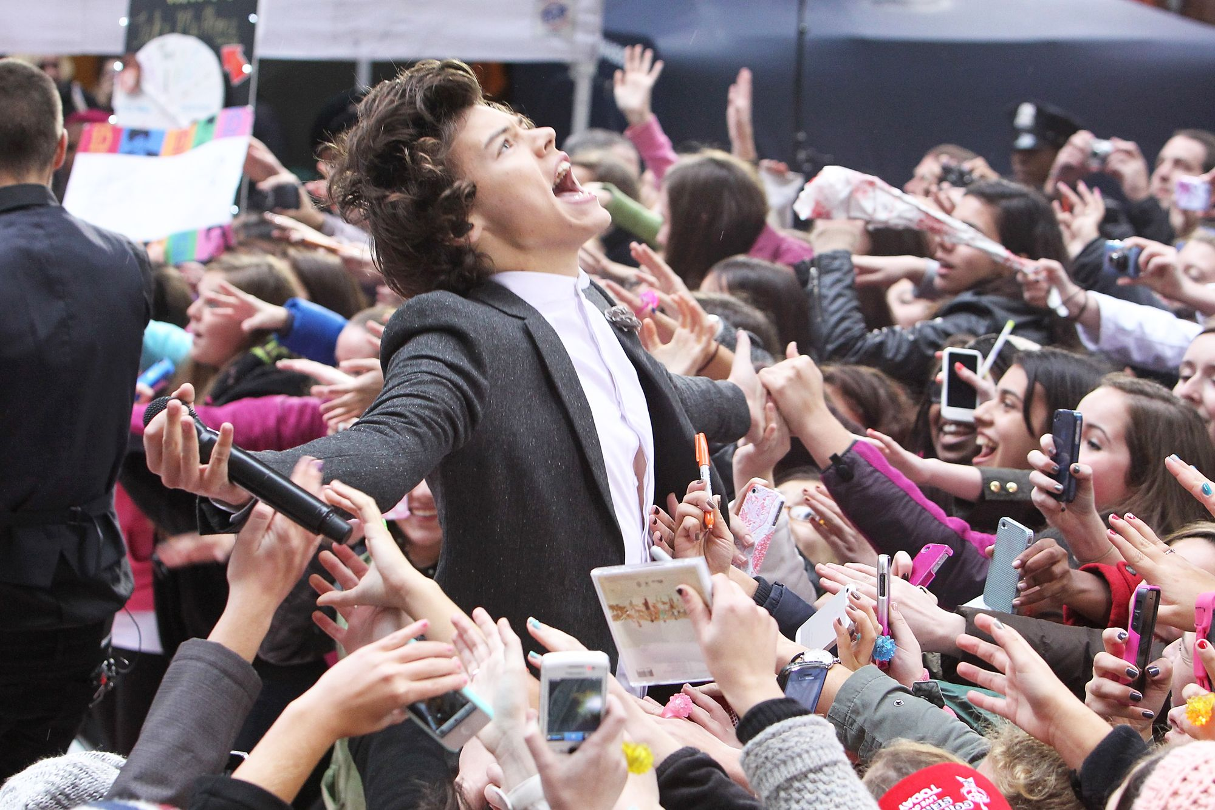
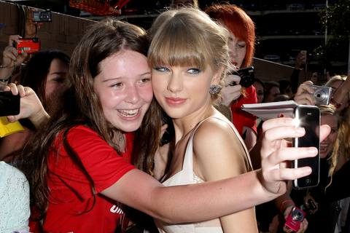
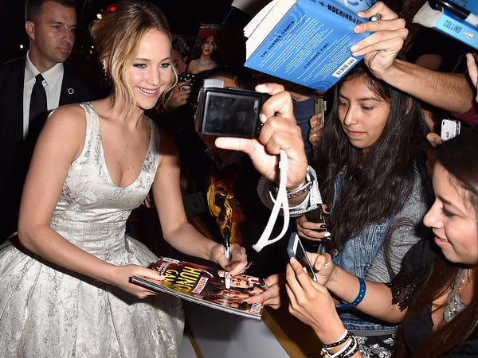
What is an idol?
An idol is someone whose talents, achievements, status, or physical appearance are especially recognized and appreciated by people.
Adolescents particularly cling to figures around them as they search for their own identity.
(Lin, Ying-Ching, and Chien-Hsin Lin)

Slide 3
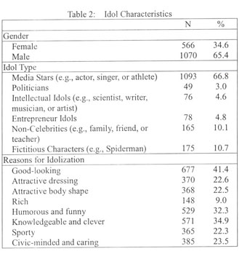
Reasons for Idolization
People idolize celebrities for many different reasons, especially external reasons.
Adolescents typically idolize celebrities who give off the illusion of a perfect idol, indicating nonrational worship behavior.
(Lin, Ying-Ching, and Chien-Hsin Lin)
Results from a study done on adolescent idolization

Slide 4
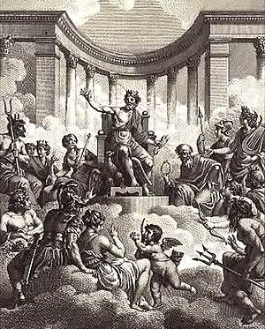
Idolization is nothing new...
Modern celebrity idolization can be compared to the worship of the Olympian gods by the Greeks and Romans.
Research shows that societies have always had a need to “worship” things or people.
(Bryner)

Slide 5
Idolization is nothing new…
Societies have always put the rich and powerful on pedestals.
There is evidence of non-human ancestors focusing on the prestigious.
The reason for excessive focus on the prestigious was to know how to gain rewards or avoid punishment.
Consistent worship throughout history → modern idolization of celebrities
(Bryner)

Slide 6
Why are we fascinated with celebrities?
Fair amounts of research identify that issues surrounding the self and social needs act as reasons for interest in celebrities.
In order to find our identities, we look toward people we consider role models and try to imitate them.
Attraction to celebrities may help to remedy feelings of inadequacy or distress.
Some people may gravitate towards celebrities as a part of the human need to seek out, form, and maintain social connections or relationships.
(“What Explains Our Fascination with Celebrities?”)

Slide 7
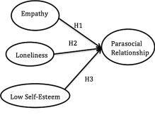
Why are we fascinated with celebrities?
Because we are humans who crave social interaction with others, at times we’ll find those social connections even when they are imaginary or illusory (parasocial relationships).
(Bryner)

Slide 8
Effects of idolization

Slide 9
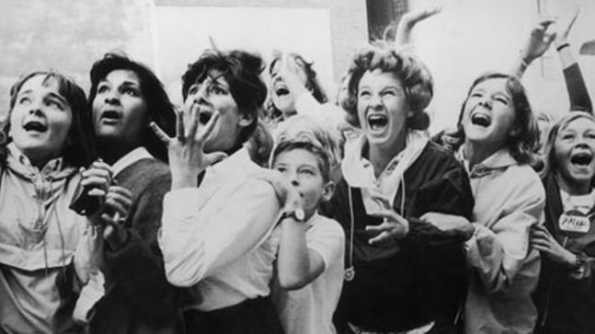
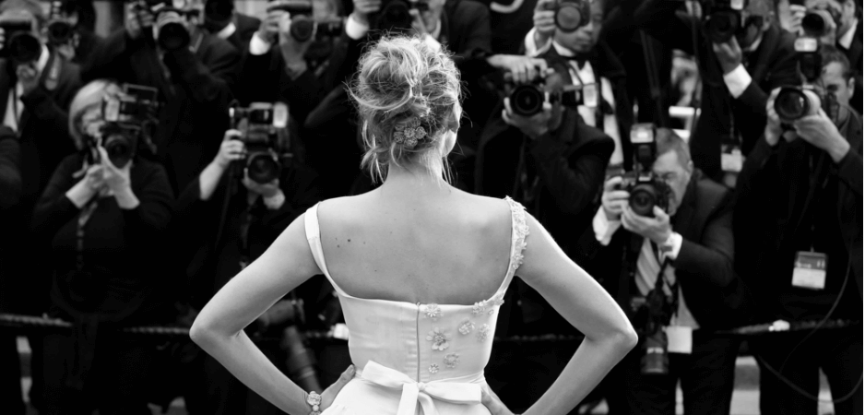
Celebrity idolization may be more harmful than we think
Celebrity worship may reach a deep level in some individuals, causing them to deviate from interactions with friends and to not participate in activities.
Research has supported the prediction that more intense levels of celebrity worship are related to negative outcomes, such as depression, anxiety, poorer self-esteem and lower life satisfaction.
(“What Explains Our Fascination with Celebrities?”)

Slide 10
“Could potential benefits outweigh the negatives?”
Although social networks are created between people who share the same celebrity idol, most people can become disconnected from society as they continue to absorb themselves in the world of celebrities (Bryner).
The effect that celebrities have on individuals can bring about positive feelings in individuals, but a loss or disruption of identity can occur as well (Bryner).
A sense of fulfillment can be established, but the motivational forces that lead us to continuously idolize a celebrity can take on an addictive component, leading to intense behavior in order to maintain the parasocial relationship (Maltby et al.).

Slide 11
Connections to the Unit
Main idea of “Bowling Alone” – decreased civic engagement in recent decades
Parasocial relationships with celebrities may contribute to decreased social interaction and engagement.
Our Town focuses on social connections/interactions between vivid characters.
Celebrity idolization creates “fake” relationships.
“Self-Reliance” argues in favor of individuality.
Idolizing celebrities in order to emulate them causes us to lose our own individuality.

Slide 12
Works Cited
Bryner, Jeanna. "Celebrity Culture Has Evolved over Time." Celebrity Culture, edited by Roman Espejo, Greenhaven Press, 2011. Opposing Viewpoints. Gale In Context: Opposing Viewpoints, link.gale.com/apps/doc/EJ3010738209/OVIC?u=tel_s_tsla&sid=bookmark-OVIC&xid=ccc35326. Accessed 12 Sept. 2021. Originally published as "As Elvis Turns 75, Celebrity Worship Alive and Well," LiveScience, 2010.
Lin, Ying-Ching, and Chien-Hsin Lin. "Impetus for worship: an exploratory study of adolescents' idol adoration behaviors." Adolescence, vol. 42, no. 167, fall 2007, pp. 575+. Gale In Context: High School, link.gale.com/apps/doc/A171019166/SUIC?u=tel_s_tsla&sid=bookmark-SUIC&xid=b1a486e4. Accessed 12 Sept. 2021.
Maltby, John, et al. "Personality and coping: a context for examining celebrity worship and mental health." British Journal of Psychology, vol. 95, no. 4, Nov. 2004, pp. 411+. Gale In Context: High School, link.gale.com/apps/doc/A126076056/SUIC?u=tel_s_tsla&sid=bookmark-SUIC&xid=c71abe48. Accessed 17 Sept. 2021.
"What Explains Our Fascination with Celebrities?" Fair Observer, 18 Aug. 2018. Gale OneFile: News, link.gale.com/apps/doc/A550636490/GPS?u=tel_main&sid=bookmark-GPS&xid=8599256c. Accessed 16 Sept. 2021.
Zsila, Ágnes, et al. “The Association of Celebrity Worship with Problematic Internet Use, Maladaptive Daydreaming, and Desire for Fame.” National Center for Biotechnology Information, Akadémiai Kiadó, 1 Sept. 2018, www.ncbi.nlm.nih.gov/pmc/articles/PMC6426373/. Accessed 17 Sept. 2021.

