Slide 1
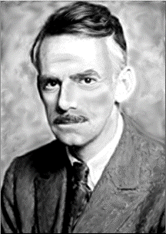
Eugene O’Neill
Father of Modern American Drama
1888 - 1953

Slide 2
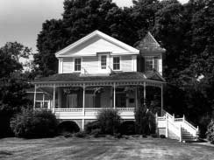
The Writer’s Life
Father: James O’Neill
Actor – Count of Monte Cristo
Son of Irish immigrant
Catholic
Mother: Ellen (Ella) Quinlan O’Neill
Devout Catholic
Morphine addiction
Attempted suicide
Monte Cristo Cottage
New London , Connecticut

Slide 3
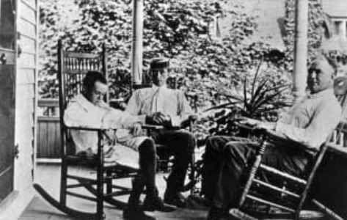
The Writer’s Life
Oldest brother, Jamie (1878)
Alcoholic
Drank himself to death
Second son, Edmund (1884)
Died of measles at 1 ½
Death blamed on Jamie
Eugene Gladstone O’Neill
Oct. 16, 1888
Born in hotel
Mother’s pain and depression > morphine addiction
Eugene, Jamie, and James O’Neill
Front Porch of Monte Cristo Cottage

Slide 4
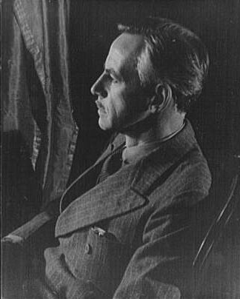
The Writer’s Life
Education
- Mount Saint Vincent Catholic
Boarding School (1895-1900)
- Betts Academy (1900-1906)
- Princeton University (1906)
- expelled
- Sea voyages (1910-1911)
- His “real” education

Slide 5
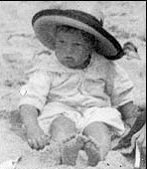
The Writer’s Life
First Marriage (1909)
Kathleen Jenkins – pregnant
- son, Eugene, Jr.
O’Neill
- left on gold-prospecting
expedition
- only saw son twice during first 10 years of his life
- granted divorce in 1912
Eugene O’Neill, Jr.

Slide 6
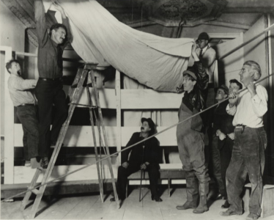
The Writer’s Life
Suicide Attempt (early 1912)
Bar “Jimmy-the-Priest’s”
Overdose of opiates
Tuberculosis Diagnosis (Nov. 1912)
Sanatorium
Decision to become playwright
Playwriting Class (1914-1915)
Harvard University
Provincetown Players (1916)
Bound East for Cardiff
Bound East for Cardiff

Slide 7
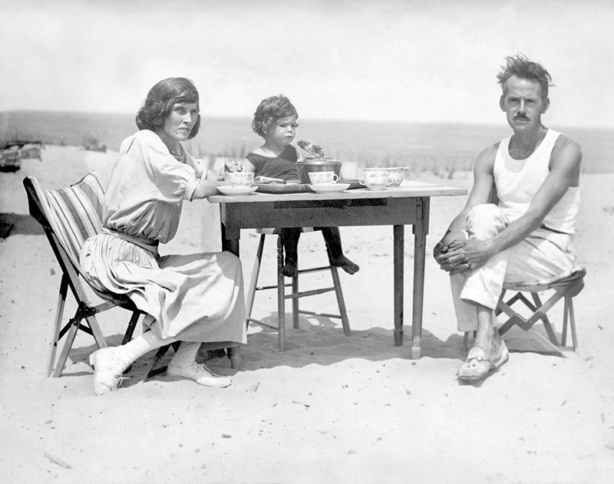
The Writer’s Life
Affair
Journalist Louise Bryant
Second Marriage (1918)
Agnes Boulton
Two children
Shane
- heroin addict/alcoholic
- suicide (age 40)
Oona
- disinherited
- married Charlie Chaplin
Agnes, Shane, and Eugene O’Neill
Cape Cod Beach, 1922
Notes:
Oona married Chaplin in 1943 when she was 17 and he was in his fifties; they remained married until Chaplin’s death in 1977; had 8 children together

Slide 8
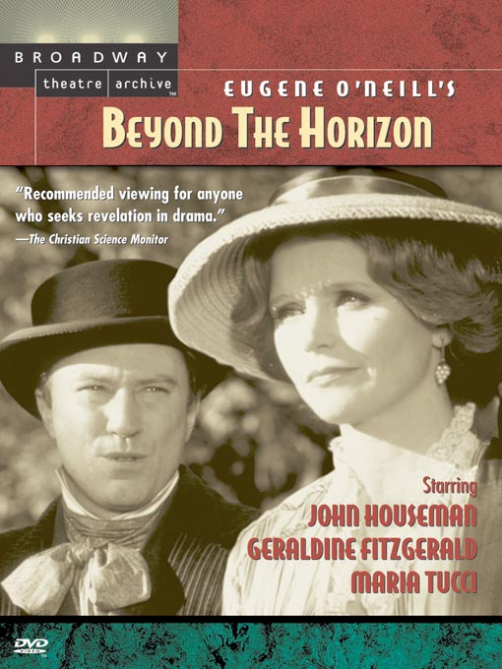
The Writer’s Life
Beyond the Horizon (1920)
144 performances on Broadway
First of four Pulitzer Prizes
Financially independent
Beginning of Series of Family Deaths
Father (1920) – intestinal cancer
Mother (1922) – brain tumor
Brother Jamie (1923) - alcoholism

Slide 9
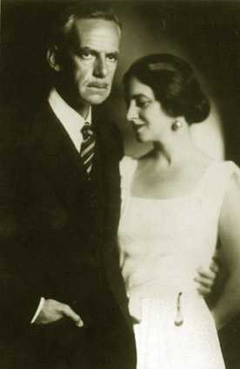
The Writer’s Life
Third Marriage (1929)
Carlotta Monterey - actress
Two year affair
Divorce from Agnes in 1929
South of France until 1931
Tao House in California
Nobel Prize for Literature (1936)
First American dramatist to win
Nearly Fatal Appendicitis (1937)
Eugene and Carlotta O’Neill

Slide 10
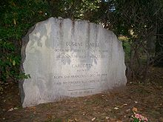
The Writer’s Life
Disease (1944)
- mimicked Parkinson’s
- caused tremors
- could not feed himself, could not write, could barely speak
- wrote nothing during last 10 years of his life
Death
- November 27, 1953
- bronchial pneumonia
Eugene O’Neill’s gravesite

Slide 11
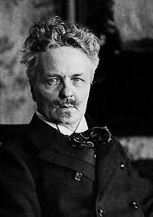
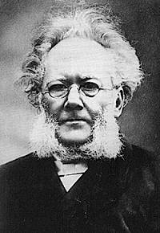
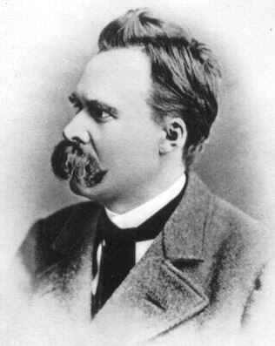
The Writer’s work
Father of Modern American Drama
First major American playwright
Major influences
Swedish playwright August Strindberg
German philosopher Friedrich Nietzsche
Norwegian playwright Henrik Ibsen
Ibsen
August Strindberg,
O’Neill’s biggest influence
Nietzsche

Slide 12
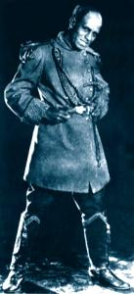
The Writer’s work
New ground for theater
- subjects that had gone unexplored,
particularly subjects concerning human
psychology (abortion, infanticide,
prostitution, adultery, incest, etc.)
- technical elements, such as masks,
asides, and stage itself
- innovation of dramatic forms (dramatic
monologues, length, trilogy, internal
conflict dramatized)
Charles Gilpin in The Emperor Jones

Slide 13
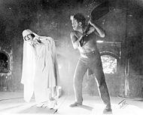
The Writer’s work
Common themes
- human beings are pitiable creatures
- woman as intruder who destroys masculine ambition or who disturbs a companionable male universe
- gifted man destroyed by predatory materialism of his woman
- desire and spiritual emptiness
Carlotta Monterey in The Hairy Ape

Slide 14
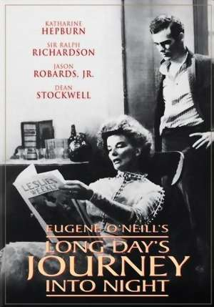
The Writer’s work
Wrote over 40 plays
Mostly tragedies
Only one comedy – Ah, Wilderness!
Autobiographical influence
Final four plays confront most directly his personal life
- Long Day’s Journey into Night

Slide 15
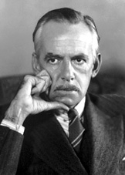
O’Neill’s Legacy
"O'Neill gave birth to the American Theater—
and died for it."
--Tennessee Williams

Slide 16
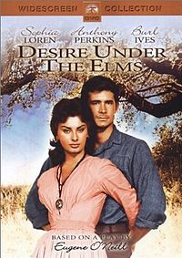
Desire Under the Elms
Published in 1925
Banned in Boston and England
Cast in Los Angeles arrested for obscenity
court case – “hung jury”
208 performances on and off Broadway
Innovative set design
Taboo subject matter

Slide 17
Tragedy
Desire Under the Elms has been called “the ﬁrst great American tragedy” by several critics, but what is tragedy exactly?
The Greek philosopher Aristotle deﬁned tragedy as
“an imitation of an action that is serious, complete, and of a certain magnitude;
in language embellished with each kind of artistic ornament, the several kinds being found in separate parts of the play;
in the form of action, not of narrative;
with incidents arousing pity and fear, wherewith to accomplish its catharsis of such emotions.”

Slide 18
Six Elements of Tragedy
According to Aristotle:
Tragedy consisted of six elements that determined its quality: plot, character, thought, diction, music and spectacle.
Plot concerns the story of the play. Aristotle thought plot was the most important element. Plots, he said, should be “complete,” having a beginning, middle and end.
A tragic character, Aristotle said, should be “true to life” and his fall “should come about as the result, not of vice, but of some great error or frailty in character.”

Slide 19
Six Elements (cont.)
By thought Aristotle meant the message “where something is proved to be or not to be, or a general maxim is enunciated.” (What's the point?)
Diction and music, while separate elements, have much in common. Both have to do with what is being spoken (or sung), but diction focuses on the words themselves while music focuses on the way these words are spoken. Diction is “the expression of the meaning in words,” and with music the sound, rhythm, and melody of the speeches should always contribute to the plot, characters, and themes.
Spectacle refers to the stage set-up and special effects. Aristotle considered this least important because it has least to do with literature. “The production of spectacular effects,” he said, “depends more on the art of the stage machinist than on that of the poet.”

Slide 20
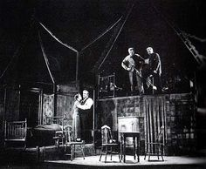
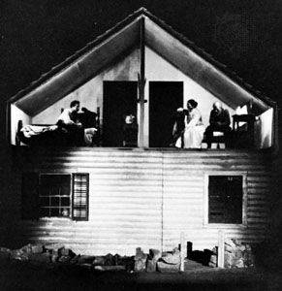
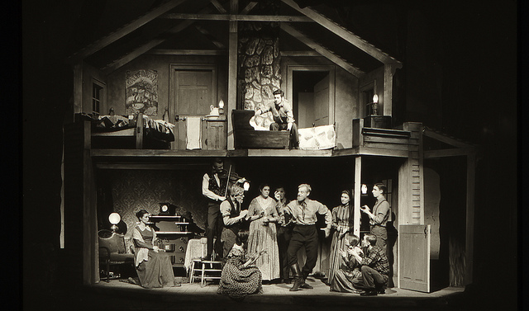

Slide 21
Tragedy and the Common Man
For a long time, tragedies were populated with kings, queens and other ﬁgures of royalty.
Very little emphasis on the lower classes until 1731 - George Lillo wrote what he called a “domestic tragedy.” Lillo wanted to focus on everyday people, on stories that took place in households instead of kingdoms.
In 1949, Arthur Miller, author of plays such as Death of a Salesman and The Crucible, wrote an essay about the current state of tragedy called “Tragedy and the Common Man.”

Slide 22
"Tragedy and the Common Man"
...As a general rule, to which there may be exceptions unknown to me, I think the tragic feeling is evoked in us when we are in the presence of a character who is ready to lay down his life, if need be, to secure one thing--his sense of personal dignity. From Orestes to Hamlet, Medea to Macbeth, the underlying struggle is that of the individual attempting to gain his “rightful” position in his society...
...The quality in such plays that does shake us, however, derives from the underlying fear of being displaced, the disaster inherent in being torn away from our chosen image of what and who we are in this world.

Slide 23
Desire under the Elms as Tragedy
1. Simply stated, what is the story? Does it have a clear beginning, middle and end?
2. Who are the main characters? Are they “true-to-life”? How so? More importantly, who is the “tragic hero” (the ﬁgure at the center of the tragedy) in this play, and what brings about his or her “fall”?
3. What is the theme or message of this play? Provide speciﬁc lines or examples that support this.
4. Find a passage or monologue from the play and determine the meaning behind the words. What is the character really trying to say?
5. Find the music in the words. Taking a look at how the characters speak, do you ﬁnd any rhythm or cadence in their speech? How does that develop their characters?
6. How would you envision the spectacle? If you were in charge of designing the set, what would you do?

Slide 24
Mythological Connections: Apollonian vs. Dionysian Characters
Apollo and Dionysus - sons of Zeus.
Apollo - god of the sun, light, music, and poetry
Dionysus - god of wine, ecstasy, and intoxication
Nietzsche’s The Birth of Tragedy - used the contrast between the gods to symbolize principles of individualism versus wholeness, light versus darkness, and civilization versus primal nature.
To be Apollonian was to exist in a dream state consisting of order, perfection and beauty. The Apollonian wants to create.
The Dionysian, on the other hand, revels in chaos, intoxication, pleasure and pain. The Dionysian wants to destroy.

Slide 25
Mythological Undercurrents
In the context of tragedy, Nietzsche explains that the tragic hero struggles to make order (in the Apollonian sense) of his unjust (chaotic) Fate, though he dies unfulﬁlled in the end.
Answers and action often come while in the Dionysian state, when one is able to act out their deepest passions. But unfortunately, that state can never survive for long.

Slide 26
Mythological Undercurrents: Oedipus
Oedipus is the story of the mythical king of Thebes (a city in Greece) who fulﬁlled a prophecy that said he would kill his father and marry his mother, and thus brought disaster on his city and family.
Psychoanalyst Sigmund Freud went on to write about the “Oedipus Complex,” a condition where a child feels sexual desire for the parent of the opposite sex and desires the death of the parent of the same sex.
What parallels do you see between the story of Oedipus and the characters in Desire Under the Elms? Do you think Eben has an Oedipus Complex? Why or why not?

Slide 27
Mythological Undercurrents: Phaedre
Phaedre, a tale which has been adapted many times over the years, is the story of a queen who is forced by the gods to fall in love with her husband’s son from another marriage.
In the play, the king’s son, Hippolytus, rejects her advances, prompting Phaedra to tell her husband that he raped her. The King casts a curse upon Hippolytus causing his death. Phaedra, in her grief, kills herself soon after.
Again, what parallels do you see between the Phaedra myth and O’Neill’s play? More importantly, what differences do you see?

Slide 28
Mythological Undercurrents: Medea
The story of Medea centers around the wife of Jason (of Jason and the Argonauts fame) who seeks revenge against him after he leaves her for a younger princess. Medea poisons the princess and her father, murders the two sons she had with Jason, and then leaves him alive to suffer.
Medea is often portrayed as a witch or sorceress, calling upon the gods to help exact her revenge. She is almost never perceived as insane.
One of the reasons Medea is so powerful is the way the authors make you empathize with such a murderous woman. Do you ﬁnd yourself empathizing with Abbie? Why or why not?

Slide 29
Symbolism: Stones
Desire Under the Elms occurs on a farm that was once a ﬁeld of stones, and there is much talk throughout the play about those stones and the building of the farm’s stone wall.
Here--it’s stones atop o’ the ground--stones atop o’ stones--makin’ stone walls--year atop o’ year--him ‘n’ yew ‘n’ me ‘n’ then Eben--makin’ stone walls fur him to fence us in!” -Peter
“An’ makin’ walls--stone atop o’ stone--makin’ walls till yer heart’s a stone ye heft up out o’ the way o’ growth onto a stone wall t’ wall in yer heart!” -Eben
“God’s hard, not easy! God’s in the stones! Build my church on a rock--out o’ stones an I’ll be in them! That’s what he meant t’ Peter! Stones. I picked ‘em up an’ piled ‘em into walls. Ye kin read the years of my life in them walls, every day a hefted stone, climbin’ over the hills up and down, fencin’ in the ﬁ elds that was mine, what I’d made thin’s grow out o’ nothin--like the will o’ God, like the servant o’ His hand. It wa’n’t easy. It was hard an’ He made me hard fur it.” -Ephraim

Slide 30
Importance of Land
To a farmer, land is everything. It’s the source of your livelihood, your income, and your happiness. You spend your days there, tending to it to make it more fertile, richer and more beautiful.
O’Neill realized the importance of the land and made it an integral part of Desire Under the Elms. Every character in the play feels that they are the rightful heir to the farm and the land, but their reasons are different.
Go through the script and ﬁnd a line of dialogue for each character that you feel sums up their feelings on the land or the farm and what it means to them:
Ephraim, Eben, Abbie, Simeon and Peter

Slide 31
Biographical Connections
Disintegration of the marital relationship
Loss of the mother
Mother figures (O'Neill's mother and his "nanny") (Two elms)
Coldness of the father
Emptiness and materialism
Decline of religion

Slide 32
For week 2:
Compose a Critical Article Reflection about Desire under the Elms. You need 3 sources (one can be the play). The reflection should be at least 750 words, not inlcuding the title page and reference page. There is a sample reflection in Week 2 Course Materials.
Read Our Town by Thornton Wilder.
Compose a journal about Our Town. (minimum of 250 words and include an APA-formatted title page; no reference page needed; the only reference should be the play itself.).
Begin working on your week 5 presentation. For example, it would be a good idea to find and read a summary and analysis of your play. As you read, highlight, annotate, and take notes. What are the key ideas in the article? What support does the author provide? How might this relate to your previous reading, class discussion, life experience? You could also begin to locate other critical articles. You might also see if there are media sources related to your play/author on YouTube, in the literature databases, or elsewhere.

Slide 33
references
Brand, G. (2002). Eugene O’Neill. In R. B. Shuman (Ed.), Great American
Writers (pp. 1157-1180). New York: Marshall Cavendish.
eOneill.com: An electronic Eugene O’Neill archive. (2010). Retrieved
December 15, 2010, from http://www.eoneill.com/index.htm
Newlyn, E. S. (2003). Eugene O’Neill. In C. Rollyson (Ed.), Critical Survey of
Drama (pp. 2528-2538). Pasadena, CA: Salem.

