Slide 1
Civil disobedience
Thoreau, Gandhi, & MLK, Jr.

Slide 2
Civil Disobedience
Read through the quotes from Thoreau, Gandhi, and King on the handout.
Thoreau, Gandhi, and King all shared a belief in the philosophy of “civil disobedience.” Based upon the quotes, what are some of the principles of this philosophy?
Select a quote from the sheet and respond to that quote. What do you think the quote means? How does it apply to our world today? Why did you select the quote; that is, what about the quote stood out to you?

Slide 3
Objectives
Identify the central ideas of three passages dealing with a similar theme – civil disobedience. (11-12.RI.KID.2)
Analyze the text for the logical, emotional, and ethical appeals the authors use to communicate their ideas. (11-12.RI.IKI.8; 11-12.RI.IKI.9)

Slide 4
Civil Disobedience
The phrase civil disobedience was coined by Henry David Thoreau when he chose to disobey a law he considered unjust.
Think about people who hold rallies, boycotts, or hunger strikes today to protest a perceived injustice. Do you think they are abusing the role of citizens or fulfilling that role in a responsible way? When protestors accept beatings, imprisonment, or even death as a consequence of disobeying laws they view as unjust, are they criminals or patriots?
Henry David Thoreau, Mohandas Gandhi, and Martin Luther King, Jr., viewed civil disobedience as an important expression of citizenship.

Slide 5
Persuasive Techniques
Speakers and writers who want to move an audience to think, feel, or act in a certain way make use of several persuasive techniques:
Logical appeals: facts, examples, and well-reasoned arguments
Ethical appeals: based on widely accepted values or moral standards or on the authority of the speaker/writer
Emotional appeals: language and anecdotes that arouse strong feelings.

Slide 6
Which Persuasive technique is exemplified?
1. America has a long-standing tradition in which every taxpayer is obliged to support the education of our young people. If it were not for the help of all taxpayers, our young people would not get the future they deserve.
II. Senior taxpayers are sick and tired of seeing their taxes used to support expensive nonacademic programs like wrestling.
III. Because 85 percent of the taxpayers are senior citizens and do not have school-age children, they should not be expected to pay for academic expenses. The school budget should be cut.
A. Logical
B. Ethical
C. Emotional
Answers: 1. B, II. C, III. A

Slide 7
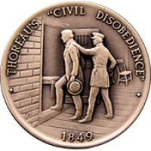
Resistance to Civil Government – Thoreau
Read “Resistance to Civil Government” by Thoreau (p. 249)
What are some of the criticisms Thoreau has of the government?
What does Thoreau believe would make the government better?
What are some appeals (logical, emotional, ethical) Thoreau uses to support these ideas?

Slide 8
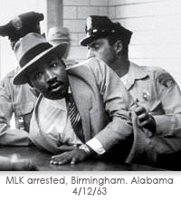
Letter from the Birmingham City Jail – MLK, JR.
Read the excerpt from the “Letter from the Birmingham City Jail” by Martin Luther King, Jr.
Under what conditions does King advocate breaking the law?
What are some appeals (logical, emotional, ethical) King uses to support his views?
How are King’s ideas similar to Thoreau’s?

Slide 9
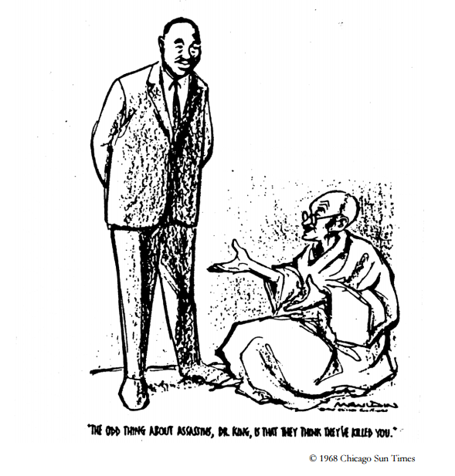
On Nonviolent resistance Mohandas K. Gandhi
Read Gandhi's speech and think about the argument he makes, the reasons he provides, and the types of appeals he uses.
Then, complete the handout comparing the works of Thoreau, Gandhi, and King.
“The odd thing about assassins, Dr. King, is that they think they’ve killed you.”
©1968, Chicago Sun Times

