Slide 1
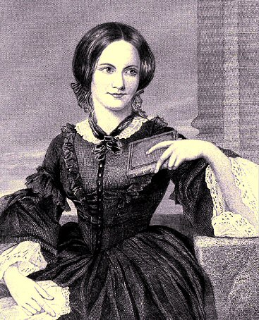
Anne Bradstreet
1612-1672

Slide 2
Significance
First American poet, according to many
First published American woman
The Tenth Muse Lately Sprung Up in America, By Gentlewoman of those Parts
Published without her knowledge by brother-in-law John Woodbridge

Slide 3
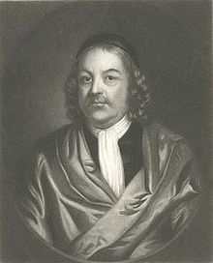
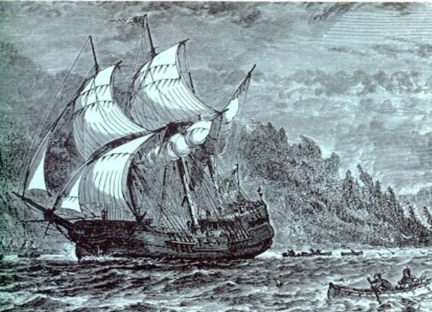
Early Life
Born in Northampton, England, in 1612
Parents: Thomas Dudley and Dorothy Yorke
Well-educated gentlewoman of noble heritage
At 16, married Simon Bradstreet
At 17, emigrated to America on the Arabella

Slide 4
Trials and Tribulations
Journey to New World – very difficult
Difficult to adapt once arrived
Small pox and paralysis
Fire that consumed her home and all her belongings
Bradstreet looked to her faith to sustain her.

Slide 5
Blessing and Bounty
Eight children
Simon prosperous politically and financially
Poems published in England and accepted fairly well

Slide 6
The Free Thinking Puritan
Puritan women
not to pursue intellectual enlightenment, let alone create and air their views and opinions
Relegated to traditional roles
Search for knowledge seen as being against God's will
Wrote for herself, her family, and close circle of educated friends, and did not intend on publication.
Anne Hutchinson
one of Bradstreet’s close friends
a religious and educated woman
banished from her community for expressing her views publicly

Slide 7
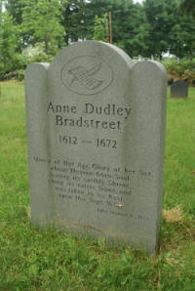
Death
Contracted tuberculosis
Shortly after, lost her daughter Dorothy to illness as well
Found solace in thinking of her daughter in a better place
Died September 16, 1672, in Andover, Massachusetts, at age 60

Slide 8
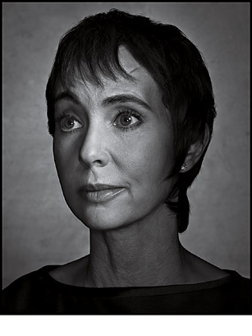
“If we had no winter, the spring would not be so pleasant;
If we did not sometimes taste of adversity, prosperity would not be so welcome.”
--Anne Bradstreet
Arizona Congresswoman Gabrielle Giffords

Slide 9
Arizona Congresswoman Gabrielle Giffords does not remember anything about the day of the shootings in Tucson, in which she almost lost her life. She does, however, believe that although American politics can be ugly, the shooter is an individual who is very sick. She is as yet uncertain about whether she will run again for Congress; the key is whether she feels that she is able to perform the job. These days, she is up by 6:30 a.m., reads news media, then goes to rehabilitation and occupational, physical, and speech therapy. Giffords confirms that her religious faith helped her through the crisis, and is inspired by American war veterans in her perseverance for recovery. She is concentrating on taking each day as it comes, and remain positive toward the future.

