Slide 1
Anglo-Saxon Period
Introduction to the
(449-1066)
&
Beowulf

Slide 2
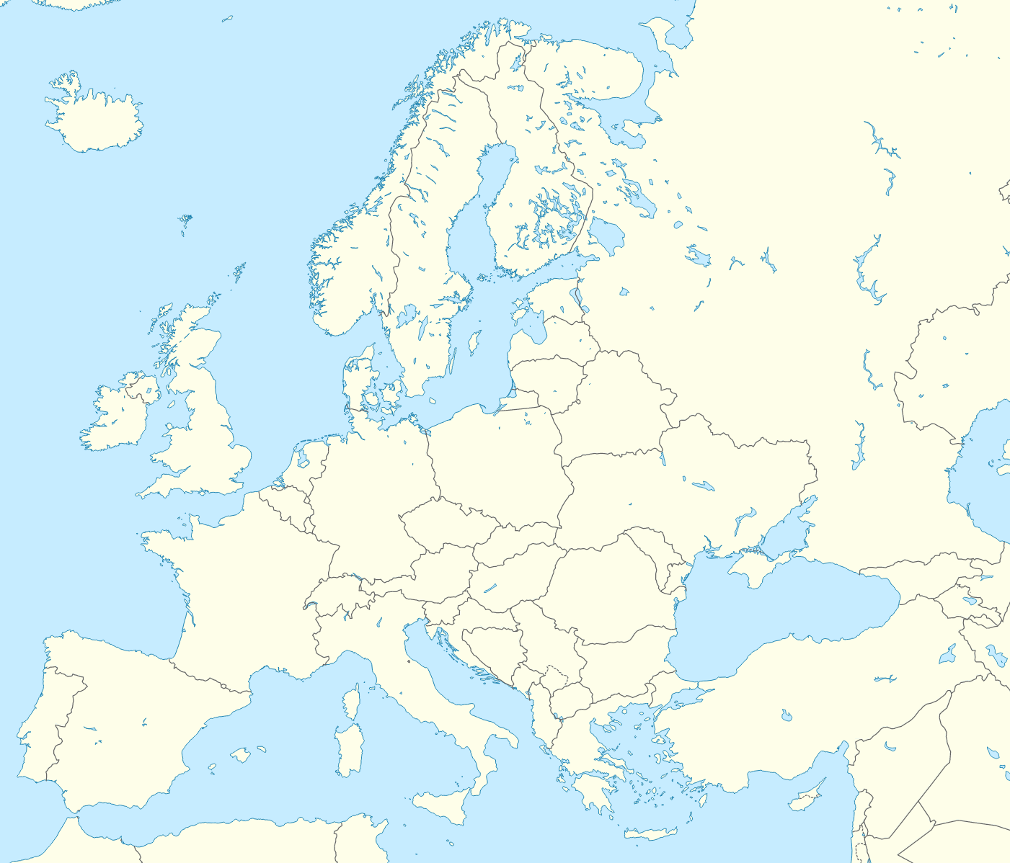
A Little Geography
Where is England?
Where is Great Britain?
What is the difference?
What is the difference between Great Britain and the United Kingdom?
https://www.ordnancesurvey.co.uk/newsroom/blog/whats-the-difference-between-uk-britain-and-british-isles
Notes:
Before this, the Brythons or Britons (a Celtic people) lived in Britain (Druids, Stonehenge).

Slide 3
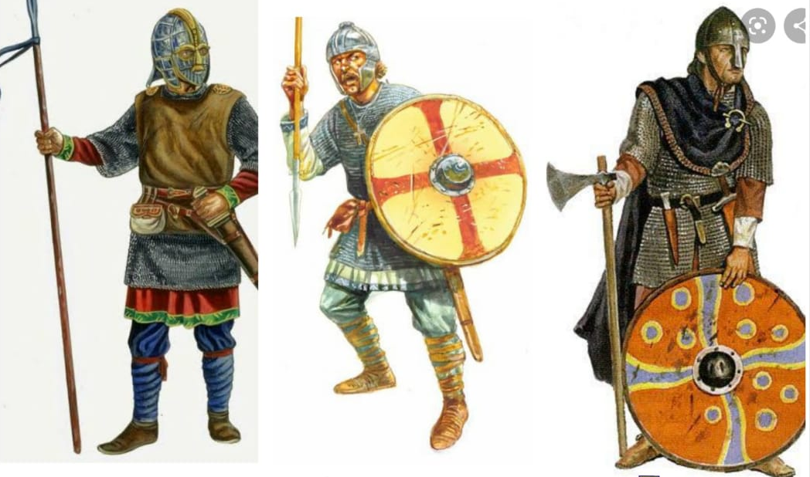
Anglo-Saxon Period
In 449, three groups invaded Britain: Angles, Saxons, Jutes
Seafaring peoples from Germany, Denmark, Sweden, and Netherlands (See map on next slide)
Came seeking land after Romans left
Notes:
Before this, the Brythons or Britons (a Celtic people) lived in Britain (Druids, Stonehenge).

Slide 4
Invading tribes circled in red
Geats (Gay'-ats) Beowulf’s tribe
Herot (like carrot with an h) Setting of Beowulf
Map from C. Warren Hollister,
The Making of England, p. 64

Slide 5
Anglo-Saxon Period
Anglo Saxons
Drove the natives from the eastern, central, and southern areas
Became known as “Angles Land” or England
Germanic language developed into “Angle-ish” or English

Slide 6
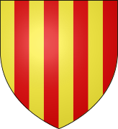
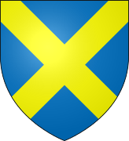
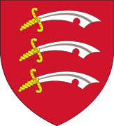
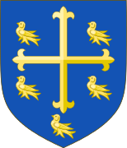
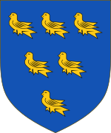
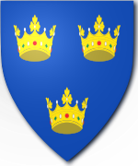
Anglo-Saxon Period
Anglo Saxons
Originally started as several tribal units organized by a king.
Witan= council of elders who would choose the king for each tribal unit; not named by succession
Kingdoms intertwined until there were 7 tribes left (heptarchy: seven + realm)
1. Essex
2. Wessex
3. Sussex
4. North Umbria
5. Mercia & the Midlands
6. East Anglia
7. Kent

Slide 7
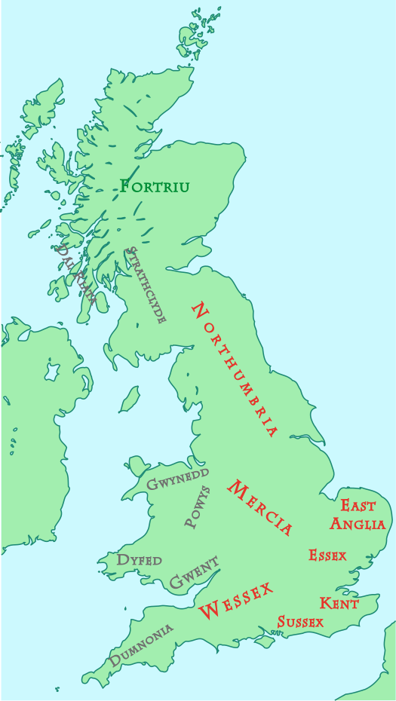
Anglo Saxons around 600

Slide 8
Anglo Saxons & Religion
Originally, Anglo Saxons were pagans.
Paganism= polytheistic religion
Early Anglo Saxons worshipped ancient gods of German mythology.
Pagan View | Christian View
Eternal fame through deeds | Afterlife in hell or heaven
Honor & gift-giving | Sin of pride
Revenge | Forgiveness
Wyrd (Anglo Saxon “Fate”) | God’s will

Slide 9
Anglo-Saxon Social Structure
2 classes: Upper = earls or thanes; Lower = thralls or churls
Most honored position in A/S culture = Warrior
Anglo Saxon Social Structure

Slide 10
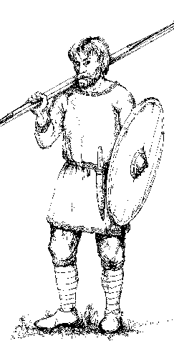
The Anglo-Saxon Man
Athletic
Strong
Seafaring
Adventurous
Strong belief in fair play

Slide 11
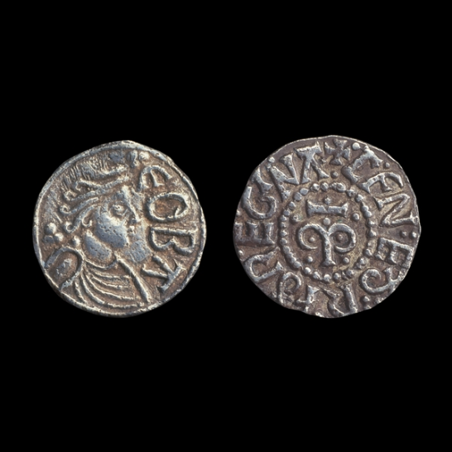
Anglo-Saxon Women
Not much known about them; a few important women written about in literature
make peace, bearing children who create blood ties
Coins depicting Offa, a "queen" of the 8th century
pass the cup at the mead-hall, cementing social bonds
lament loss, don’t avenge
carry on the memories of those who've died

Slide 12
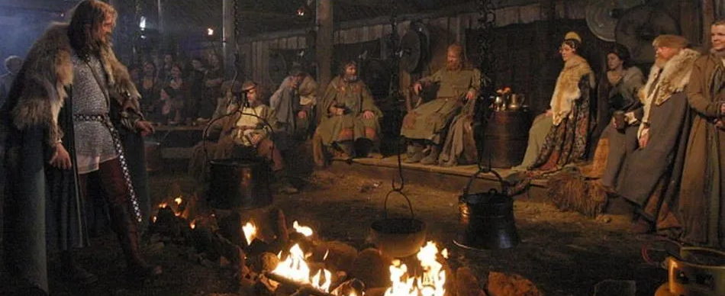
Anglo Saxons & the Mead Hall
All social events began and ended at the mead hall.
Mead: Fermented beverages made from honey (Think of beer made from honey)
The hall was built by the local lord or king for the entertainment of the thanes.
Thanes: warriors and soldiers loyal to the local lord or king

Slide 13
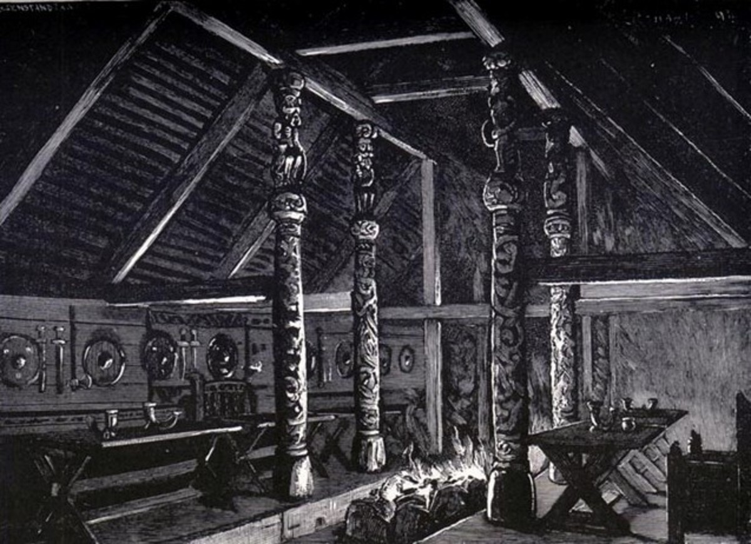
Anglo Saxons & the Mead Hall
Feasting Hall
Great Hall of the King
Safest Place in the Kingdom
Appearance
Rectangular
Pointed roof
Middle trench on the inside for fires
Two long, low tables on each side of the trench
Supported by rows of columns

Slide 14
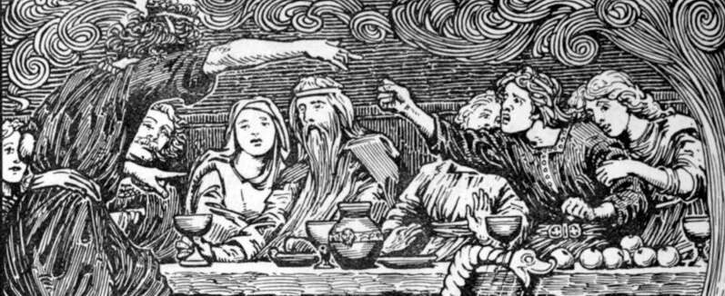
Anglo Saxons & the Mead Hall
Anglo Saxons believed the only thing that lasted was fame.
“Flytings” held in mead hall where warriors held a contest of wits to praise themselves and belittle others
Scops
Were storytellers or bards
Were as honored as the warrior
Provided entertainment but were touched by the “grace of God”

Slide 15
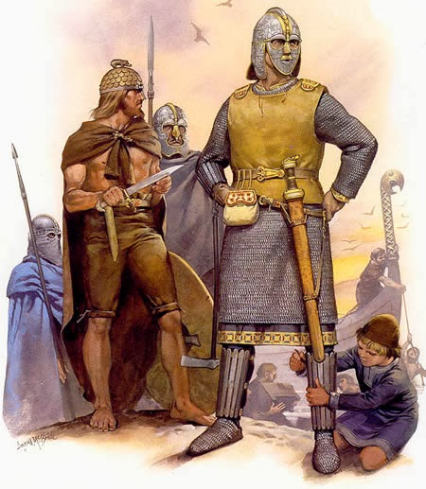
Anglo-Saxon Ideals
Heroism
Physical strength
Skill and resourcefulness in battle
Courage/Bravery
Loyalty (comitatus – see next slide)
Fighting for one’s king
Avenging one’s kinsmen (wergild – next slide)
Keeping one’s word
Generosity -- gifts symbolize bonds
Brotherly love -- not romantic love

Slide 16
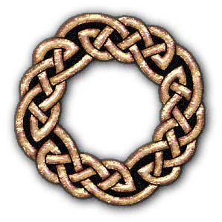
Comitatus
bond between the lord or chieftan and his men or warband; the men were supremely loyal to their lord, and the lord rewarded his men generously.

Slide 17
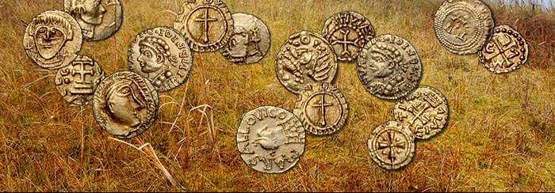
Wergild
“man payment” – price set upon a person’s life on the basis of rank and paid as compensation by the family of a slayer to the kindred or lord of the slain person to free the culprit of further punishment or obligation and to prevent a blood feud
Pictured above is The Crondall Hoard, which was discovered by 18-year-old Charles Lefroy in 1828 in Crondall, England and which is the largest collection of Anglo-Saxon coins discovered in a single find. Some scholars speculate that the hoard could be a wergild because the weight of the coins found equaled the weight required for payment for killing a free Anglo-Saxon man. However, some evidence brings this possibility into question.

Slide 18
Anglo-Saxon Language
Can you figure out these words?
wiþ
bæþ
sceap
Þæt
nacod
Old English
Germanic language
Inflected language
Some changes
Ash – æ – short a
Thorn – þ - th
Eth – ð - th
Wynn – ƿ – w
Sc – “sh”
C – “k”
= with
= bath
= sheep
= that
= naked
The next slide should play a recording of the Prologue of Beowulf, recited in Old English. You’ll notice how it sounds more like German, and you probably won’t recognize many, if any, of the words. (If it won’t play, you can search for Prologue of Beowulf in Old English on YouTube and you should find a clip.

Slide 19
Prologue in Old English

Slide 20
Anglo-Saxon Literature
Many ancient works were memorized and recited—and were not written down until centuries later (Odyssey, Iliad, Beowulf)
Often written down by monks, who were literate and spent much of their time writing.
Wrote in Latin
Laced the stories of pagan cultures with Christian ideas

Slide 21
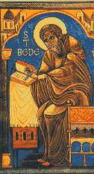
Anglo-Saxon Literature
Venerable Bede (monk & scholar)
Translated “Caedmon’s Hymn” in Latin
Oldest poem in English
Uneducated shepherd visited by angel in a dream
Wrote Ecclesiastical History of the English People
Wanted to show how the church brought unity to England, ending a period of violence and barbarism

Slide 22
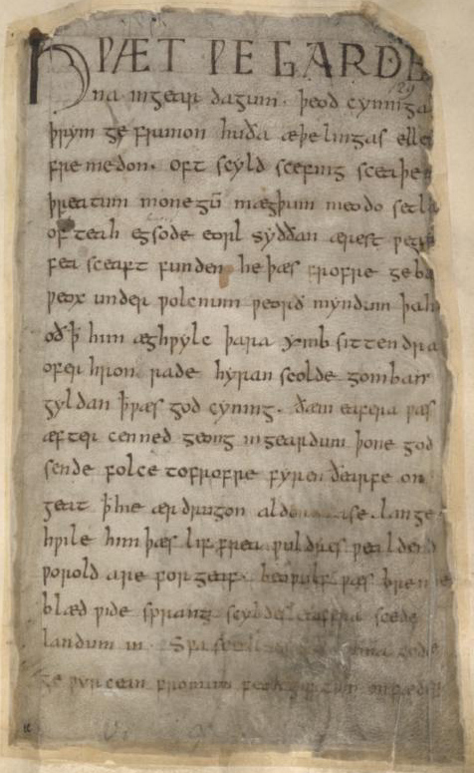
Beowulf Manuscript (Note the burn marks on the top and sides—the manuscript was severely damaged in a fire)
Only surviving Beowulf manuscript dates from late 10th century
Probably composed mid-8th century in Old English
Depicts a much earlier time (perhaps early 6th century)
Christian elements in poem suggest that the person who wrote the story down may have been a monk
Epic poem – although with approx. 3200 lines it is relatively short in comparison to Homer’s epics (approx. 15,000 lines)

Slide 23
Characteristics of Anglo-Saxon Literature
Frequent use of
caesura
kennings
metonymy
synecdoche
Highly Alliterative
Appositive style
Since most Anglo-Saxon stories were recited orally and passed down from generation to generation, having these characteristics makes sense. They would make the story easier to remember and more pleasing to the audience.

Slide 24
Characteristics of Anglo-Saxon Literature
Caesura - light but definite pause in middle of line; line would have 4 stresses total
“Heart was bent. The best and most noble” (Beowulf, line 171)
“On wounded knees. Humbaba fell and seemed” (The Epic of Gilgamesh, line 182)
Alliteration –
repetition of consonant
sounds at the beginning
of words; often several
matching consonants
in a line
…. Then suddenly,
Where clumps of trees bent across
Cold gray stones, they came to a dismal
Wood; below them was the lake, its water
Bloody and bubbling. And the Danes shivered,
Miserable, mighty men tormented
By grief, seeing, there on that cliff
Above the water, Esher's bloody
Head. …
(from Burton Raffel’s translation of Beowulf, lines 1413–1421)

Slide 25
Characteristics of Anglo-Saxon Literature
Appositive style - one phrase modifies and intensifies another
“Hrothgar's men lived happy in his hall / Till the monster stirred, that demon, that fiend, / Grendel, who haunted the moors, the wild / Marshes, ….”
“Beowulf, Higlac's follower and strongest of the Geats…”

Slide 26
Characteristics of Anglo-Saxon Literature
Kennings - A metaphorical expression used in place of a noun
Sea = “whale-road” or “swan’s way”
Joints, ligaments = “bone-locks”
Sun = “sky-candle”
Icicles = “water-ropes”
Open Compound | Hyphenated Compound | Possessive Compound | Prepositional Compound
Wakeful sleeper | Gold-shining hall | Hell’s captive | Shepherd of evil
Icy wave | Whale-road | Hrothgar’s son | Proud with wine

Slide 27
Characteristics of Anglo-Saxon Literature
metonymy – name of one thing substituted with something most people would associate with it
“iron” for “sword”
“crown” for “king” or “monarchy”
synecdoche – substitute a part for the whole
“twelve sails set out” (instead of twelve ships set out
“keel” for “ship”
“all hands on deck”
“heads of cattle”

