Slide 1
The American Dream
Poetry Annotation

Slide 2
Exploring the American Dream
How would the speaker define the American dream?
Does the speaker suggest that the American dream is attainable or unattainable or both?
What evidence supports your ideas?

Slide 3
The Poems (publication date)
1860
"I Hear America Singing" by Walt Whitman
1926
"I, Too" by Langston Hughes
1979
"Ellis Island" by Joseph Bruchac
2018
"Citizen, Illegal" by José Olivarez
2013
"One Today" by Richard Blanco

Slide 4
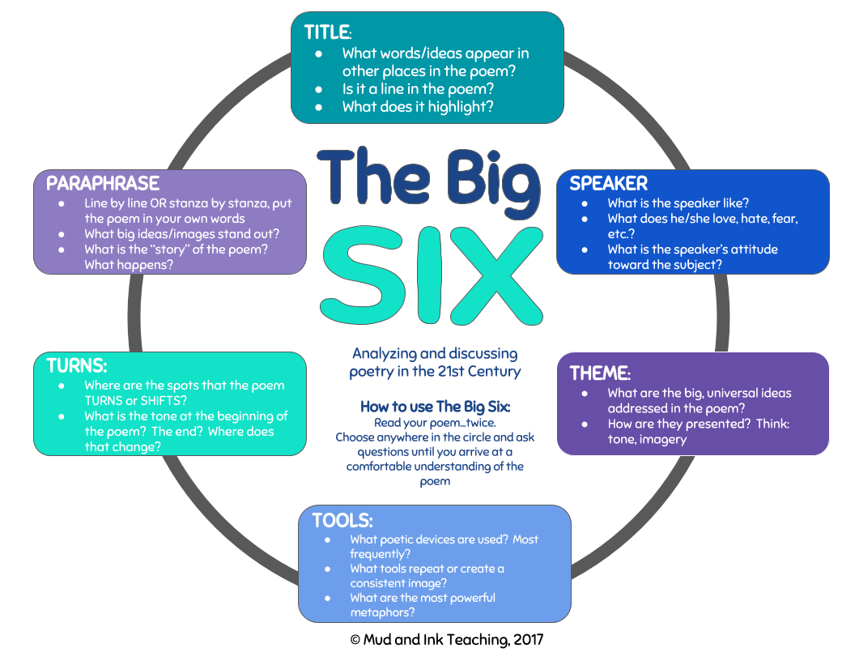

Slide 5
Get into your group with your poem packet, "Big Six" handout, and annotating tools (pens, pencils, highlighters, etc.)
Have someone in the group read YOUR GROUP'S poem aloud. As they read, mark anything that stands out to you.
Next, each person should read the poem again silently and add to their annotations. Use the "Big Six" handout out to help you annotate.
As you consider the questions on the "Big Six" handout, be sure to consider what the poem says about the American dream. How would the speaker define the American dream? Does the speaker suggest that the American dream is attainable or unattainable or both? What evidence supports your ideas?
Discuss the poem as a group and add to your annotations.
Create a "sketchnote" for the poem that includes the group's key ideas/annotations.

Slide 6
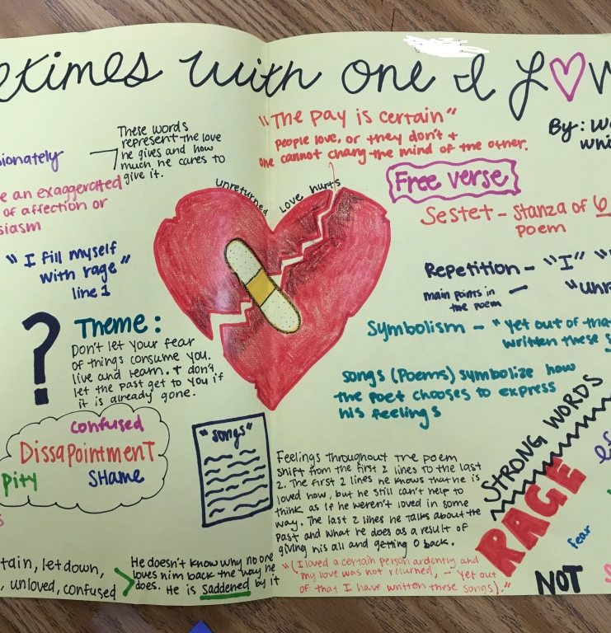
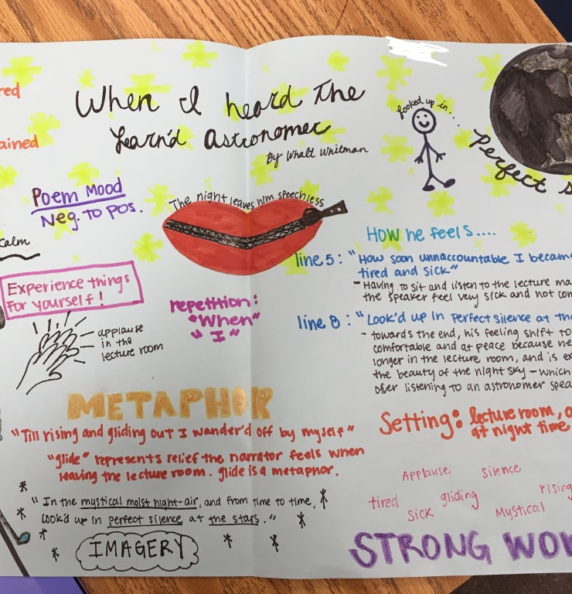

Slide 7
"I Hear America Singing"
Calleigh | Razan | Lana Kate
Sara | Akiria | Mary
Alysia | David | Noah
 | Caroline | Brady
 |  | Zabdi
"I, Too"
Emily | Caroline L | Elizabeth
Libby | Jessi | Ammar
Maleah | Eli | Grecia
Keylee | Layne | Kelli
 |  | Abby
"Ellis Island"
Leo | Sophia | Alexi
McLane | Mia | Joshua
Tamera | Jenna | Jaylen
Amy |  | Tucker
"One Today"
Scott | Kristin | Lynlee
Kris | Anna | Avery
Hannah Grace | Stephen | Gracie
Caleigh | Jackson | Claudia
"Citizen Illegal"
Shelby | Rachel | Emily
Josie | Noah | Courtney
Zoe | Brandon | My
Hailey |  | Amy
 |  | Alana

